Slide 1
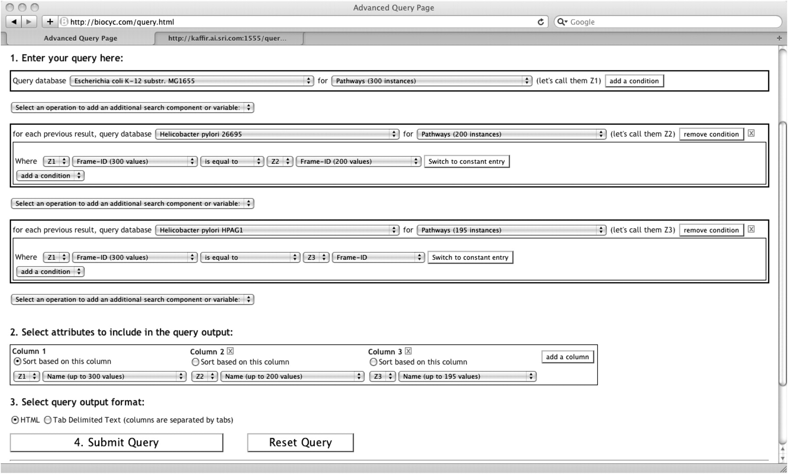
Figure 4. Three search components are used in this query across three DBs. This query searches for all pathways of ...
Notes:
Figure 4. Three search components are used in this query across three DBs. This query searches for all pathways of Escherichia coli that also exist in two other DBs, Helicobacter pylori for strains 26995 and HPAG1.
Unless provided in the caption above, the following copyright applies to the content of this slide: © The Author(s) 2010. Published by Oxford University Press.This is Open Access article distributed under the terms of the Creative Commons Attribution Non-Commercial License (http://creativecommons.org/licenses/by-nc/2.5), which permits unrestricted non-commercial use, distribution, and reproduction in any medium, provided the original work is properly cited.

