Slide 1
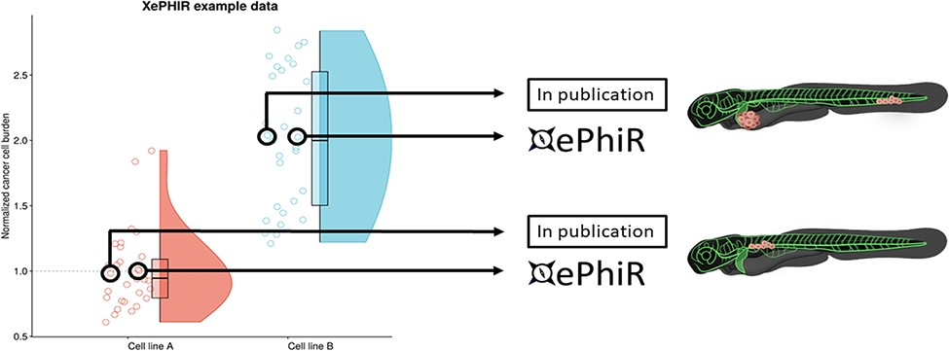
Figure 4. Data are derived from redundant image-based analysis. Image-based analysis data are used to generate a graph ...
Notes:
Figure 4. Data are derived from redundant image-based analysis. Image-based analysis data are used to generate a graph and are subsequently used for the publication of the original paper, where one representative sample individual is used in the original manuscript. Another representative individual is submitted to XePHIR either directly or indirectly through deposition of the underlying data set in Zenodo and subsequent publication of the representative image in XePhIR. Using the plotted data used for the generation of a figure in a research article allows for the selection of an adjacent, representative individual in normally distributed data.
Unless provided in the caption above, the following copyright applies to the content of this slide: © The Author(s) 2022. Published by Oxford University Press.This is an Open Access article distributed under the terms of the Creative Commons Attribution-NonCommercial License (https://creativecommons.org/licenses/by-nc/4.0/), which permits non-commercial re-use, distribution, and reproduction in any medium, provided the original work is properly cited. For commercial re-use, please contact journals.permissions@oup.com

