Slide 1
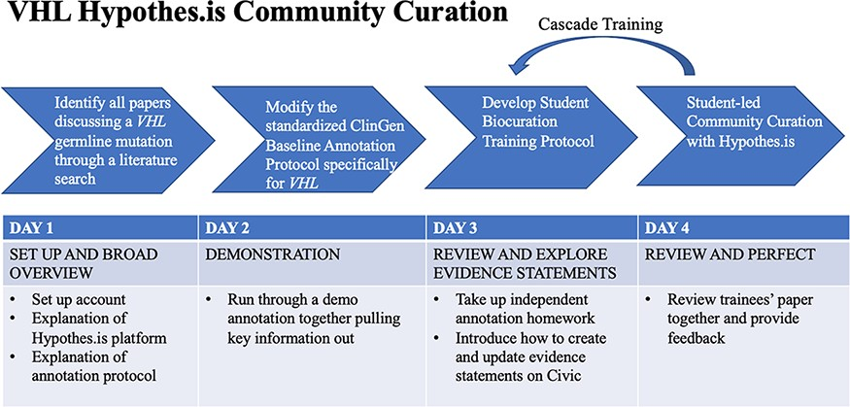
Figure 3. VHL-specific protocol development and training protocol. Summary of a 4-day lesson plan. Refer to ...
Notes:
Figure 3. VHL-specific protocol development and training protocol. Summary of a 4-day lesson plan. Refer to Supplementary Material and Methods for the full training protocol, which details the specific steps and homework tasks that were assigned, and the resource guide, which includes links and diagrams that are useful during the annotation process.
Unless provided in the caption above, the following copyright applies to the content of this slide: © The Author(s) 2023. Published by Oxford University Press.This is an Open Access article distributed under the terms of the Creative Commons Attribution License (https://creativecommons.org/licenses/by/4.0/), which permits unrestricted reuse, distribution, and reproduction in any medium, provided the original work is properly cited.

