Slide 1
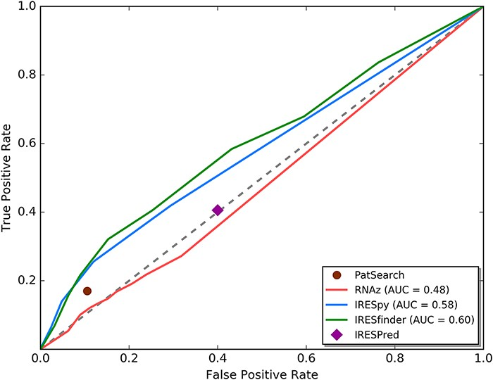
Figure 2. ROC curve analysis for currently available IRES prediction tools on 5ʹ UTRs.
Notes:
Figure 2. ROC curve analysis for currently available IRES prediction tools on 5ʹ UTRs. We used the ROC curve analysis technique to evaluate the results of different IRES prediction tools. From the ROC curve, RNAz and IRESPred have performance similar to random guessing. IRESfinder, IRESpy and PatSearch have AUC larger than 0.5. Based on this analysis, only IRESpy, PatSearch and IRESfinder are suitable for obtaining potential IRES elements in 5ʹ UTRs.
Unless provided in the caption above, the following copyright applies to the content of this slide: © The Author(s) 2021. Published by Oxford University Press.This is an Open Access article distributed under the terms of the Creative Commons Attribution License (http://creativecommons.org/licenses/by/4.0/), which permits unrestricted reuse, distribution, and reproduction in any medium, provided the original work is properly cited.

