Slide 1
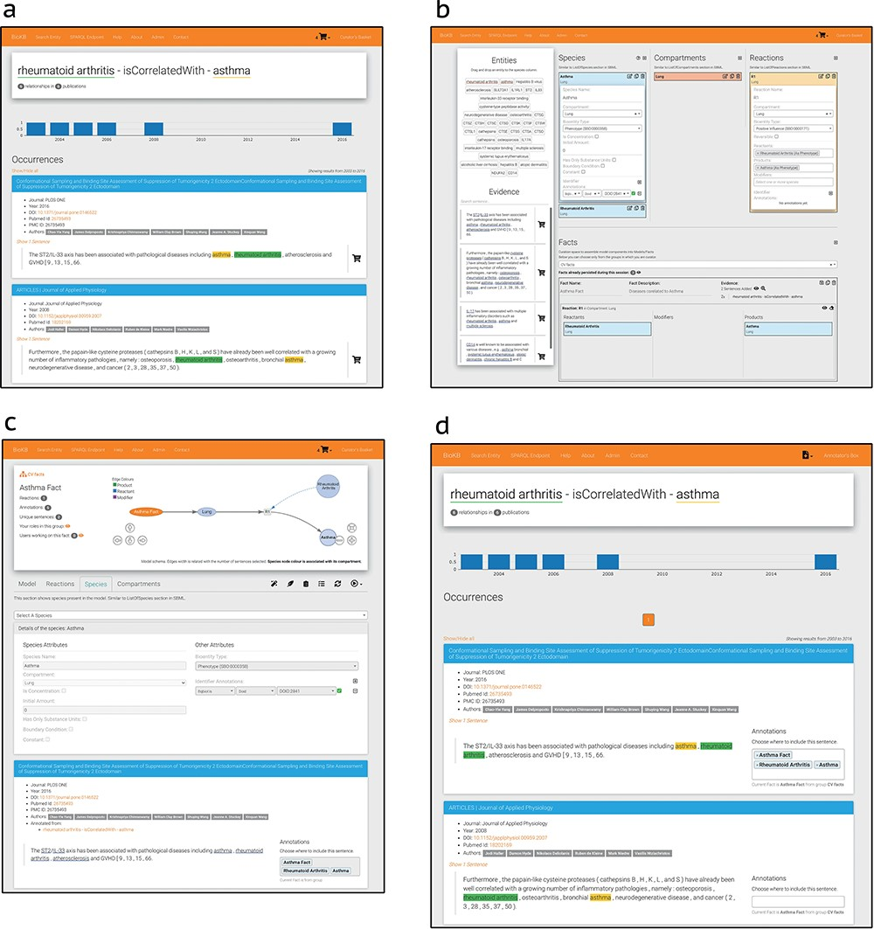
Figure 4. BioKC interface and functionalities. (a) BioKB relationship view showing sentences for a given entity ...
Notes:
Figure 4. BioKC interface and functionalities. (a) BioKB relationship view showing sentences for a given entity relationship, and the sentences can be added to the basket. (b) Basket checkout redirects to the basket view where facts and their elements can be composed. (c) The ‘Fact view’ is where facts can be edited, either from scratch or after being persisted in the basket view. (d) The annotation mode enables annotation capabilities in BioKB to assign supporting evidence to one or multiple elements of a fact.
Unless provided in the caption above, the following copyright applies to the content of this slide: © The Author(s) 2024. Published by Oxford University Press.This is an Open Access article distributed under the terms of the Creative Commons Attribution License (https://creativecommons.org/licenses/by/4.0/), which permits unrestricted reuse, distribution, and reproduction in any medium, provided the original work is properly cited.

