Slide 1
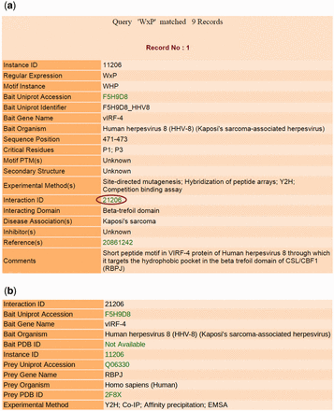
Figure 3. Output results of LMPID. ( a ) The main search result against the query ‘WxP’. ( b ) Page showing the ...
Notes:
Figure 3. Output results of LMPID. ( a ) The main search result against the query ‘WxP’. ( b ) Page showing the details of the interacting bait and prey proteins by clicking on the hyperlink ‘Interaction ID’.
Unless provided in the caption above, the following copyright applies to the content of this slide: © The Author(s) 2015. Published by Oxford University Press.This is an Open Access article distributed under the terms of the Creative Commons Attribution License (http://creativecommons.org/licenses/by/4.0/), which permits unrestricted reuse, distribution, and reproduction in any medium, provided the original work is properly cited.

