Slide 1
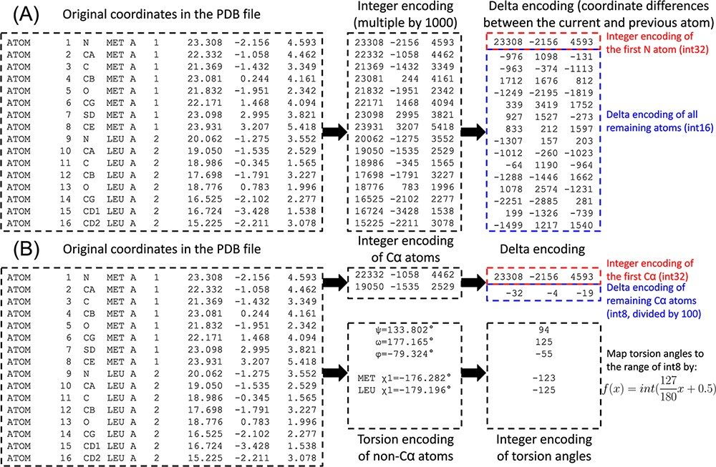
Figure 1. Illustration of PDC compression of the coordinates for the first two residues for the AlphaFold structure of ...
Notes:
Figure 1. Illustration of PDC compression of the coordinates for the first two residues for the AlphaFold structure of methylated-DNA—protein-cysteine methyltransferase (UniProt ID P0AFH0). (A) Lossless compression. (B) Lossy compression.
Unless provided in the caption above, the following copyright applies to the content of this slide: © The Author(s) 2023. Published by Oxford University Press.This is an Open Access article distributed under the terms of the Creative Commons Attribution License (https://creativecommons.org/licenses/by/4.0/), which permits unrestricted reuse, distribution, and reproduction in any medium, provided the original work is properly cited.

Slide 2
Figure 3. Superimposition between the original structure (black) and after PDC lossy compression (white). (A) Cα ...
Notes:
Figure 3. Superimposition between the original structure (black) and after PDC lossy compression (white). (A) Cα structure. (B) Full-atomic structure of Leader peptide SpeFL from E. coli (UniProt ID: P0DTV7), which is the protein with the worst Cα MAE (Cα MAE = 0.104 Å; non-Cα MAE = 0.193 Å) among all proteins in the E. coli benchmark dataset (average MAE = 0.094 and 0.167 Å for Cα and non-Cα atoms, respectively).
Unless provided in the caption above, the following copyright applies to the content of this slide: © The Author(s) 2023. Published by Oxford University Press.This is an Open Access article distributed under the terms of the Creative Commons Attribution License (https://creativecommons.org/licenses/by/4.0/), which permits unrestricted reuse, distribution, and reproduction in any medium, provided the original work is properly cited.

Slide 3
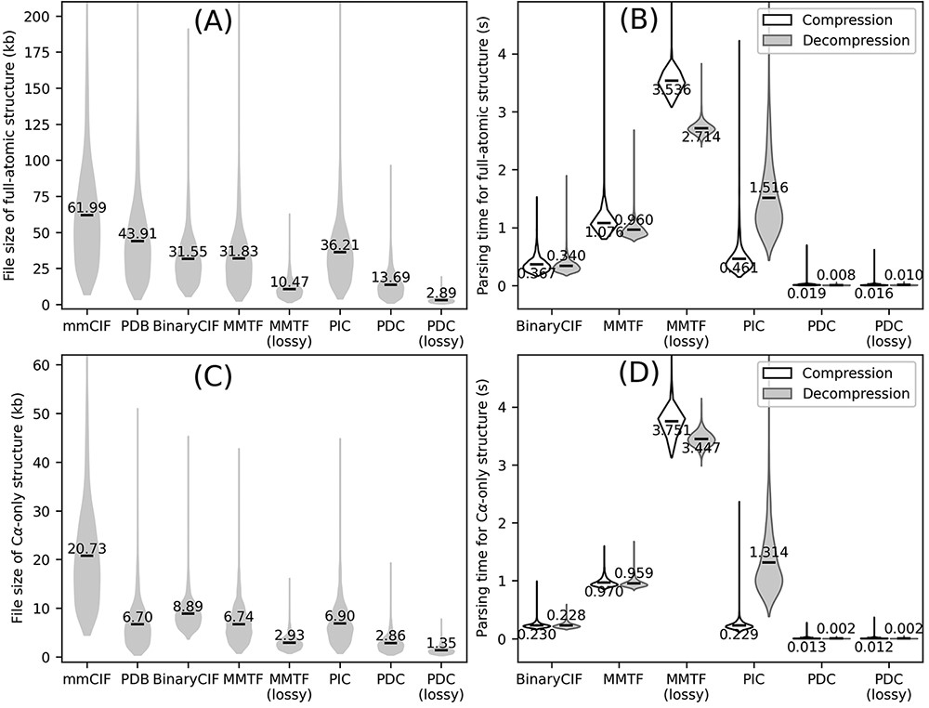
Figure 2. Overall performance of different structure compression schemes on the AlphaFold DB E. coli dataset. (A–B) ...
Notes:
Figure 2. Overall performance of different structure compression schemes on the AlphaFold DB E. coli dataset. (A–B) File sizes (A) and compression/decompression time (B) for full-atomic structures. (C–D) File sizes (C) and compression/decompression time for Cα-only structures. Conversion to/from BinaryCIF, MMTF and PIC was performed by python-modelcif, Atomium and PIC, respectively. Conversion to/from lossy MMTF was performed by BioJava. Conversion of mmCIF versus PDB files to PIC files leads to different PIC metadata files; this figure uses the PIC files converted from PDB files because the resulting PIC files are smaller in size. The markers and values the violin plots indicate the average values for each method.
Unless provided in the caption above, the following copyright applies to the content of this slide: © The Author(s) 2023. Published by Oxford University Press.This is an Open Access article distributed under the terms of the Creative Commons Attribution License (https://creativecommons.org/licenses/by/4.0/), which permits unrestricted reuse, distribution, and reproduction in any medium, provided the original work is properly cited.

