Slide 1
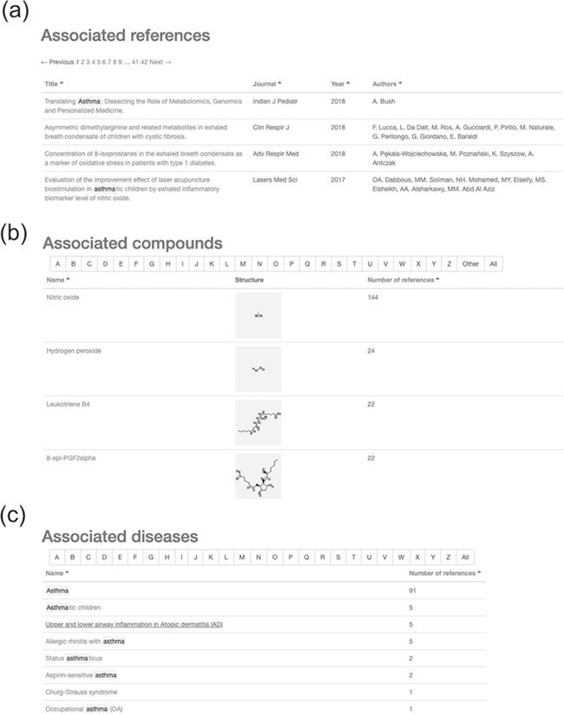
Figure 2 Results of searching for ‘asthma’ in the HBDB. (a) Associated references for asthma. (b) Associated compounds ...
Notes:
Figure 2 Results of searching for ‘asthma’ in the HBDB. (a) Associated references for asthma. (b) Associated compounds for asthma in descending order of related number of references. (c) Associated diseases for asthma.
Unless provided in the caption above, the following copyright applies to the content of this slide: © The Author(s) 2020. Published by Oxford University Press.This is an Open Access article distributed under the terms of the Creative Commons Attribution License (http://creativecommons.org/licenses/by/4.0/), which permits unrestricted reuse, distribution, and reproduction in any medium, provided the original work is properly cited.

