Slide 1
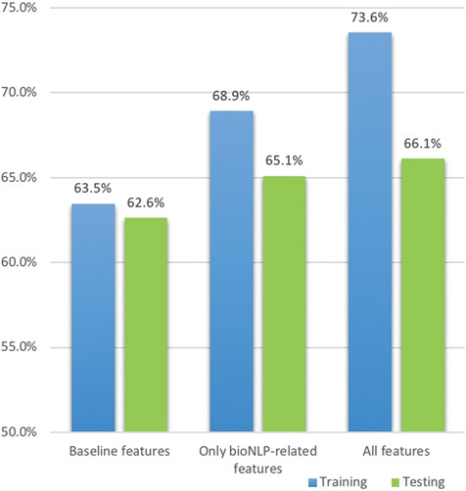
Figure 9 Comparative F1 scores for boosting logistic regression over the training and testing sets. The legend shows ...
Notes:
Figure 9 Comparative F1 scores for boosting logistic regression over the training and testing sets. The legend shows the features used in the training set and the corresponding columns are presented in the testing set.
Unless provided in the caption above, the following copyright applies to the content of this slide: © The Author(s) 2018. Published by Oxford University Press.This is an Open Access article distributed under the terms of the Creative Commons Attribution License (http://creativecommons.org/licenses/by/4.0/), which permits unrestricted reuse, distribution, and reproduction in any medium, provided the original work is properly cited.

