Slide 1
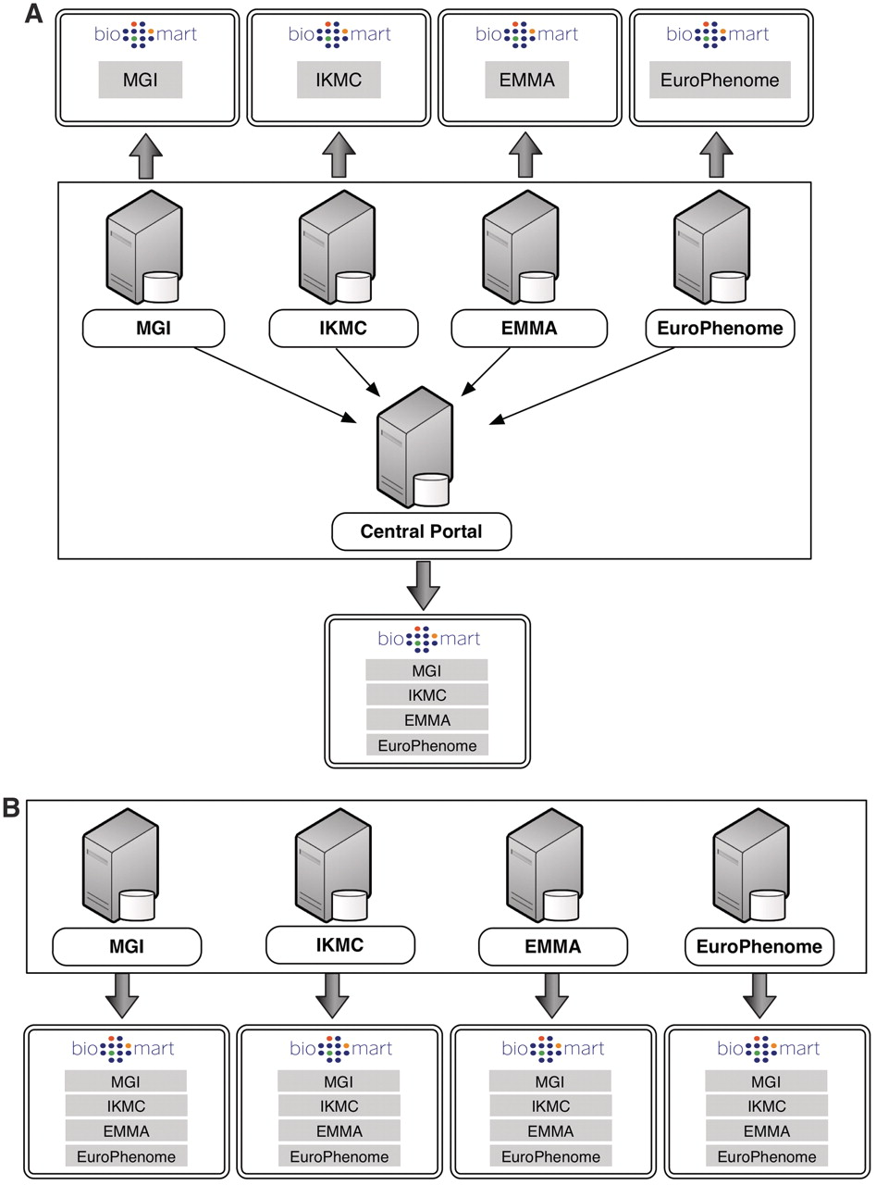
Figure 1. BioMart Portal architecture. The BioMart Portal can be deployed in either of two different types of server ...
Notes:
Figure 1. BioMart Portal architecture. The BioMart Portal can be deployed in either of two different types of server architectures. In the ‘master/slave’-like architecture (A) each ‘slave’ server only provides access to its own local data, while the ‘master’ server acts as a portal presenting a unified view over data residing on all the ‘slave’ servers. In the ‘peer-to-peer’-like architecture (B) each server not only provides data access to its own data source, but also data from all other servers. In this way, every server acts as a data portal providing access to all the data.
Unless provided in the caption above, the following copyright applies to the content of this slide: © The Author(s) 2011. Published by Oxford University Press.This is Open Access article distributed under the terms of the Creative Commons Attribution Non-Commercial License (http://creativecommons.org/licenses/by-nc/2.5), which permits unrestricted non-commercial use, distribution, and reproduction in any medium, provided the original work is properly cited.

Slide 2
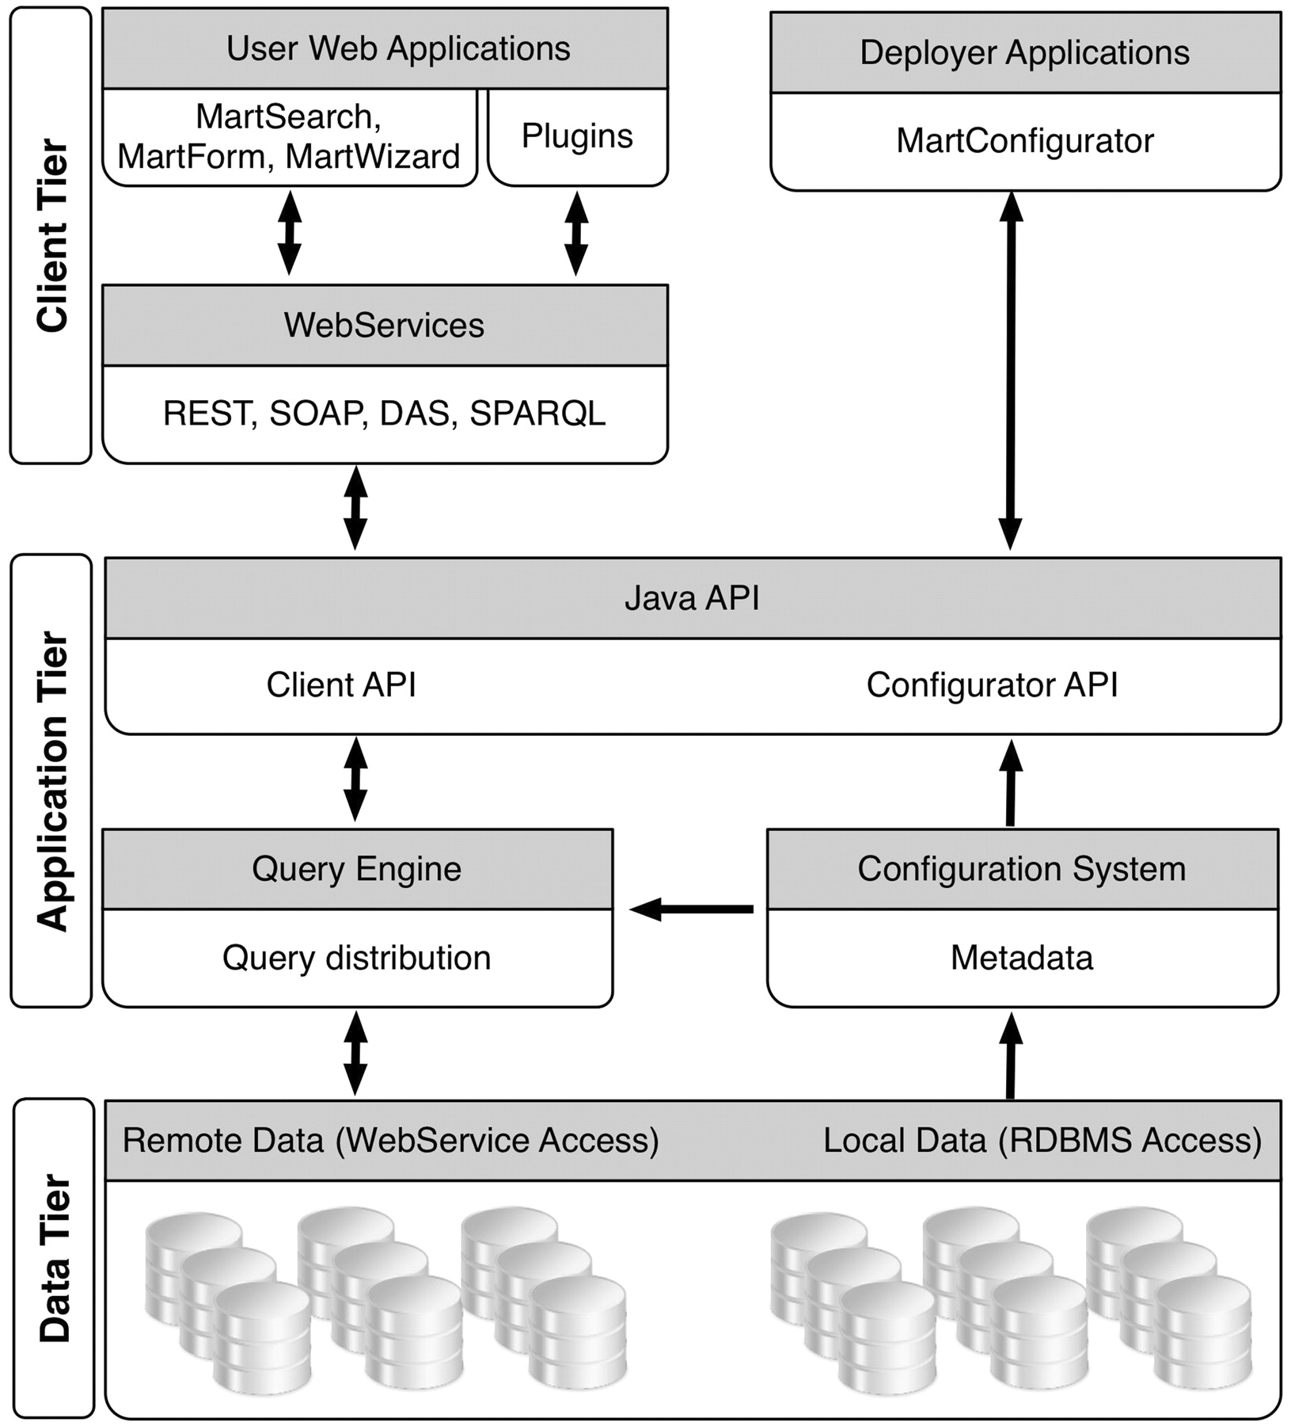
Figure 2. BioMart system components.
Notes:
Figure 2. BioMart system components.
Unless provided in the caption above, the following copyright applies to the content of this slide: © The Author(s) 2011. Published by Oxford University Press.This is Open Access article distributed under the terms of the Creative Commons Attribution Non-Commercial License (http://creativecommons.org/licenses/by-nc/2.5), which permits unrestricted non-commercial use, distribution, and reproduction in any medium, provided the original work is properly cited.

Slide 3
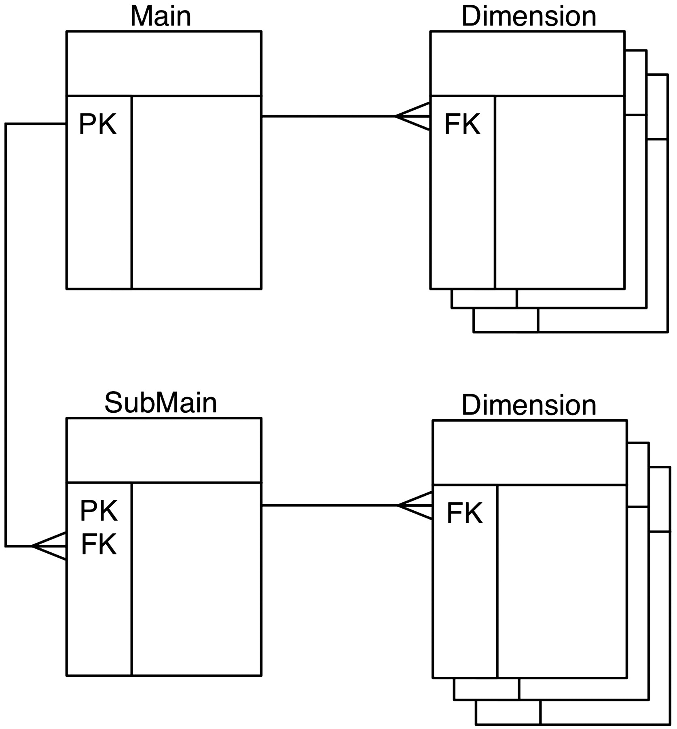
Figure 3. Reverse star schema. This data set has one main table and one submain table, each of which has several ...
Notes:
Figure 3. Reverse star schema. This data set has one main table and one submain table, each of which has several dimension tables. Main and submain tables have one-to-many relations, while the relations between main and dimension tables are one-to-many.
Unless provided in the caption above, the following copyright applies to the content of this slide: © The Author(s) 2011. Published by Oxford University Press.This is Open Access article distributed under the terms of the Creative Commons Attribution Non-Commercial License (http://creativecommons.org/licenses/by-nc/2.5), which permits unrestricted non-commercial use, distribution, and reproduction in any medium, provided the original work is properly cited.

Slide 4
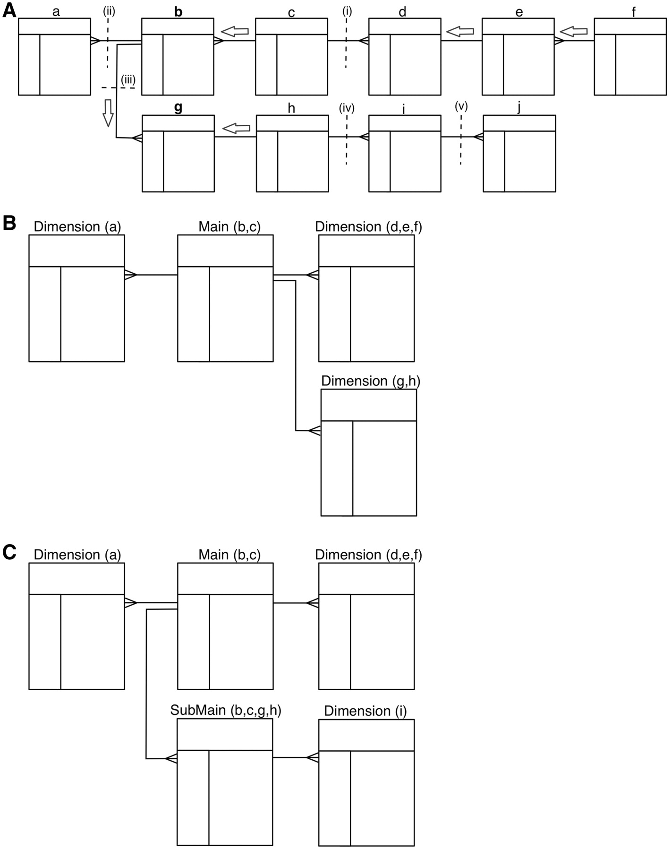
Figure 4. Transformation algorithm. A schematic showing how a 3NF schema is transformed into a reverse star schema. (A) ...
Notes:
Figure 4. Transformation algorithm. A schematic showing how a 3NF schema is transformed into a reverse star schema. (A) Shows the 3NF schema with 10 tables, with relations between tables indicated by connectors. To build a main table, the algorithm starts from the candidate table and walks outwards along all possible paths of related tables until a one-to-many relation is encountered. Such a one-to-many relation is called a break point. When starting from table b, there are three break points: i–iii; when starting from table g, the break points are: i, ii and iv. Tables traversed before reaching the break point will be merged via an SQL join to create the main table. Tables b and c are merged when table b is chosen as the candidate main; tables b, c, g and h are merged to build the main table when table g is chosen as the candidate. The same traversing and merging rule is applied for building dimension tables. (B) Shows the resulting reverse star schema when table b is chosen as the candidate main table. The transformed schema includes one main table (the original tables b and c merged) and three dimension tables: the original table a becomes the first dimension table, tables d, e and f are merged to form the second dimension table and tables g and h are merged to create the third dimension table. (C) Shows the resulting reverse star schema when both tables b and g are chosen as candidate main tables. In addition to one main table and two dimension tables that are the same as in B, there is one new submain table that is built by merging tables b, c, g and h. The original table i becomes a dimension table to the submain table. Note that, the submain table and main table have a many-to-one relation, and the submain table contains all the contents of the main table.
Unless provided in the caption above, the following copyright applies to the content of this slide: © The Author(s) 2011. Published by Oxford University Press.This is Open Access article distributed under the terms of the Creative Commons Attribution Non-Commercial License (http://creativecommons.org/licenses/by-nc/2.5), which permits unrestricted non-commercial use, distribution, and reproduction in any medium, provided the original work is properly cited.

Slide 5
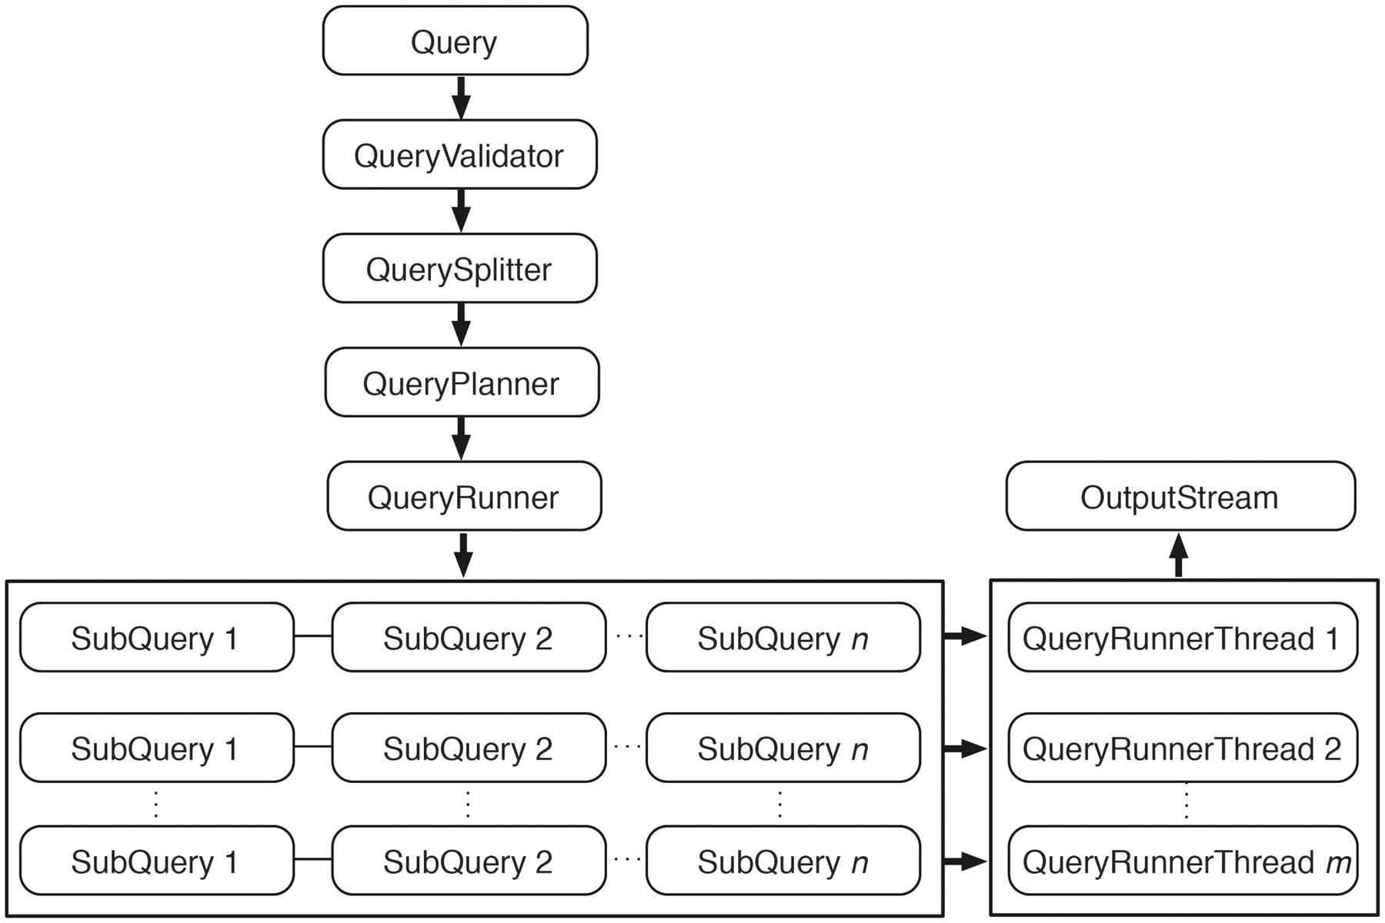
Figure 5. Query engine. An incoming query is first passed to QueryValidator to ensure the requested resources exist. ...
Notes:
Figure 5. Query engine. An incoming query is first passed to QueryValidator to ensure the requested resources exist. Once validated, this original query is split into smaller subqueries if it involves attributes or filters from multiple data sets. QueryPlanner then decides the optimal order in which the subqueries should be executed; this involves checking whether a relevant link index exists (and consulting it if it does) and determining which subqueries have filters applied. After the optimal execution order is decided, subqueries are passed to QueryRunner for execution. When the query involves a data set that is partitioned, QueryRunner will create one QueryRunnerThread for each partition to maximize the query performance by concurrently executing independent queries. Query results are streamed to OutputStream as they are produced from any of the QueryRunnerThreads.
Unless provided in the caption above, the following copyright applies to the content of this slide: © The Author(s) 2011. Published by Oxford University Press.This is Open Access article distributed under the terms of the Creative Commons Attribution Non-Commercial License (http://creativecommons.org/licenses/by-nc/2.5), which permits unrestricted non-commercial use, distribution, and reproduction in any medium, provided the original work is properly cited.

Slide 6
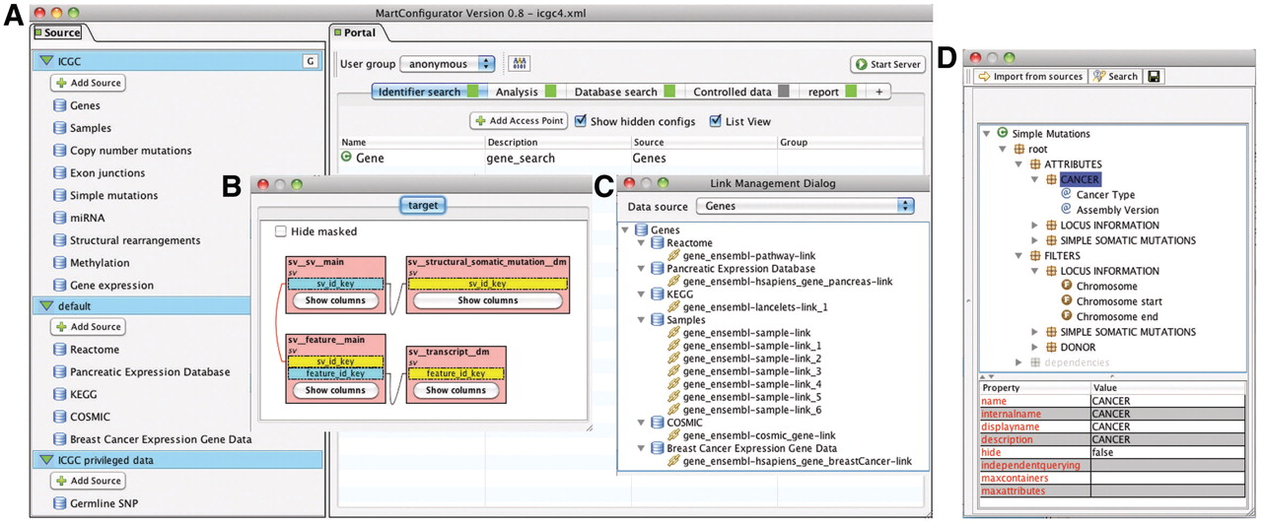
Figure 6. MartConfigurator. (A) The main MartConfigurator window is divided into two panels. Data sources are listed on ...
Notes:
Figure 6. MartConfigurator. (A) The main MartConfigurator window is divided into two panels. Data sources are listed on the left. Data portal access points are listed on the right and are organized by types. (B) The Schema Editor window, showing the reverse star schema of a data set. (C) The Link Management window, showing the data links between data sources. (D) The Access Point Editor window, showing attributes and filters organized in containers.
Unless provided in the caption above, the following copyright applies to the content of this slide: © The Author(s) 2011. Published by Oxford University Press.This is Open Access article distributed under the terms of the Creative Commons Attribution Non-Commercial License (http://creativecommons.org/licenses/by-nc/2.5), which permits unrestricted non-commercial use, distribution, and reproduction in any medium, provided the original work is properly cited.

Slide 7
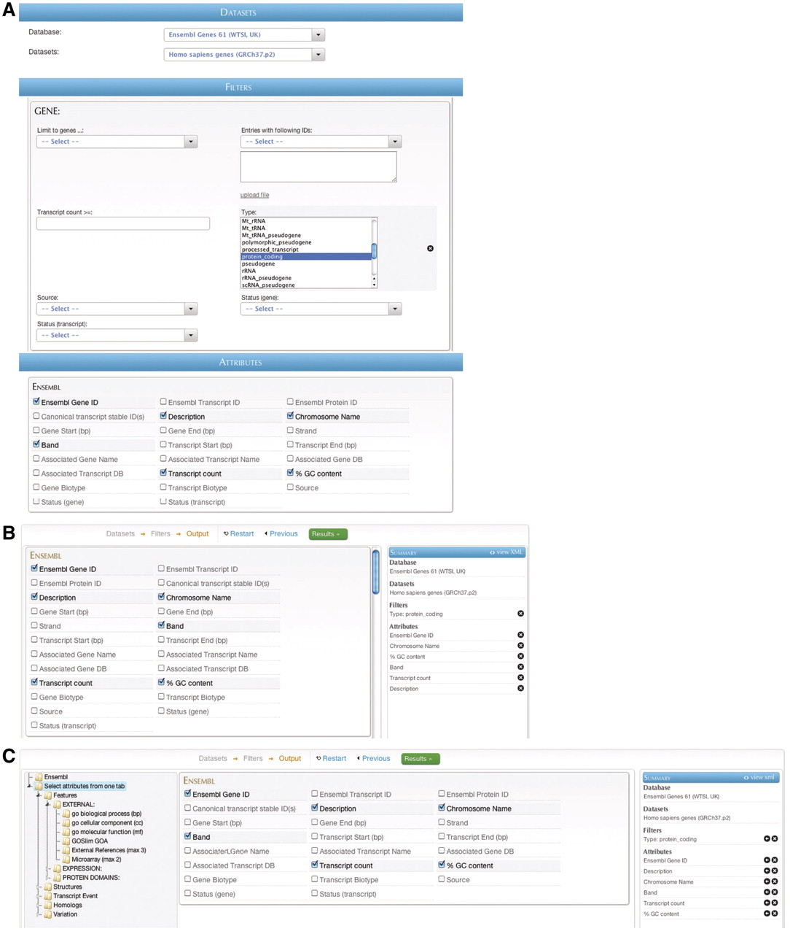
Figure 7. BioMart web GUIs: ‘MartForm’, ‘MartWizard’ and ‘MartExplorer’. (A) ‘MartForm’ presents, from top to bottom, a ...
Notes:
Figure 7. BioMart web GUIs: ‘MartForm’, ‘MartWizard’ and ‘MartExplorer’. (A) ‘MartForm’ presents, from top to bottom, a choice of data sets, filters and attributes. Filters and attributes may be organized in containers and subcontainers, and mutually exclusive sets of filters and attributes can be segregated into separate tabs. MartForm presents all options on a single page, and so is most appropriate for queries that require user-configurability, but that have a relatively small number of filters and attributes. (B) For searches with a larger number of filters and attributes, there is the ‘MartWizard’ interface. In the ‘MartWizard’ interface, data sets, filters and attributes are chosen in successive steps, each step presented on its own page. The query is summarized in the right-hand column as it is being built, and users can move between the filter and attribute pages to modify the query. Within each page, filters and attributes can be presented in containers and as in ‘MartForm’. (C) For maximum flexibility and complex querying, there is the ‘MartExplorer’ interface. As in ‘MartWizard’, in ‘MartExplorer’ data sets, filters and attributes are presented on separate pages. However, instead of being organized into containers on a single page, in ‘MartExplorer’, filters and attributes are organized into a hierarchical folder structure presented in the left-hand column on the screen. As such, ‘MartExplorer’ is most appropriate for queries with a large number of filters and attributes that are organized in a complex directory structure.
Unless provided in the caption above, the following copyright applies to the content of this slide: © The Author(s) 2011. Published by Oxford University Press.This is Open Access article distributed under the terms of the Creative Commons Attribution Non-Commercial License (http://creativecommons.org/licenses/by-nc/2.5), which permits unrestricted non-commercial use, distribution, and reproduction in any medium, provided the original work is properly cited.

Slide 8
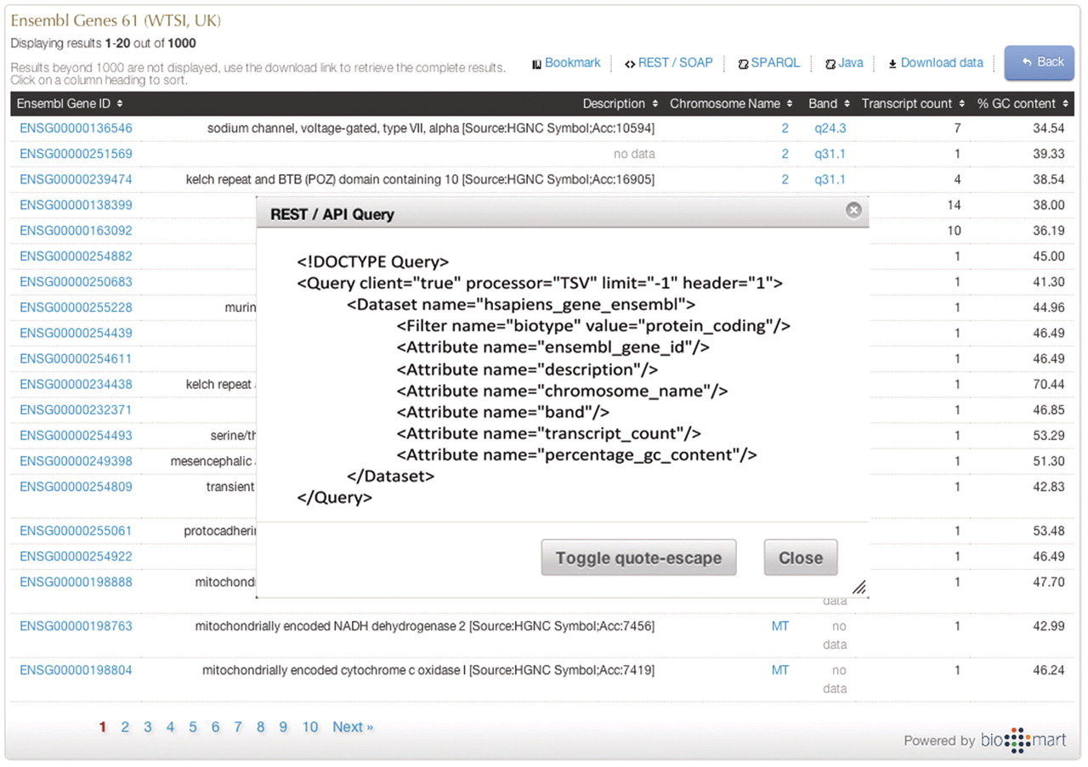
Figure 8. Programmatic access with a click of a button. By clicking one of the available API buttons such as REST/SOAP ...
Notes:
Figure 8. Programmatic access with a click of a button. By clicking one of the available API buttons such as REST/SOAP web service, SPARQL or Java, a query that has been constructed in a web-based GUI is automatically compiled to the desired syntax.
Unless provided in the caption above, the following copyright applies to the content of this slide: © The Author(s) 2011. Published by Oxford University Press.This is Open Access article distributed under the terms of the Creative Commons Attribution Non-Commercial License (http://creativecommons.org/licenses/by-nc/2.5), which permits unrestricted non-commercial use, distribution, and reproduction in any medium, provided the original work is properly cited.

Slide 9
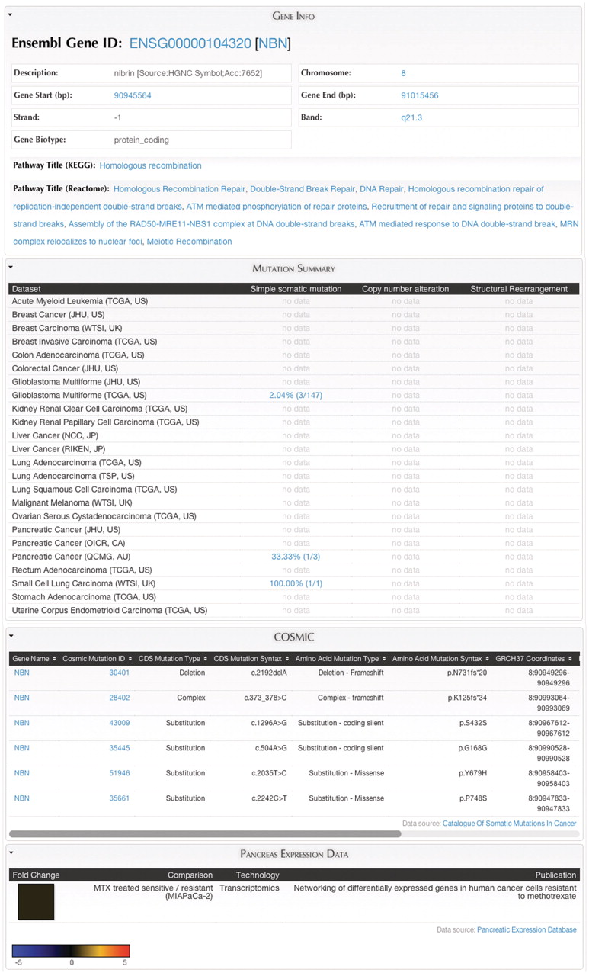
Figure 9. MartReport. ‘MartReport’ presents detailed information about a single data entry such as a cancer sample, a ...
Notes:
Figure 9. MartReport. ‘MartReport’ presents detailed information about a single data entry such as a cancer sample, a gene or a point mutation. MartReport allows data from multiple data sources to be presented in a single report page. In this example, data about the NBN gene are retrieved and integrated from Ensembl, KEGG, Reactome, ICGC, COSMIC and the Pancreatic Expression Database.
Unless provided in the caption above, the following copyright applies to the content of this slide: © The Author(s) 2011. Published by Oxford University Press.This is Open Access article distributed under the terms of the Creative Commons Attribution Non-Commercial License (http://creativecommons.org/licenses/by-nc/2.5), which permits unrestricted non-commercial use, distribution, and reproduction in any medium, provided the original work is properly cited.

Slide 10
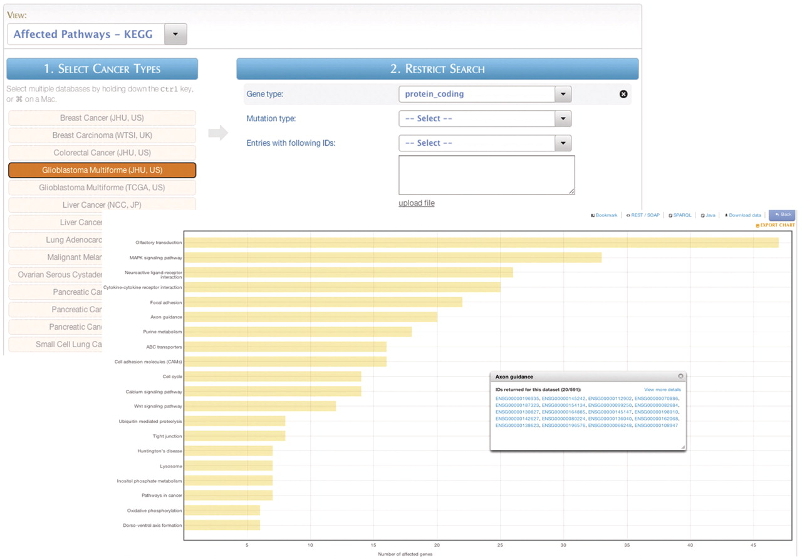
Figure 10. MartAnalysis. ‘MartAnalysis’ presents the user with a choice of data sets in a column on the left and a list ...
Notes:
Figure 10. MartAnalysis. ‘MartAnalysis’ presents the user with a choice of data sets in a column on the left and a list of filters in a column on the right. The attributes are determined in advance by the administrator and cannot be changed by the user. As such, the ‘MartAnalysis’ interface is best suited for quick querying of commonly used attributes. In this example, the query result is processed to produce a histogram presentation of the most frequently affected pathways.
Unless provided in the caption above, the following copyright applies to the content of this slide: © The Author(s) 2011. Published by Oxford University Press.This is Open Access article distributed under the terms of the Creative Commons Attribution Non-Commercial License (http://creativecommons.org/licenses/by-nc/2.5), which permits unrestricted non-commercial use, distribution, and reproduction in any medium, provided the original work is properly cited.

