Slide 1
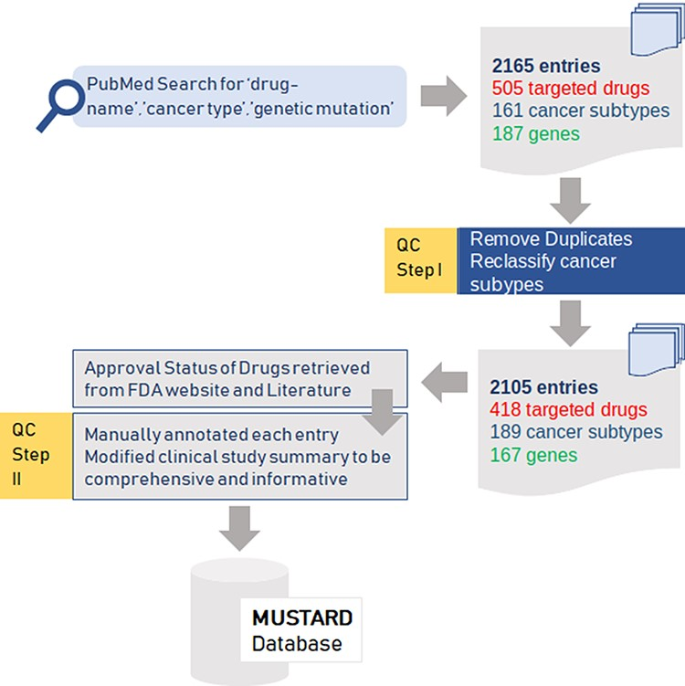
Figure 1. Summary of the data collection and quality control (QC) for the data for mutation-specific therapies in ...
Notes:
Figure 1. Summary of the data collection and quality control (QC) for the data for mutation-specific therapies in cancer.
Unless provided in the caption above, the following copyright applies to the content of this slide: © The Author(s) 2021. Published by Oxford University Press.This is an Open Access article distributed under the terms of the Creative Commons Attribution License (http://creativecommons.org/licenses/by/4.0/), which permits unrestricted reuse, distribution, and reproduction in any medium, provided the original work is properly cited.

Slide 2
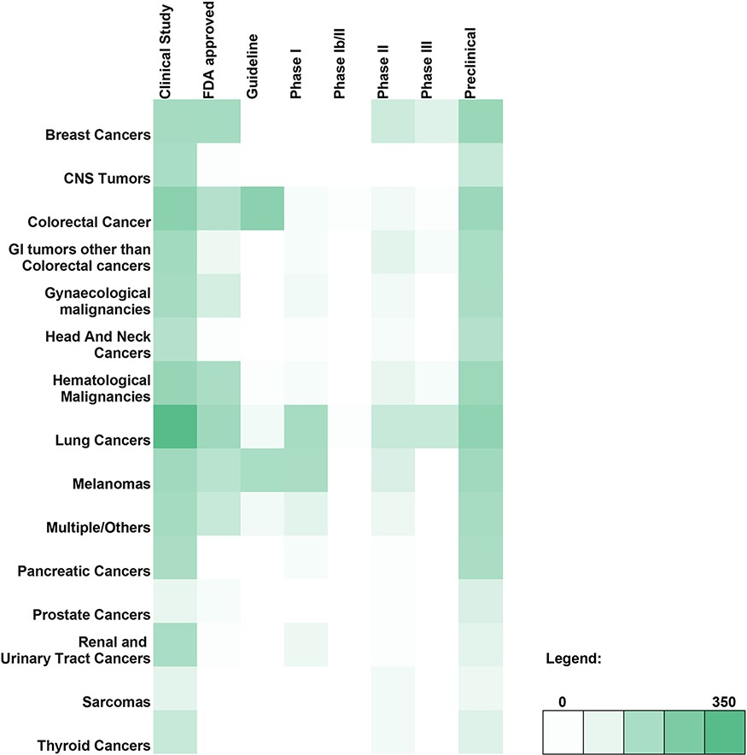
Figure 2. Heatmap depicting the genomic variant and therapy combinations studied for different types of cancer.
Notes:
Figure 2. Heatmap depicting the genomic variant and therapy combinations studied for different types of cancer.
Unless provided in the caption above, the following copyright applies to the content of this slide: © The Author(s) 2021. Published by Oxford University Press.This is an Open Access article distributed under the terms of the Creative Commons Attribution License (http://creativecommons.org/licenses/by/4.0/), which permits unrestricted reuse, distribution, and reproduction in any medium, provided the original work is properly cited.

Slide 3
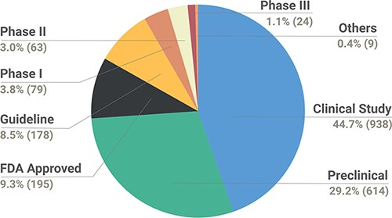
Figure 3. Pie chart depicting the breakdown of types of studies reported in the database.
Notes:
Figure 3. Pie chart depicting the breakdown of types of studies reported in the database.
Unless provided in the caption above, the following copyright applies to the content of this slide: © The Author(s) 2021. Published by Oxford University Press.This is an Open Access article distributed under the terms of the Creative Commons Attribution License (http://creativecommons.org/licenses/by/4.0/), which permits unrestricted reuse, distribution, and reproduction in any medium, provided the original work is properly cited.

Slide 4
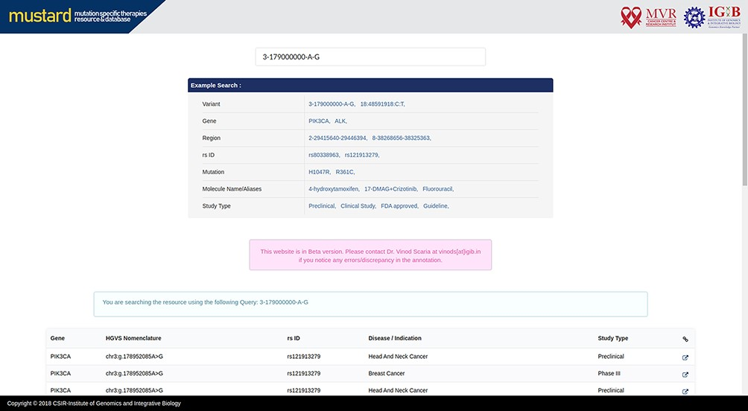
Figure 4. MUSTARD homepage showcasing the different search query formats that can be used.
Notes:
Figure 4. MUSTARD homepage showcasing the different search query formats that can be used.
Unless provided in the caption above, the following copyright applies to the content of this slide: © The Author(s) 2021. Published by Oxford University Press.This is an Open Access article distributed under the terms of the Creative Commons Attribution License (http://creativecommons.org/licenses/by/4.0/), which permits unrestricted reuse, distribution, and reproduction in any medium, provided the original work is properly cited.

Slide 5
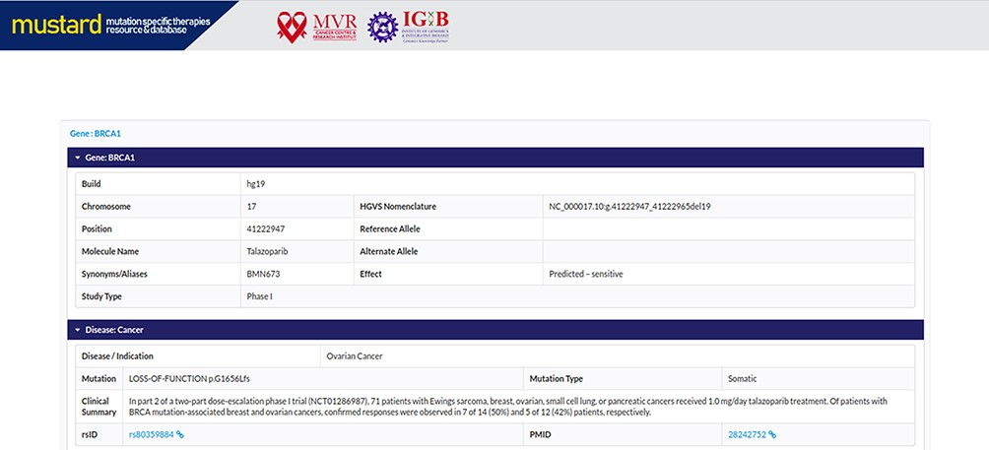
Figure 5. Screenshot of the MUSTARD database showing the expanded search results.
Notes:
Figure 5. Screenshot of the MUSTARD database showing the expanded search results.
Unless provided in the caption above, the following copyright applies to the content of this slide: © The Author(s) 2021. Published by Oxford University Press.This is an Open Access article distributed under the terms of the Creative Commons Attribution License (http://creativecommons.org/licenses/by/4.0/), which permits unrestricted reuse, distribution, and reproduction in any medium, provided the original work is properly cited.

Slide 6
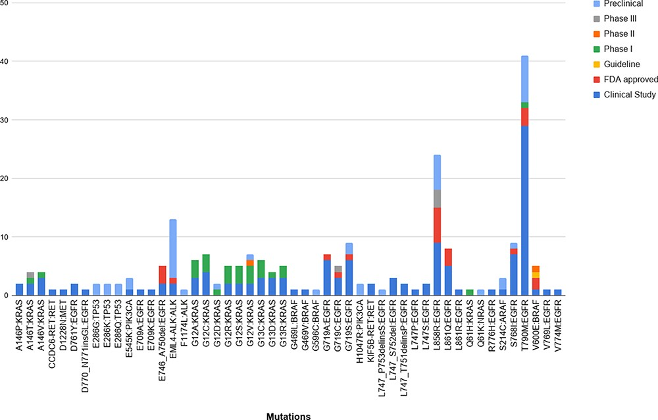
Figure 6. The breakdown of the 50 unique variants overlapping between the patient dataset and MUSTARD, according to ...
Notes:
Figure 6. The breakdown of the 50 unique variants overlapping between the patient dataset and MUSTARD, according to their stage of study as per the database annotations.
Unless provided in the caption above, the following copyright applies to the content of this slide: © The Author(s) 2021. Published by Oxford University Press.This is an Open Access article distributed under the terms of the Creative Commons Attribution License (http://creativecommons.org/licenses/by/4.0/), which permits unrestricted reuse, distribution, and reproduction in any medium, provided the original work is properly cited.

Slide 7
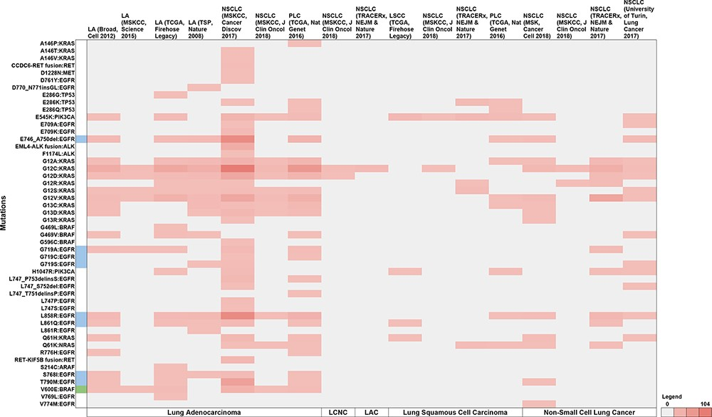
Figure 7. Summary of the breakdown of each of the 50 unique variants across the 11 studies. The variants highlighted in ...
Notes:
Figure 7. Summary of the breakdown of each of the 50 unique variants across the 11 studies. The variants highlighted in blue represent molecules that have been FDA approved, while green represents guidelines as well as FDA approved molecules. Note: LA—Lung adenocarcinoma, NSCLC—non-small cell lung cancer, PLC—pan-lung cancer, LSCC—lung squamous cell carcinoma, LCNC—large cell neuroendocrine carcinoma, LAC—lung adenosquamous carcinoma.
Unless provided in the caption above, the following copyright applies to the content of this slide: © The Author(s) 2021. Published by Oxford University Press.This is an Open Access article distributed under the terms of the Creative Commons Attribution License (http://creativecommons.org/licenses/by/4.0/), which permits unrestricted reuse, distribution, and reproduction in any medium, provided the original work is properly cited.

