Slide 1
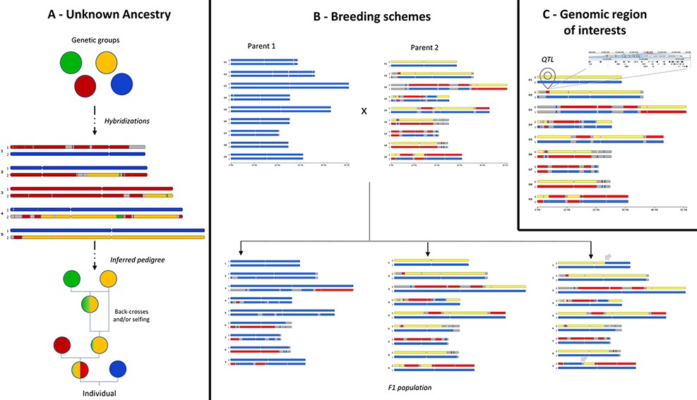
Figure 3. Examples of use cases supported by in silico chromosome painting. (A) Based on defined ancestral genetic ...
Notes:
Figure 3. Examples of use cases supported by in silico chromosome painting. (A) Based on defined ancestral genetic groups, a genome ancestry mosaic is painted, allowing identification of the genetic group involved in the hybridization process and deduction of the pedigree. (B) In silico chromosome painting in a breeding bi-parental population showing a subset of possible gametic chromosome distribution and possible chromosome recombinations (gray arrows) in progenies. (C) Co-localization of a genomic block with a genomic feature of interest (e.g. QTL) to explore gene content in related JBrowse.
Unless provided in the caption above, the following copyright applies to the content of this slide: © The Author(s) 2022. Published by Oxford University Press.This is an Open Access article distributed under the terms of the Creative Commons Attribution-NonCommercial License (https://creativecommons.org/licenses/by-nc/4.0/), which permits non-commercial re-use, distribution, and reproduction in any medium, provided the original work is properly cited. For commercial re-use, please contact journals.permissions@oup.com

