Slide 1
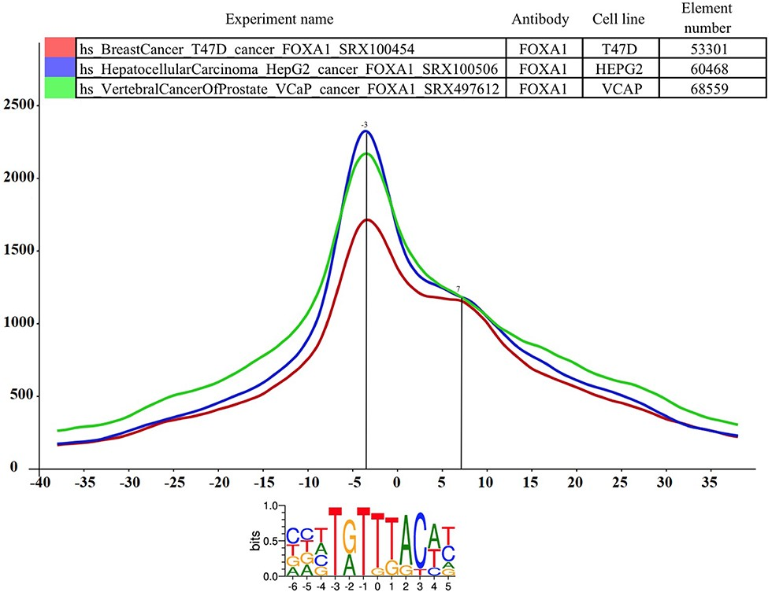
Figure 2 The distance distribution of FOXA1 summits relative to the motif centers of FOXA1 binding sites. The ...
Notes:
Figure 2 The distance distribution of FOXA1 summits relative to the motif centers of FOXA1 binding sites. The horizontal axis represents the distance of summits in different cell lines [T47D (SRA ID: SRX100454, red curve), HepG2 (SRA ID: SRX100506 blue curve) and VCaP (SRA ID: SRX497612, green curve)] relative to the FOXA1 motif center. The vertical axis represents the distance frequencies. A rolling mean with a 5 bp window was applied to smooth the frequency curves. The distance between the maxima (main summit, maxima at −3 bp) and the shoulder (7 bp) is ~10 bp. Element numbers in the table indicate the number of peak regions obtained in a ChIP-seq experiment, which overlap with a particular consensus motif binding site set. Figure is adapted from ChIPSummitDB website: http://summit.med.unideb.hu/summitdb/paired_shift_view.php?exp1=419&exp2=1960&exp3=3681&motive=FOXA1&motifid=77&limit=25&low_limit=-25&formminid=1&formmaxid=10000&mnelem=100&formmaxelem=120000.
Unless provided in the caption above, the following copyright applies to the content of this slide: © The Author(s) 2020. Published by Oxford University Press.This is an Open Access article distributed under the terms of the Creative Commons Attribution License (http://creativecommons.org/licenses/by/4.0/), which permits unrestricted reuse, distribution, and reproduction in any medium, provided the original work is properly cited.

