Slide 1
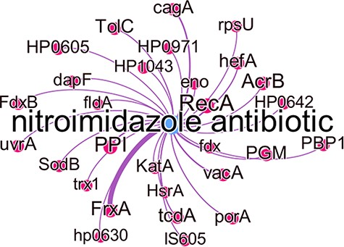
Figure 8. Subgraph of the nitroimidazole antibiotic group with predicted gene relations where the edge thickness is ...
Notes:
Figure 8. Subgraph of the nitroimidazole antibiotic group with predicted gene relations where the edge thickness is proportional to the number of times this association was predicted.
Unless provided in the caption above, the following copyright applies to the content of this slide: © The Author(s) 2022. Published by Oxford University Press.This is an Open Access article distributed under the terms of the Creative Commons Attribution License (https://creativecommons.org/licenses/by/4.0/), which permits unrestricted reuse, distribution, and reproduction in any medium, provided the original work is properly cited.

