Slide 1
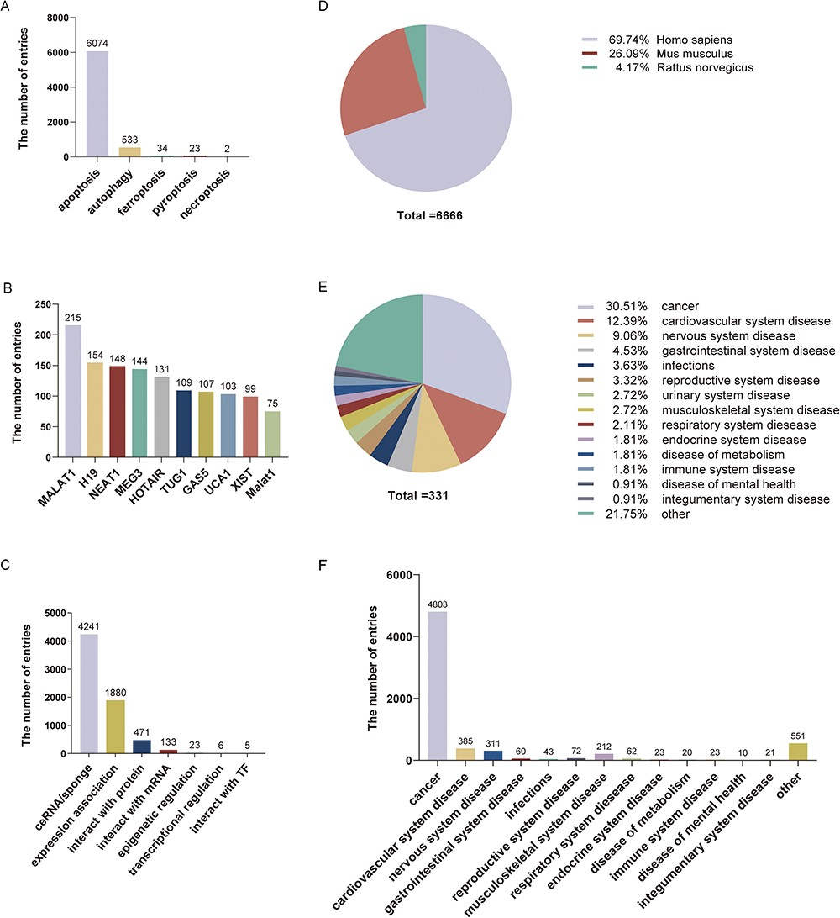
Figure 2. Statistical information on LncPCD. (A) Numbers of entries for different types of programmed cell death. (B) ...
Notes:
Figure 2. Statistical information on LncPCD. (A) Numbers of entries for different types of programmed cell death. (B) Numbers of entries for the top 10 lncRNAs. (C) Numbers of entries for lncRNA-mediated regulatory mechanisms. (D) Numbers of entries for three species. (E) Numbers of diseases for different classes. (F) Numbers of entries in different disease classes.
Unless provided in the caption above, the following copyright applies to the content of this slide: © The Author(s) 2023. Published by Oxford University Press.This is an Open Access article distributed under the terms of the Creative Commons Attribution License (https://creativecommons.org/licenses/by/4.0/), which permits unrestricted reuse, distribution, and reproduction in any medium, provided the original work is properly cited.

