Slide 1
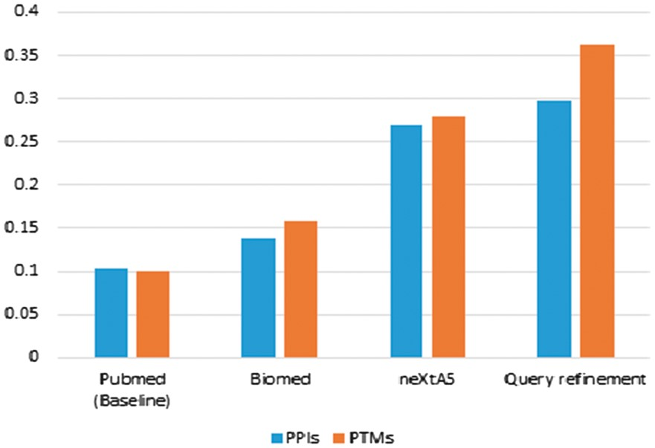
Figure 1. Comparison of the precision at P0 for the PPIs and PTMs ranking task by using PubMed versus BioMed, ...
Notes:
Figure 1. Comparison of the precision at P0 for the PPIs and PTMs ranking task by using PubMed versus BioMed, neXtA5 and neXtA5 augmented with the query refinement approach.
Unless provided in the caption above, the following copyright applies to the content of this slide: © The Author(s) 2017. Published by Oxford University Press.This is an Open Access article distributed under the terms of the Creative Commons Attribution License (http://creativecommons.org/licenses/by/4.0/), which permits unrestricted reuse, distribution, and reproduction in any medium, provided the original work is properly cited.

Slide 2
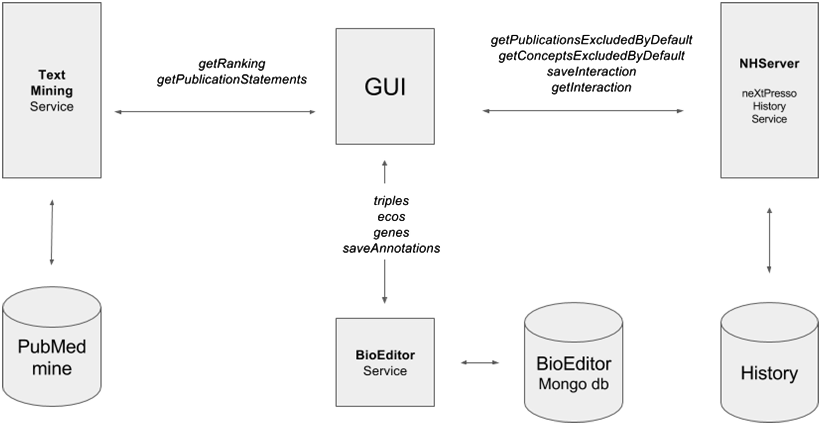
Figure 2. Architecture of the neXtA⁵ implementation in the BioEditor.
Notes:
Figure 2. Architecture of the neXtA5 implementation in the BioEditor.
Unless provided in the caption above, the following copyright applies to the content of this slide: © The Author(s) 2017. Published by Oxford University Press.This is an Open Access article distributed under the terms of the Creative Commons Attribution License (http://creativecommons.org/licenses/by/4.0/), which permits unrestricted reuse, distribution, and reproduction in any medium, provided the original work is properly cited.

Slide 3
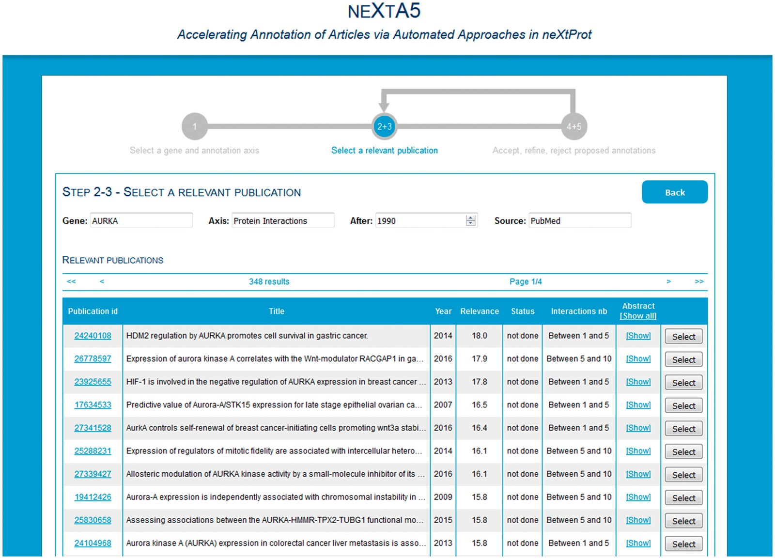
Figure 3. Phase 2, selection of a relevant publication in the ranked list.
Notes:
Figure 3. Phase 2, selection of a relevant publication in the ranked list.
Unless provided in the caption above, the following copyright applies to the content of this slide: © The Author(s) 2017. Published by Oxford University Press.This is an Open Access article distributed under the terms of the Creative Commons Attribution License (http://creativecommons.org/licenses/by/4.0/), which permits unrestricted reuse, distribution, and reproduction in any medium, provided the original work is properly cited.

Slide 4
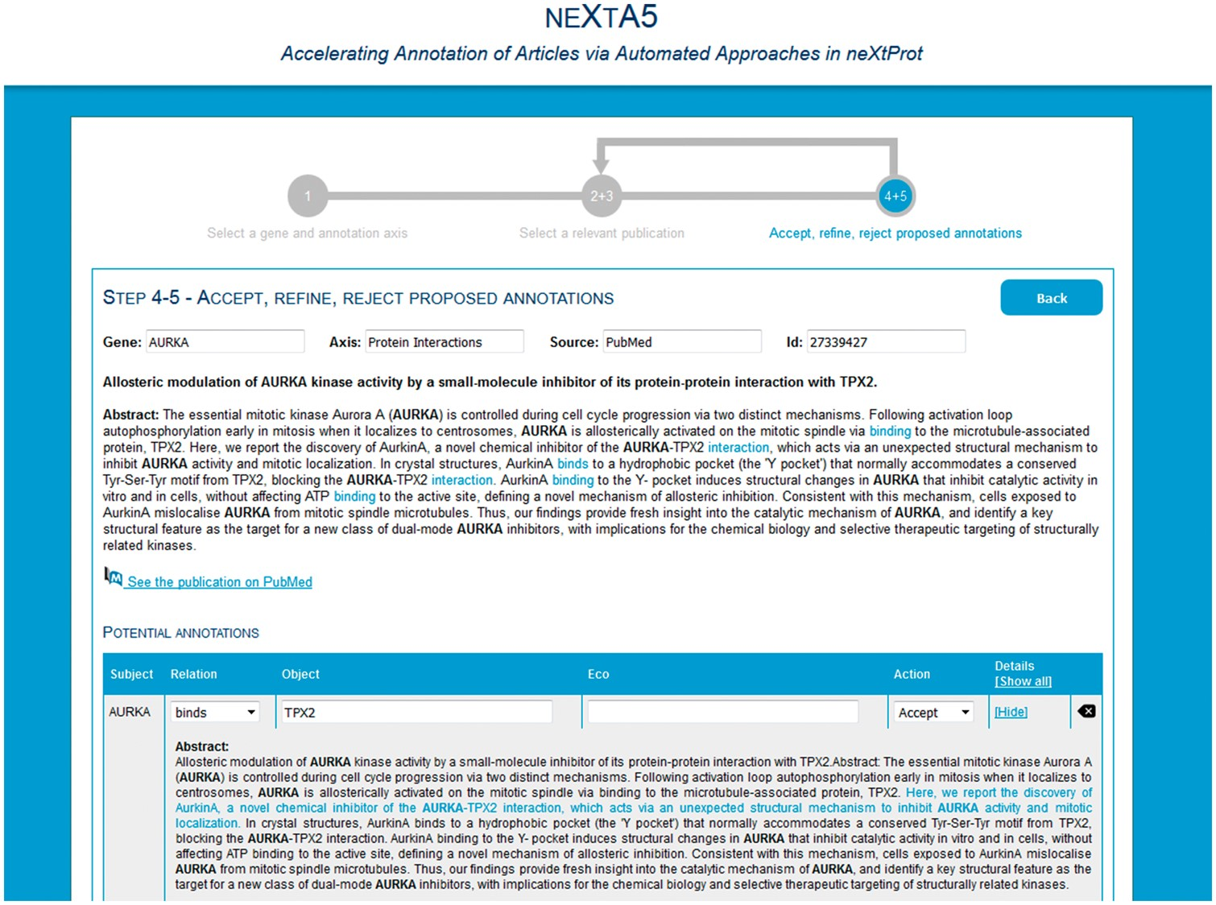
Figure 4. Phase 3, curation of the proposed annotations.
Notes:
Figure 4. Phase 3, curation of the proposed annotations.
Unless provided in the caption above, the following copyright applies to the content of this slide: © The Author(s) 2017. Published by Oxford University Press.This is an Open Access article distributed under the terms of the Creative Commons Attribution License (http://creativecommons.org/licenses/by/4.0/), which permits unrestricted reuse, distribution, and reproduction in any medium, provided the original work is properly cited.

