Slide 1
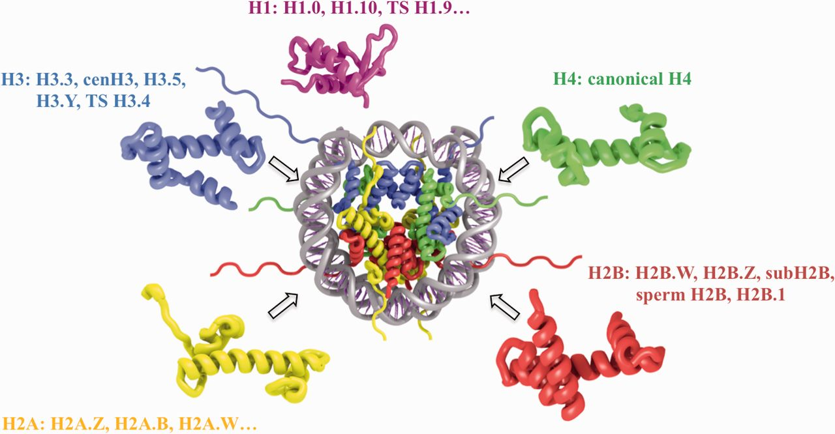
Figure 1. Schematic representation of nucleosome structure and its composition of different histone variants. The ...
Notes:
Figure 1. Schematic representation of nucleosome structure and its composition of different histone variants. The nucleosome core is formed by 147 bp of DNA and an octamer of H3, H4, H2A and H2B histones (depicted in blue, green, yellow and red, respectively). H1 linker histone (magenta) is associated with the nucleosome core near the DNA entry exit points. Selected histone variant names for each histone type are shown.
Unless provided in the caption above, the following copyright applies to the content of this slide: Published by Oxford University Press 2015. This work is written by US Government employees and is in the public domain in the United States.

