Slide 1
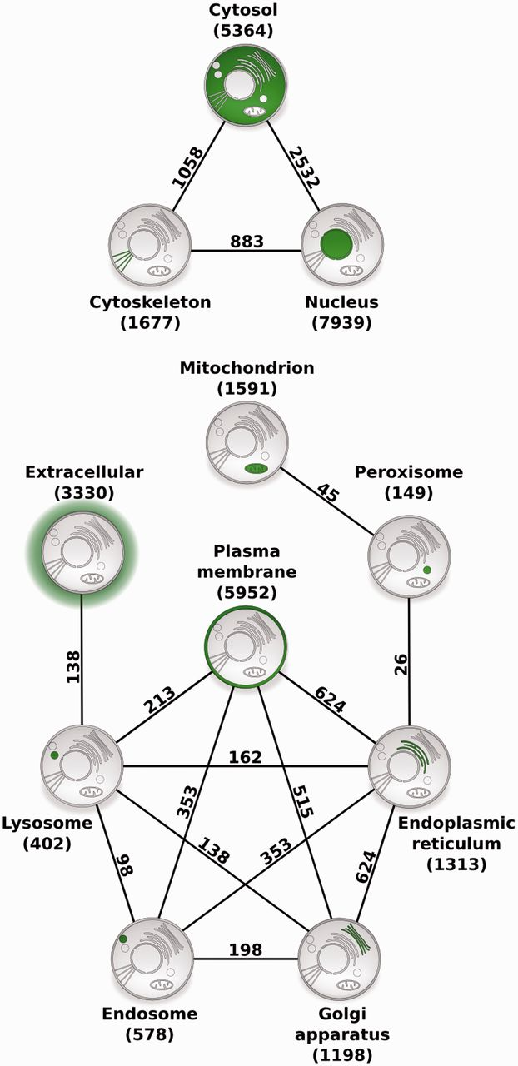
Figure 4. Compartment relationships derived from shared proteins. Illustrating the usefulness of COMPARTMENTS for ...
Notes:
Figure 4. Compartment relationships derived from shared proteins. Illustrating the usefulness of COMPARTMENTS for global analysis of protein localization, we studied relationships between compartments. Each node represents a single compartment, which is highlighted in green. The number of proteins in the compartment is shown in parenthesis. We show an edge between two compartments whenever they share more proteins than expected at random (false discovery rate <0.1%). The number of proteins co-localized to the two compartments is shown next to the edge.
Unless provided in the caption above, the following copyright applies to the content of this slide: © The Author(s) 2014. Published by Oxford University Press.This is an Open Access article distributed under the terms of the Creative Commons Attribution License (http://creativecommons.org/licenses/by/3.0/), which permits unrestricted reuse, distribution, and reproduction in any medium, provided the original work is properly cited.

