Slide 1
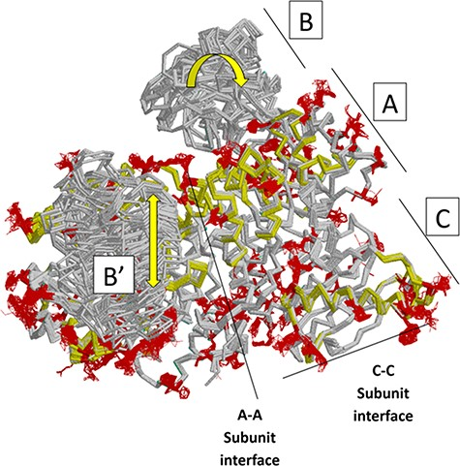
Figure 7. Locations of changes in the domains A and C were detected by comparing monomeric structures of rM1PYK. To ...
Notes:
Figure 7. Locations of changes in the domains A and C were detected by comparing monomeric structures of rM1PYK. To highlight the many changes located at the A–A subunit interface, representative dimers were extracted and superimposed from each PDB; note that the perspective of the left-most monomer is looking down at the top of its B domain (B’). The other two monomers of the rM1PYK homotetramer are not shown. The locations of the largest backbone shifts are shown in light yellow (>3.3 Å; most >10 Å); and the locations of the largest side-chain differences are in dark red (>3.3 Å; most >10 Å). Since the entire B domains experience change (yellow arrows), they are not individually highlighted.
Unless provided in the caption above, the following copyright applies to the content of this slide: © The Author(s) 2023. Published by Oxford University Press.This is an Open Access article distributed under the terms of the Creative Commons Attribution License (https://creativecommons.org/licenses/by/4.0/), which permits unrestricted reuse, distribution, and reproduction in any medium, provided the original work is properly cited.

