Slide 1
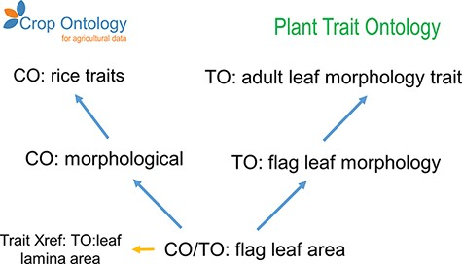
Figure 4. Example of granularity improvement for the CO for the ‘Flag leaf area’ term. Blue arrows represent the ‘is_a’ ...
Notes:
Figure 4. Example of granularity improvement for the CO for the ‘Flag leaf area’ term. Blue arrows represent the ‘is_a’ relationship. Abbreviations are related to existent ontologies: Crop Ontology (CO), Plant Trait Ontology (TO), Plant Ontology (PO), Phenotype and Trait Ontology (PATO) and Basic Formal Ontology (BFO).
Unless provided in the caption above, the following copyright applies to the content of this slide: © The Author(s) 2021. Published by Oxford University Press.This is an Open Access article distributed under the terms of the Creative Commons Attribution License (http://creativecommons.org/licenses/by/4.0/), which permits unrestricted reuse, distribution, and reproduction in any medium, provided the original work is properly cited.

