Slide 1
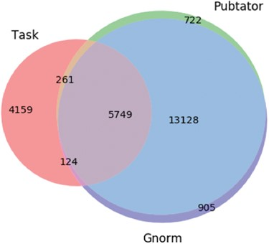
Figure 3 Venn diagram showing the differences in the gene entity annotations over the PPIm dataset. An entity ...
Notes:
Figure 3 Venn diagram showing the differences in the gene entity annotations over the PPIm dataset. An entity annotation is regarded as a triple (document id, character span, entity id). The three sets are the set of annotations given in the task dataset (Task) and from the two entity annotators namely Pubtator and GNormPlus (GNorm).
Unless provided in the caption above, the following copyright applies to the content of this slide: © The Author(s) 2018. Published by Oxford University Press.This is an Open Access article distributed under the terms of the Creative Commons Attribution License (http://creativecommons.org/licenses/by/4.0/), which permits unrestricted reuse, distribution, and reproduction in any medium, provided the original work is properly cited.

