Slide 1
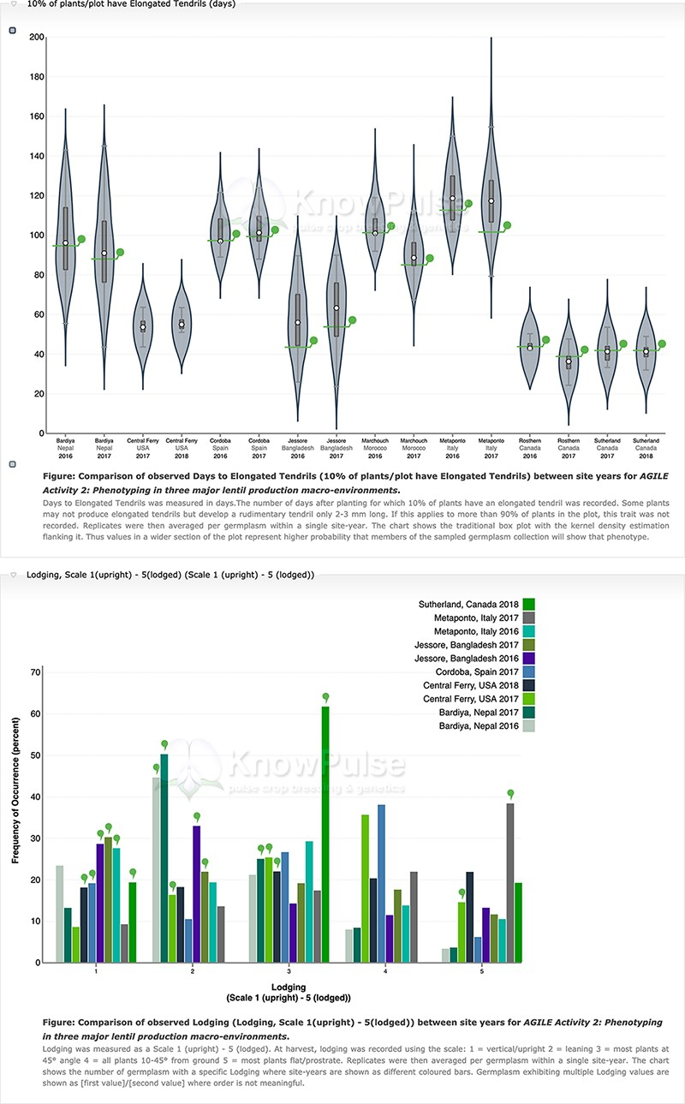
Figure 6. Phenotypic data visualization on a generic Tripal site. Both visualizations are available on specific ...
Notes:
Figure 6. Phenotypic data visualization on a generic Tripal site. Both visualizations are available on specific germplasm pages and show the distribution of phenotypic data collected separated by site-year with the current germplasm indicated by a green indicator. Violin plots (top panel) are used to visualize quantitative data with the mean value shown on the y-axis and the site-year indicated along the x-axis. Histograms (bottom panel) are used to visualize qualitative data with the frequency of occurrence on the y-axis, the scale shown along the x-axis and each site-year indicated by bar color.
Unless provided in the caption above, the following copyright applies to the content of this slide: © The Author(s) 2021. Published by Oxford University Press.This is an Open Access article distributed under the terms of the Creative Commons Attribution License (http://creativecommons.org/licenses/by/4.0/), which permits unrestricted reuse, distribution, and reproduction in any medium, provided the original work is properly cited.

