Slide 1
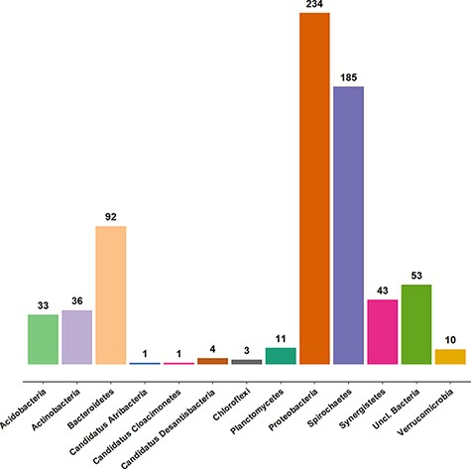
Figure 2. Taxonomic coverage of the clone sequence data set of AcetoBase at the phylum level, excluding Firmicutes ...
Notes:
Figure 2. Taxonomic coverage of the clone sequence data set of AcetoBase at the phylum level, excluding Firmicutes (n = 2355 sequences). The values shown represent the sequence count for the respective phylum present in the AcetoBase clone data set.
Unless provided in the caption above, the following copyright applies to the content of this slide: © The Author(s) 2022. Published by Oxford University Press.This is an Open Access article distributed under the terms of the Creative Commons Attribution-NonCommercial License (https://creativecommons.org/licenses/by-nc/4.0/), which permits non-commercial re-use, distribution, and reproduction in any medium, provided the original work is properly cited. For commercial re-use, please contact journals.permissions@oup.com

