Slide 1
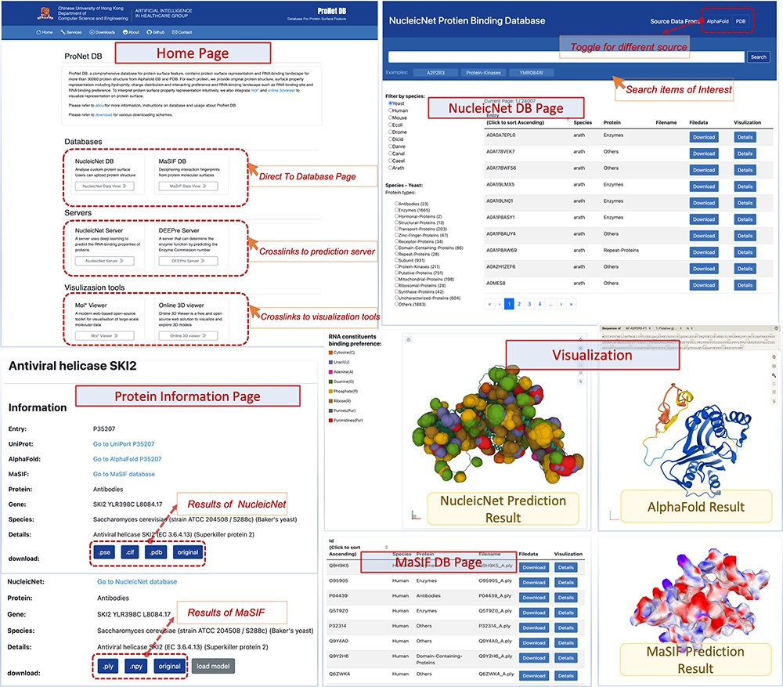
Figure 2. User interface of ProNet DB. Top-left: Home page contains three subsections: servers, databases and ...
Notes:
Figure 2. User interface of ProNet DB. Top-left: Home page contains three subsections: servers, databases and visualization tools. Top-right: NucleicNet DB page. Users can search, filter and view the searched results. On the top-right corner of NucleicNet DB page, a toggle button provides different protein sources. Bottom: Protein information page and visualization details for each item.
Unless provided in the caption above, the following copyright applies to the content of this slide: © The Author(s) 2024. Published by Oxford University Press.This is an Open Access article distributed under the terms of the Creative Commons Attribution License (https://creativecommons.org/licenses/by/4.0/), which permits unrestricted reuse, distribution, and reproduction in any medium, provided the original work is properly cited.

