Slide 1
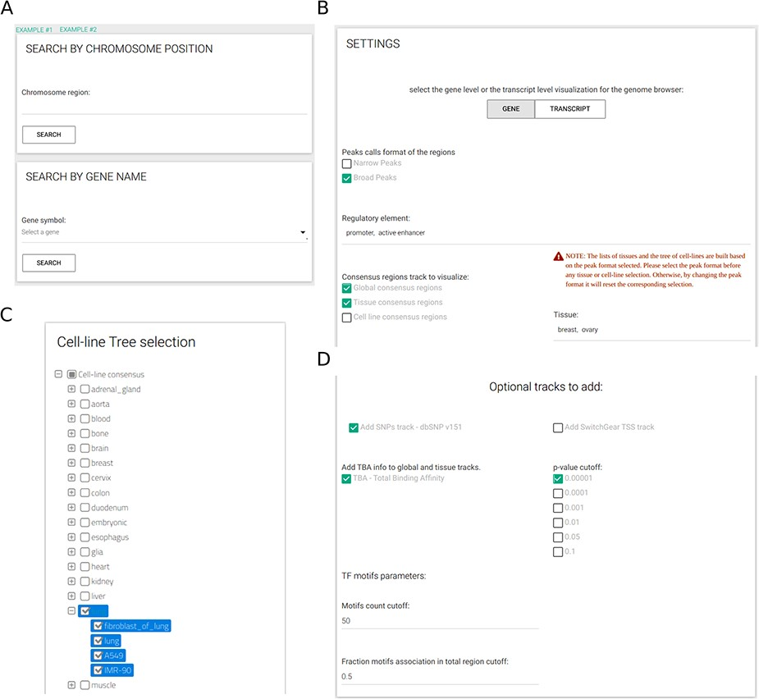
Figure 3. CONREL interface. (A) Search tab allows to select a specific genomic region or a gene name. Input tabs allow ...
Notes:
Figure 3. CONREL interface. (A) Search tab allows to select a specific genomic region or a gene name. Input tabs allow for the selection of source peak data and types of CRE to be displayed (B) using, when needed, also a cell line selection tree when activated (C) and TBA statistical filters (D).
Unless provided in the caption above, the following copyright applies to the content of this slide: © The Author(s) 2020. Published by Oxford University Press.This is an Open Access article distributed under the terms of the Creative Commons Attribution License (http://creativecommons.org/licenses/by/4.0/), which permits unrestricted reuse, distribution, and reproduction in any medium, provided the original work is properly cited.

