Slide 1
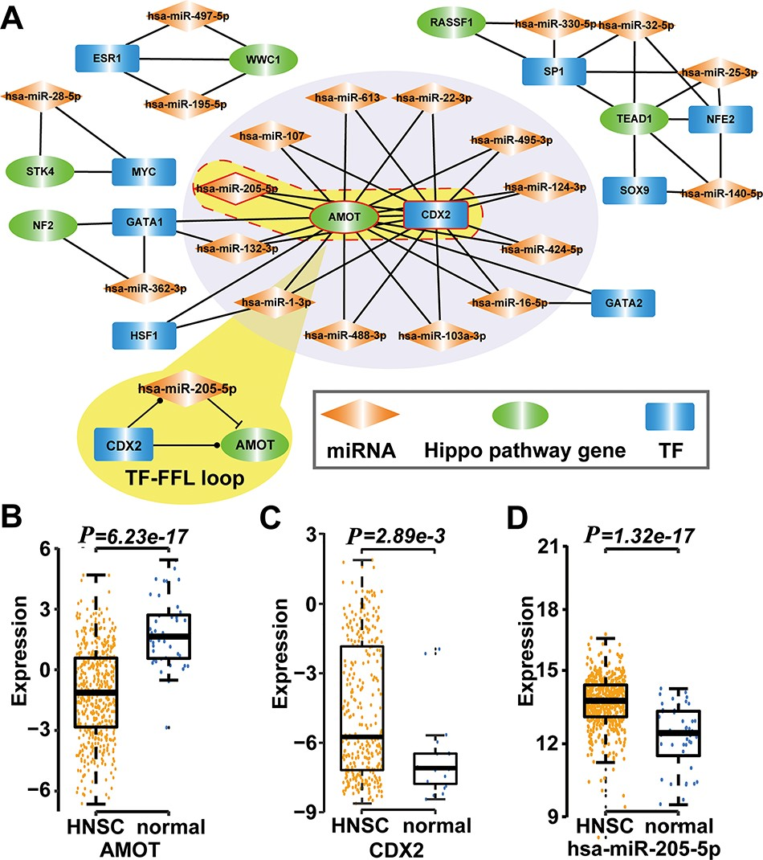
Figure 4 Type 2 motif (FFLs) subnetworks predicted by RHPCG. (A) Both AMOT and CDX2 are hubs in the type 2 motif ...
Notes:
Figure 4 Type 2 motif (FFLs) subnetworks predicted by RHPCG. (A) Both AMOT and CDX2 are hubs in the type 2 motif (FFLs) subnetworks. (B–D) Box plot of expression of molecules in healthy and patients with HNSC.
Unless provided in the caption above, the following copyright applies to the content of this slide: © The Author(s) 2019. Published by Oxford University Press.This is an Open Access article distributed under the terms of the Creative Commons Attribution License (http://creativecommons.org/licenses/by/4.0/), which permits unrestricted reuse, distribution, and reproduction in any medium, provided the original work is properly cited.

