Slide 1
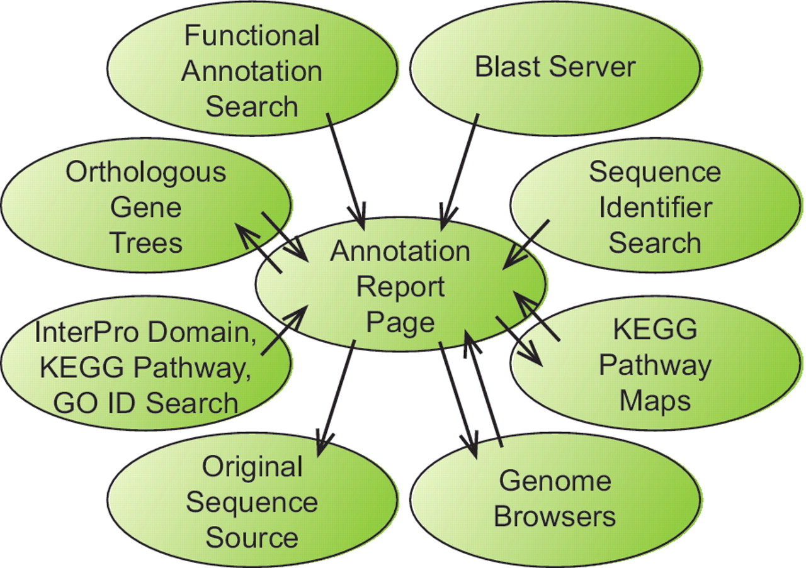
Figure 1. Information flow within the BFGR website. The Annotation Report Page maintains a central position within the ...
Notes:
Figure 1. Information flow within the BFGR website. The Annotation Report Page maintains a central position within the organization of the BFGR database website. Features in tracks on the genome browsers, BLAST results and multiple other search results all provide links to sequence Annotation Report Pages. Additionally, Annotation Report Pages present graphical KEGG pathway maps and orthologous gene trees have links to the Annotation Report Pages for other sequences. Links also exist from Annotation Report Pages to the BFGR genome browsers and the original sequence source of the sequence.
Unless provided in the caption above, the following copyright applies to the content of this slide: © The Author(s) 2012. Published by Oxford University Press.This is an Open Access article distributed under the terms of the Creative Commons Attribution Non-Commercial License (http://creativecommons.org/licenses/by-nc/3.0), which permits unrestricted non-commercial use, distribution, and reproduction in any medium, provided the original work is properly cited.

Slide 2
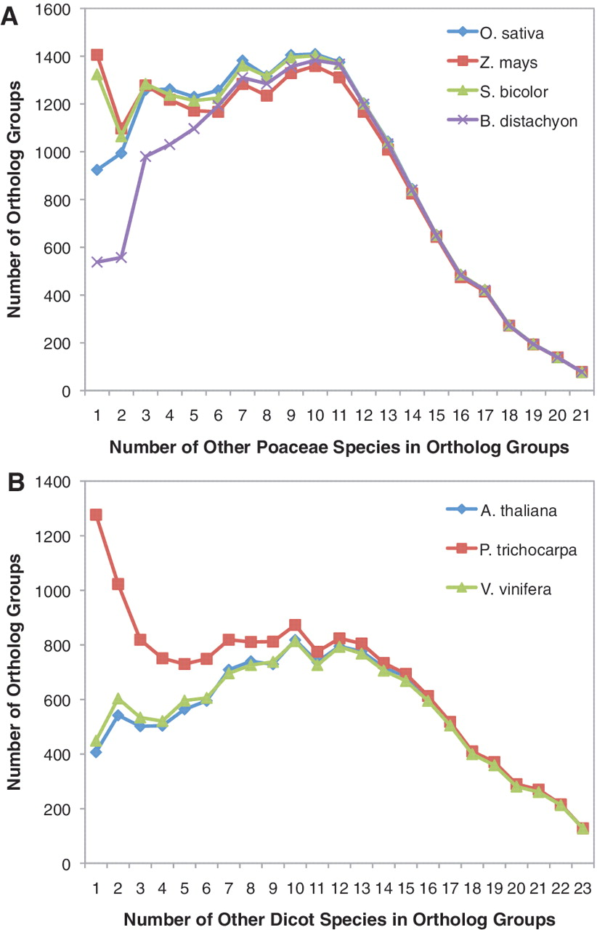
Figure 2. Number of additional species in orthologous groups with B. distachyon, O. sativa, S. bicolor and Z. mays. (A) ...
Notes:
Figure 2. Number of additional species in orthologous groups with B. distachyon, O. sativa, S. bicolor and Z. mays. (A) For each orthologous group, the number of other Poaceae species present within the orthologous group was quantified. Counts were determined separately for orthologous groups containing B. distachyon, O. sativa, S. bicolor and Z. mays sequences. Proteins from A. thaliana, P. trichocarpa and V. vinifera were not included in these species counts. (B) For each orthologous group, the number of other dicot species present within the orthologous group was quantified. Counts were determined separately for orthologous groups containing A. thaliana, P. trichocarpa and V. vinifera sequences. Proteins from B. distachyon, O. sativa, S. bicolor and Z. mays were not included in these species counts.
Unless provided in the caption above, the following copyright applies to the content of this slide: © The Author(s) 2012. Published by Oxford University Press.This is an Open Access article distributed under the terms of the Creative Commons Attribution Non-Commercial License (http://creativecommons.org/licenses/by-nc/3.0), which permits unrestricted non-commercial use, distribution, and reproduction in any medium, provided the original work is properly cited.

