Slide 1
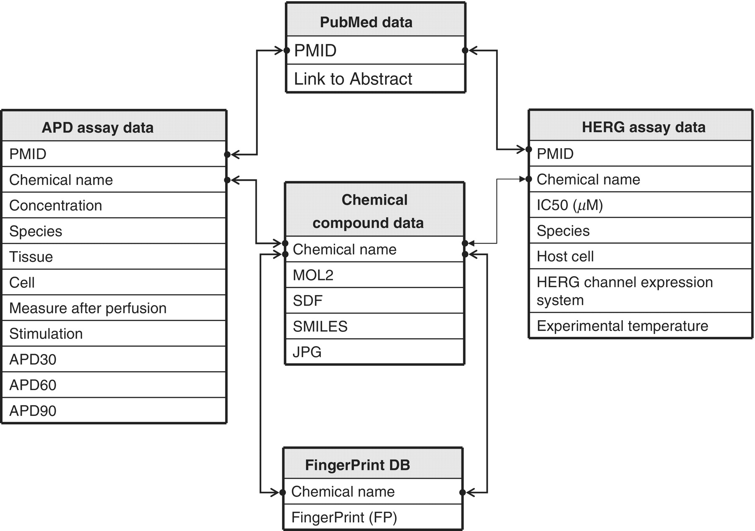
Figure 2. Schematic representation of hERGAPDbase architecture. hERGAPDbase consists of five data tables: PubMed data, ...
Notes:
Figure 2. Schematic representation of hERGAPDbase architecture. hERGAPDbase consists of five data tables: PubMed data, Chemical compound data, FP DB, APD assay data and HERG assay data. The abbreviations APD and HERG indicate APD and hERG, respectively. The PubMed data table consists of two attributes: PubMed Unique Identifier (PMID) and Link to Abstract. The Chemical compound data table consists of five attributes: chemical name, Sybyl Mol2 chemical modeller output (MOL2), SDF, SMILES and JPEG). The FP DB data table consists of two attributes: chemical name and FP. The APD assay data table consists of 11 attributes: PMID, chemical name, concentration, species, tissues, cell, measure after perfusion, stimulation, APD at 30% repolarization (APD30), APD at 60% repolarization (APD60) and APD at 90% repolarization (APD90). The HERG assay data table consists of seven attributes: PMID, chemical name, half maximal inhibitory concentration (IC50; µM), species, host cell, HERG channel expression system and experimental temperature.
Unless provided in the caption above, the following copyright applies to the content of this slide: © The Author(s) 2011. Published by Oxford University Press.This is Open Access article distributed under the terms of the Creative Commons Attribution Non-Commercial License (http://creativecommons.org/licenses/by-nc/2.5), which permits unrestricted non-commercial use, distribution, and reproduction in any medium, provided the original work is properly cited.

