Slide 1
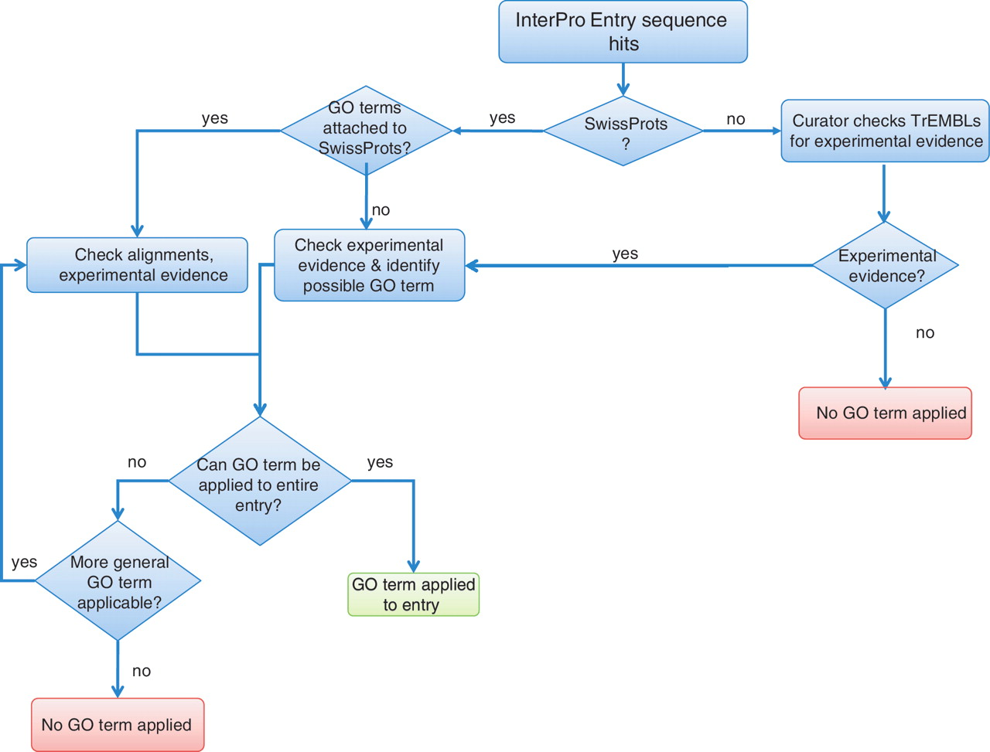
Figure 1. Flowchart outlining the decision process taken by InterPro curators in order to assign GO terms.
Notes:
Figure 1. Flowchart outlining the decision process taken by InterPro curators in order to assign GO terms.
Unless provided in the caption above, the following copyright applies to the content of this slide: © The Author(s) 2012. Published by Oxford University Press.This is an Open Access article distributed under the terms of the Creative Commons Attribution Non-Commercial License (http://creativecommons.org/licenses/by-nc/3.0), which permits unrestricted non-commercial use, distribution, and reproduction in any medium, provided the original work is properly cited.

