Slide 1
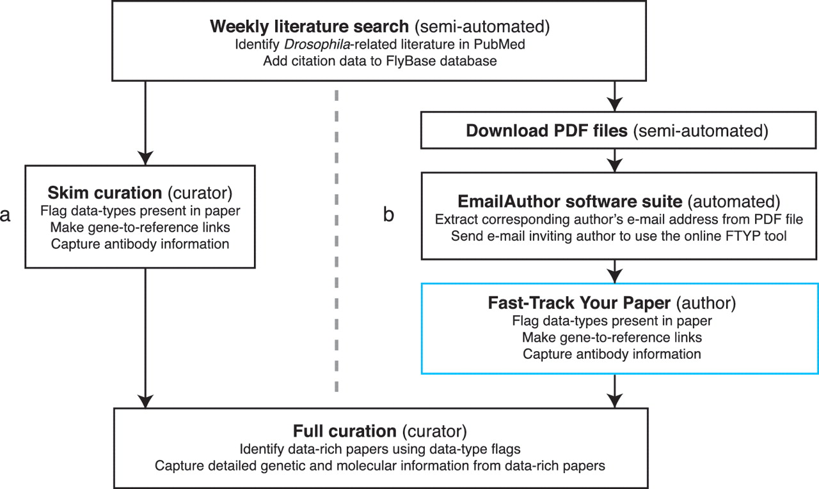
Figure 1. Literature curation pipeline before (a) and after (b) integrating community curation. A weekly search of the ...
Notes:
Figure 1. Literature curation pipeline before (a) and after (b) integrating community curation. A weekly search of the PubMed database identifies recent Drosophila-related publications. Newly identified papers subsequently undergo skim curation, which assigns data type flags and captures a limited subset of curated information (genes studied and antibodies generated). The data type flags are used to identify data-rich papers which are prioritized for full curation. The skim curation step previously carried out by FlyBase curators (a), has been replaced by community curation (b) by adapting the pipeline. First, we now download the PDF file of each new publication (currently possible for 89% of new papers). Secondly, we developed the EmailAuthor software suite, which is used to automatically e-mail the corresponding author of new papers. Finally, authors who have been e-mailed use the FTYP tool to skim curate their paper.
Unless provided in the caption above, the following copyright applies to the content of this slide: © The Author(s) 2012. Published by Oxford University Press.This is an Open Access article distributed under the terms of the Creative Commons Attribution Non-Commercial License (http://creativecommons.org/licenses/by-nc/3.0), which permits unrestricted non-commercial use, distribution, and reproduction in any medium, provided the original work is properly cited.

