Slide 1
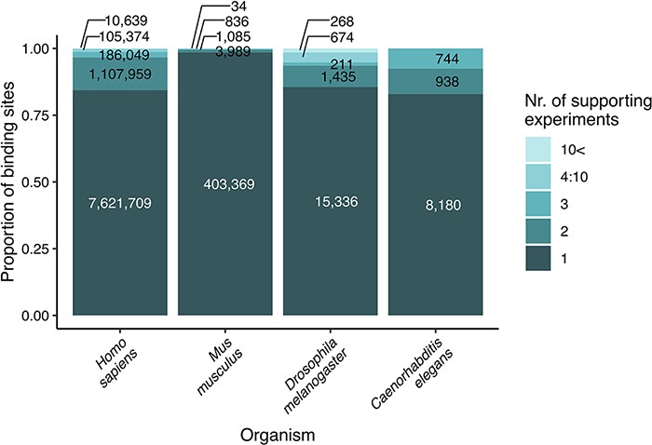
Figure 1. Strength of evidence (number of supporting experiments) for each transcription factor binding site, referring ...
Notes:
Figure 1. Strength of evidence (number of supporting experiments) for each transcription factor binding site, referring to the number of binding sites (for a particular transcription factor) that overlap (in at least one nucleotide length) with the investigated binding site. The original data are included as binding site tables in the download parts of the TFLink database.
Unless provided in the caption above, the following copyright applies to the content of this slide: © The Author(s) 2022. Published by Oxford University Press.This is an Open Access article distributed under the terms of the Creative Commons Attribution-NonCommercial License (https://creativecommons.org/licenses/by-nc/4.0/), which permits non-commercial re-use, distribution, and reproduction in any medium, provided the original work is properly cited. For commercial re-use, please contact journals.permissions@oup.com

