Slide 1
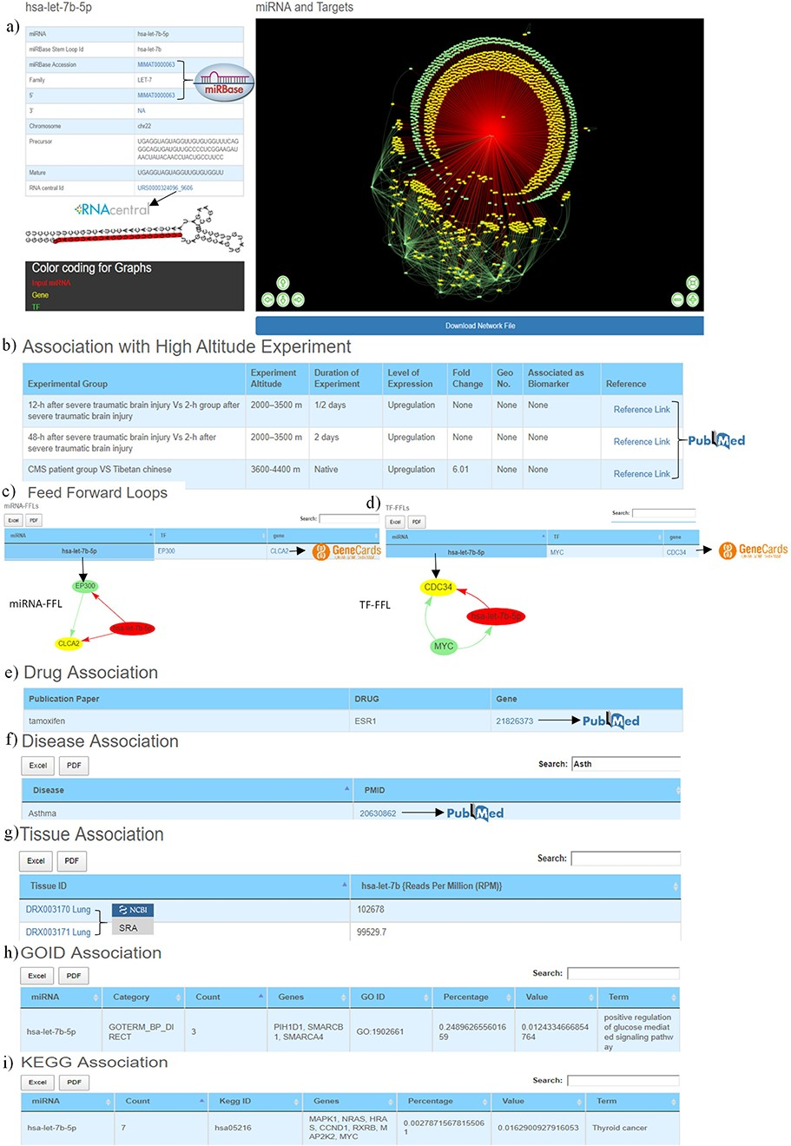
Figure 3. Web image of the miRNA information page. (a) The first section of hsa-let-7b-5p miRNA information page with ...
Notes:
Figure 3. Web image of the miRNA information page. (a) The first section of hsa-let-7b-5p miRNA information page with details about the miRNA and hyperlinking to external databases like miRBase and RNAcentral. (b) The second section shows information related to experimental details of DE human miRNA under HA conditions in published literature. (c) The web image of the miRNA–FFL in tabular format. (d) The web image of the TF–FFL in tabular format. (e) miRNA associations with drug. (f) miRNA associations with different disease. (g) miRNA expression level in different tissues. (h) GO functional enrichment of the miRNA targets. (i) KEGG pathway enrichment of the miRNA targets. The lengthy tables can be searched through ‘search’ box and information in table can be download in both Excel and PDF formats.
Unless provided in the caption above, the following copyright applies to the content of this slide: © The Author(s) 2020. Published by Oxford University Press.This is an Open Access article distributed under the terms of the Creative Commons Attribution License (http://creativecommons.org/licenses/by/4.0/), which permits unrestricted reuse, distribution, and reproduction in any medium, provided the original work is properly cited.

Slide 2
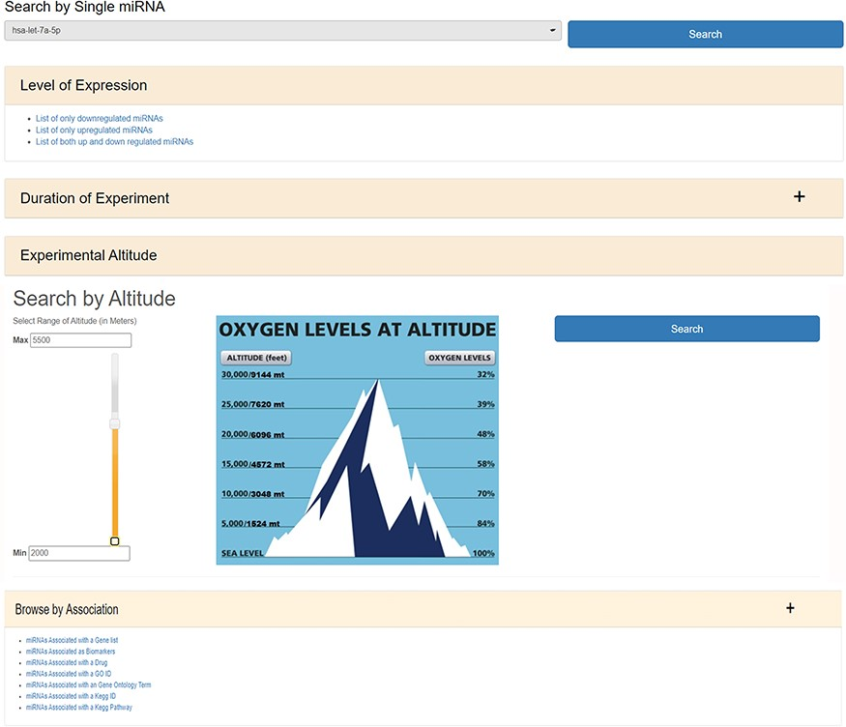
Figure 2. The web image of HAHmiR.DB—‘Browse’ option allows the user to browse differentially expressed (DE) miRNA ...
Notes:
Figure 2. The web image of HAHmiR.DB—‘Browse’ option allows the user to browse differentially expressed (DE) miRNA during HA acclimatization using multiple filters, i.e. level of expression, duration of experiment, experimental altitude and browse by associations that includes filters such as miRNAs Associated with a Gene List, miRNAs Associated as Biomarkers, miRNAs Associated with a Drug, miRNAs Associated with a GO ID/term, miRNAs Associated with a KEGG ID/Pathway.
Unless provided in the caption above, the following copyright applies to the content of this slide: © The Author(s) 2020. Published by Oxford University Press.This is an Open Access article distributed under the terms of the Creative Commons Attribution License (http://creativecommons.org/licenses/by/4.0/), which permits unrestricted reuse, distribution, and reproduction in any medium, provided the original work is properly cited.

Slide 3
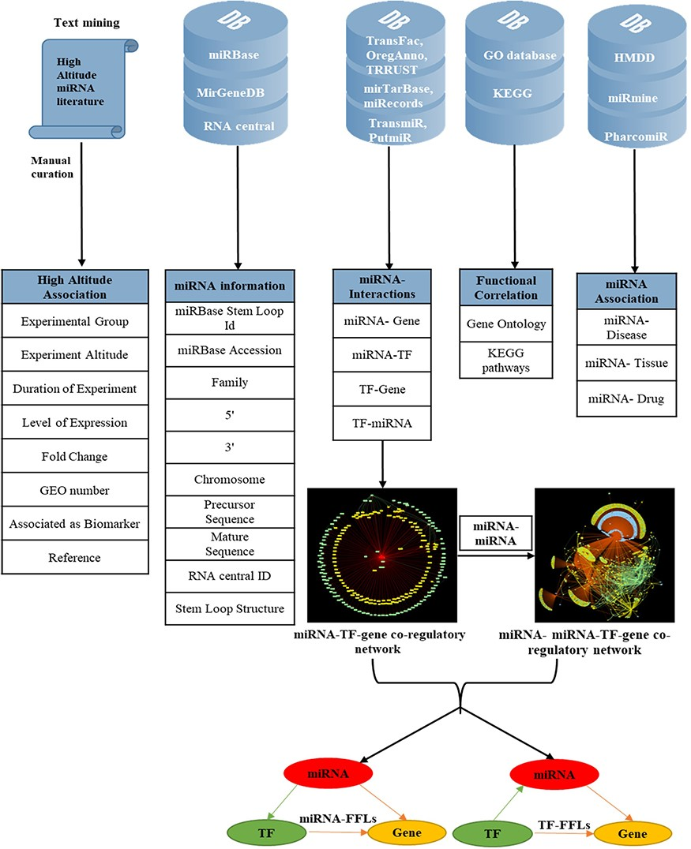
Figure 1. Overview of data collection and annotation in HAHmiR.DB. A comprehensive list of differentially expressed ...
Notes:
Figure 1. Overview of data collection and annotation in HAHmiR.DB. A comprehensive list of differentially expressed HA-associated human miRNAs was mined from the published literature with its HA-associated information, i.e experimental group, experiment altitude, duration of experiment, level of expression, fold change, GEO accession and association as biomarker. These miRNAs were further enriched with a variety of other information from generic biological databases that includes miRNA sequence–related information, miRNA stem-loop structure, miRNA–network interactions (miRNA–gene, miRNA–TF, TF–miRNA, TF–gene), functional enrichments (Gene Ontology, pathways), miRNA–disease association, miRNA–drug association and miRNA–tissue expression.
Unless provided in the caption above, the following copyright applies to the content of this slide: © The Author(s) 2020. Published by Oxford University Press.This is an Open Access article distributed under the terms of the Creative Commons Attribution License (http://creativecommons.org/licenses/by/4.0/), which permits unrestricted reuse, distribution, and reproduction in any medium, provided the original work is properly cited.

Slide 4
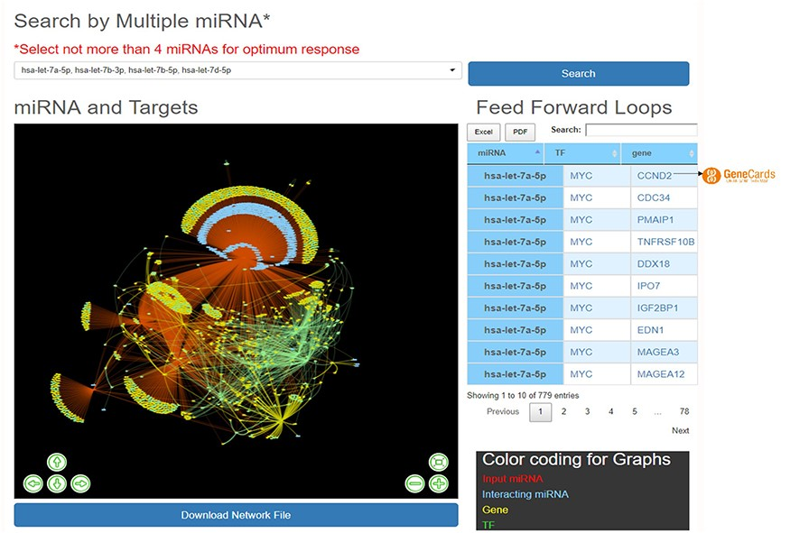
Figure 4. ‘Explore’ option of the database. The web image of the section shows complex network of four miRNA, i.e ...
Notes:
Figure 4. ‘Explore’ option of the database. The web image of the section shows complex network of four miRNA, i.e hsa-let-7b-5p, hsa-let-7a-5p, hsa-let-7b-3p, hsa-let-7d-5p and identified FFLs in the adjacent table.
Unless provided in the caption above, the following copyright applies to the content of this slide: © The Author(s) 2020. Published by Oxford University Press.This is an Open Access article distributed under the terms of the Creative Commons Attribution License (http://creativecommons.org/licenses/by/4.0/), which permits unrestricted reuse, distribution, and reproduction in any medium, provided the original work is properly cited.

Slide 5
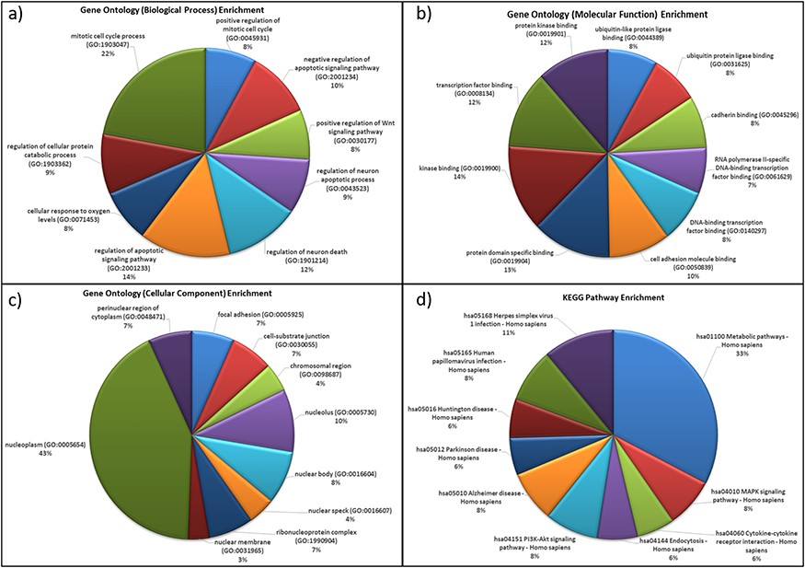
Figure 5. Functional characterization of differentially expressed HA miRNA–targets (a) GO: biological processes. (b) ...
Notes:
Figure 5. Functional characterization of differentially expressed HA miRNA–targets (a) GO: biological processes. (b) GO: molecular functions (c) GO: cellular compartment and (d) KEGG pathway enrichment.
Unless provided in the caption above, the following copyright applies to the content of this slide: © The Author(s) 2020. Published by Oxford University Press.This is an Open Access article distributed under the terms of the Creative Commons Attribution License (http://creativecommons.org/licenses/by/4.0/), which permits unrestricted reuse, distribution, and reproduction in any medium, provided the original work is properly cited.

