Slide 1
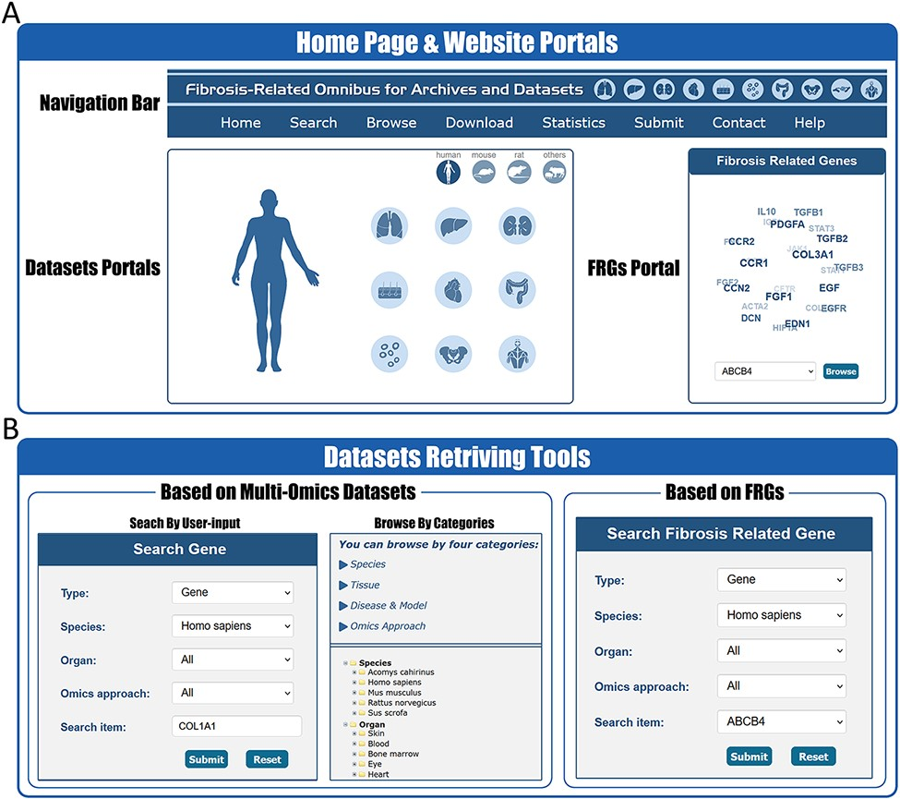
Figure 2. Website interface for FibROAD portals and dataset retrieving tools. (A) The home page of the FibROAD website ...
Notes:
Figure 2. Website interface for FibROAD portals and dataset retrieving tools. (A) The home page of the FibROAD website was equipped with a navigation bar at the top and portals to enter dataset browsers within specific categories (left), as well as portals to enter for the page containing fibrosis-related genes (right). (B) The FibROAD dataset retrieving tools (Search and Browse), which can be accessed through the navigation bar on the home page. Users can retrieve relative information with either self-defined keywords (left) or with pre-set FRGs (right).
Unless provided in the caption above, the following copyright applies to the content of this slide: © The Author(s) 2022. Published by Oxford University Press.This is an Open Access article distributed under the terms of the Creative Commons Attribution License (https://creativecommons.org/licenses/by/4.0/), which permits unrestricted reuse, distribution, and reproduction in any medium, provided the original work is properly cited.

