Slide 1
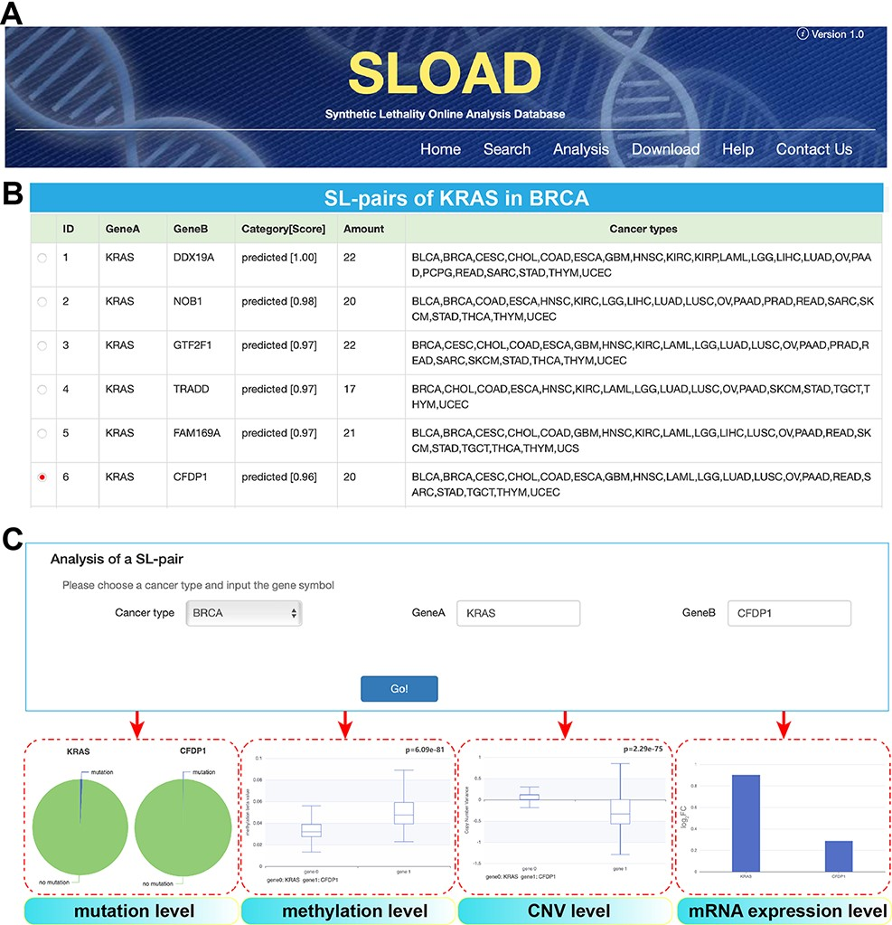
Figure 3. Overview of SLOAD database.
Notes:
Figure 3. Overview of SLOAD database. (A) Main functions of SLOAD. (B) An example of searching modules in BRCA. All of synthetic lethal interactions in BRCA can be presented, and they are also detected in other cancer types. Amount indicates the genetic interactions shared by different cancer types. Further analysis is performed based on the selected gene pair of KRAS:CFDP1. (C) An example of further analysis of above-selected gene pair of KRAS:CFDP1, mainly including visible results of mutation level, methylation level, CNV level and mRNA expression level.
Unless provided in the caption above, the following copyright applies to the content of this slide: © The Author(s) 2022. Published by Oxford University Press.This is an Open Access article distributed under the terms of the Creative Commons Attribution-NonCommercial License (https://creativecommons.org/licenses/by-nc/4.0/), which permits non-commercial re-use, distribution, and reproduction in any medium, provided the original work is properly cited. For commercial re-use, please contact journals.permissions@oup.com

