Slide 1
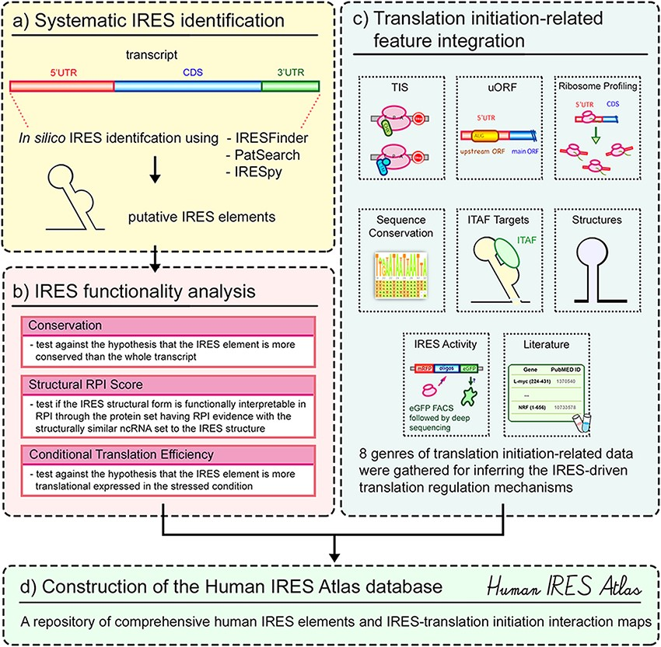
Figure 1. Overview of the Human IRES Atlas database.
Notes:
Figure 1. Overview of the Human IRES Atlas database. The construction of Human IRES Atlas can be divided into four different parts. First, the systematic transcriptome-wide IRES identification on all human transcripts was performed based on the evaluated screening tools (part a). The IRES functionality from sequence conservation, structural RPI score and conditional translation efficiency was then estimated for each identified putative IRES (part b). To further provide potential translational regulation information, eight types of datasets were collected and integrated into the repository to assist the deduction of IRES-mediated translational regulation mechanism hypotheses (part c). Finally, an easy-to-use query interface and a transcript detail page with translation initiation interaction maps were implemented to help biologists infer testable hypotheses for subsequent IRES-driven translation initiation research experiments (part d).
Unless provided in the caption above, the following copyright applies to the content of this slide: © The Author(s) 2021. Published by Oxford University Press.This is an Open Access article distributed under the terms of the Creative Commons Attribution License (http://creativecommons.org/licenses/by/4.0/), which permits unrestricted reuse, distribution, and reproduction in any medium, provided the original work is properly cited.

Slide 2
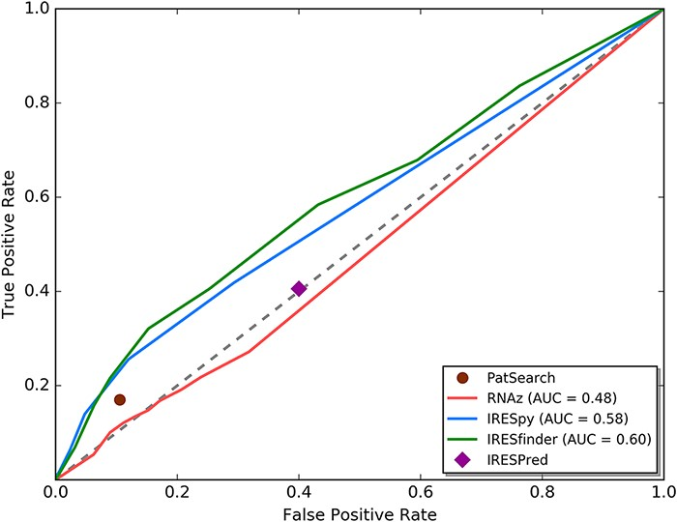
Figure 2. ROC curve analysis for currently available IRES prediction tools on 5ʹ UTRs.
Notes:
Figure 2. ROC curve analysis for currently available IRES prediction tools on 5ʹ UTRs. We used the ROC curve analysis technique to evaluate the results of different IRES prediction tools. From the ROC curve, RNAz and IRESPred have performance similar to random guessing. IRESfinder, IRESpy and PatSearch have AUC larger than 0.5. Based on this analysis, only IRESpy, PatSearch and IRESfinder are suitable for obtaining potential IRES elements in 5ʹ UTRs.
Unless provided in the caption above, the following copyright applies to the content of this slide: © The Author(s) 2021. Published by Oxford University Press.This is an Open Access article distributed under the terms of the Creative Commons Attribution License (http://creativecommons.org/licenses/by/4.0/), which permits unrestricted reuse, distribution, and reproduction in any medium, provided the original work is properly cited.

Slide 3
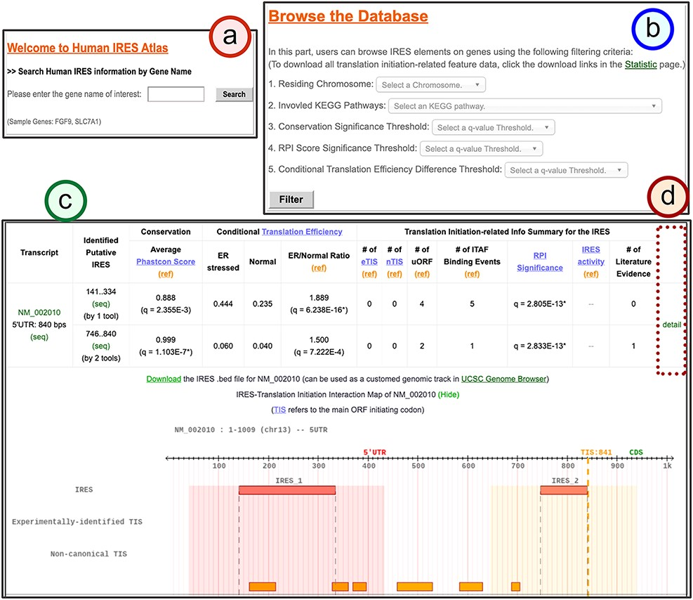
Figure 3. The search result page for the identified IRESs of a given gene.
Notes:
Figure 3. The search result page for the identified IRESs of a given gene. (a) The search mode: users can type in the gene of interest to search for the identified IRESs on the given gene transcripts. (b) The browse mode: users can filter out the IRESs categorized by their residing chromosomes, annotated KEGG pathways of the regulated genes and the thresholds of IRES functionality q-values. (c) The result table for the identified IRES elements in all transcript isoforms of the queried gene. In this table, three IRES functionality test results and other translational regulatory features for each identified IRES element are summarized. (d) The link to the detail page of the selected transcript.
Unless provided in the caption above, the following copyright applies to the content of this slide: © The Author(s) 2021. Published by Oxford University Press.This is an Open Access article distributed under the terms of the Creative Commons Attribution License (http://creativecommons.org/licenses/by/4.0/), which permits unrestricted reuse, distribution, and reproduction in any medium, provided the original work is properly cited.

Slide 4
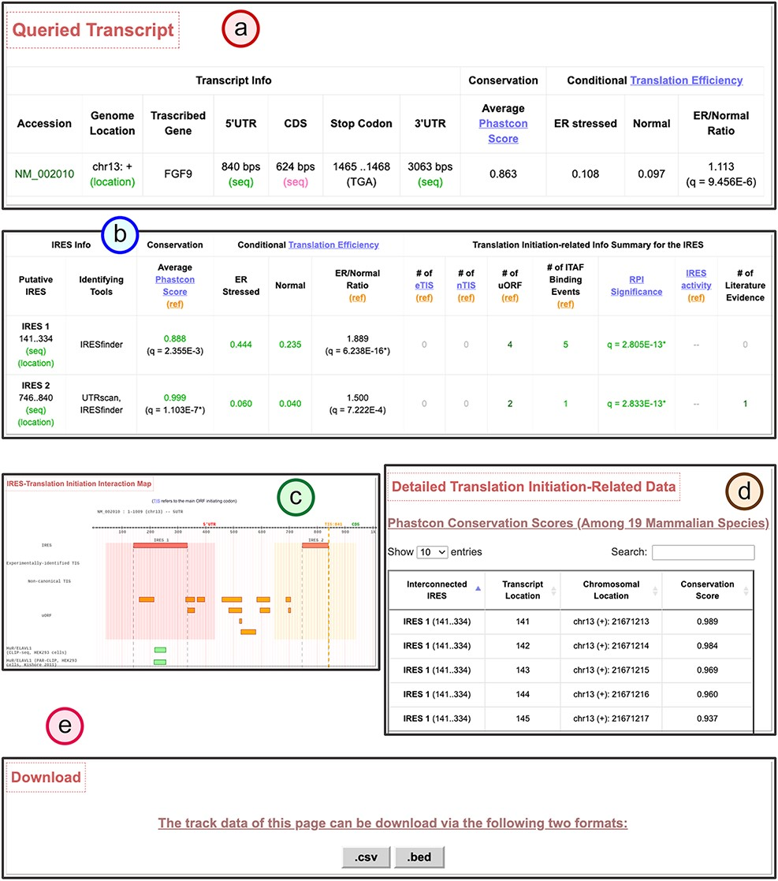
Figure 4. The transcript detail page showing the potential IRES-driven translation regulatory program of the given ...
Notes:
Figure 4. The transcript detail page showing the potential IRES-driven translation regulatory program of the given transcript. (a) The brief information table of the queried gene transcript. (b) The translation initiation–related feature summary table for the identified IRES elements within the queried gene transcript. (c) The IRES–translation initiation interaction map for the queried gene transcript. (d) The detail of the translation initiation–related feature data found for each IRES. (e) The download function to obtain the .csv or .bed formats of all information in the detail page.
Unless provided in the caption above, the following copyright applies to the content of this slide: © The Author(s) 2021. Published by Oxford University Press.This is an Open Access article distributed under the terms of the Creative Commons Attribution License (http://creativecommons.org/licenses/by/4.0/), which permits unrestricted reuse, distribution, and reproduction in any medium, provided the original work is properly cited.

Slide 5
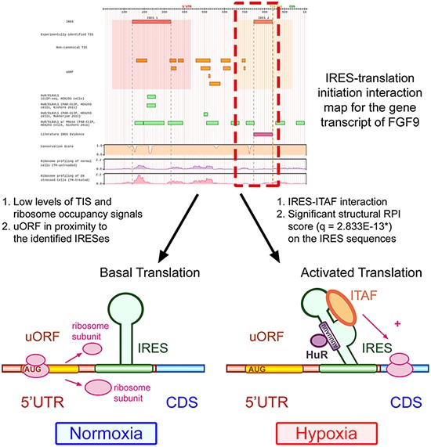
Figure 5. Human IRES Atlas helps suggest testable IRES-mediated translational regulation mechanism hypotheses.
Notes:
Figure 5. Human IRES Atlas helps suggest testable IRES-mediated translational regulation mechanism hypotheses. For the FGF9 5ʹ UTR, the IRES–translation initiation interaction map suggests that (1) the transcript is of low translation level and (2) some regulatory program between the RPI interpretable IRESs, the nearby uORFs and some ITAFs may exist. From experimental literature evidence, we know that the uORF represses FGF9 protein synthesis in normal conditions. Some ITAFs bind to the IRES to start cap-independent translation under hypoxia, verifying the testable hypotheses suggested by the constructed database.
Unless provided in the caption above, the following copyright applies to the content of this slide: © The Author(s) 2021. Published by Oxford University Press.This is an Open Access article distributed under the terms of the Creative Commons Attribution License (http://creativecommons.org/licenses/by/4.0/), which permits unrestricted reuse, distribution, and reproduction in any medium, provided the original work is properly cited.

