Slide 1
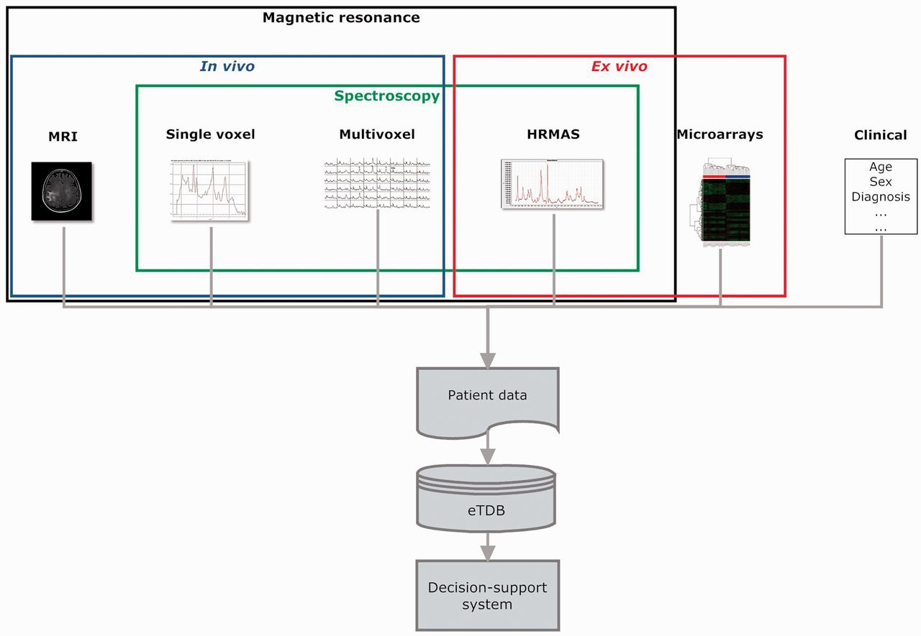
Figure 1 Overview of the eT project with respect to data. The database is built on the concept of patient and each ...
Notes:
Figure 1 Overview of the eT project with respect to data. The database is built on the concept of patient and each patient has different data types.
Unless provided in the caption above, the following copyright applies to the content of this slide: © The Author(s) 2012. Published by Oxford University Press.This is an Open Access article distributed under the terms of the Creative Commons Attribution License (http://creativecommons.org/licenses/by-nc/3.0/), which permits non-commercial reuse, distribution, and reproduction in any medium, provided the original work is properly cited. For commercial re-use, please contact journals.permissions@oup.com.

Slide 2
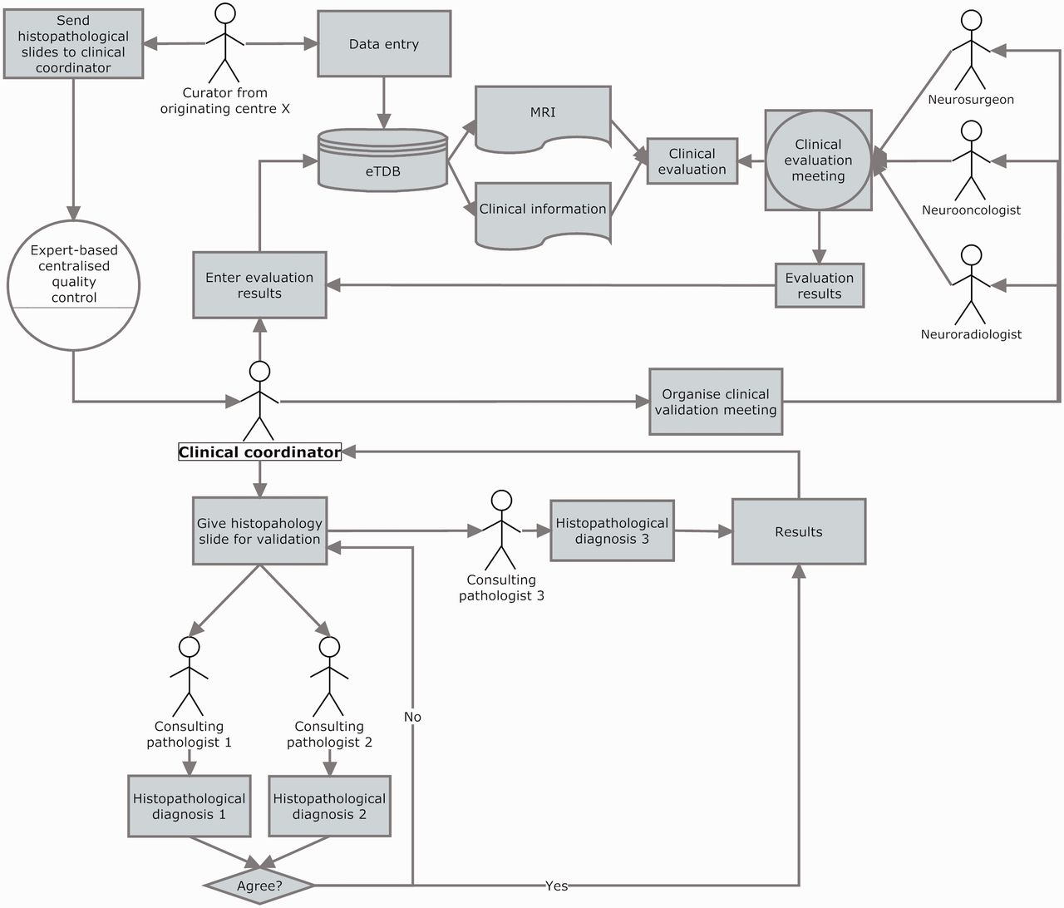
Figure 6 Clinical data validation. The review was internally coordinated by a clinical coordinator that collected all ...
Notes:
Figure 6 Clinical data validation. The review was internally coordinated by a clinical coordinator that collected all the results and entered them into the eTDB. This person was in charge of gathering the results of the clinical meetings, organizing the slides distribution among neuropathologists, collecting their diagnoses and entering all this meta-data for all the centres into the eTDB. In this case, the permission schema for this user was that of a senior curator and specifically tailored for this sole purpose.
Unless provided in the caption above, the following copyright applies to the content of this slide: © The Author(s) 2012. Published by Oxford University Press.This is an Open Access article distributed under the terms of the Creative Commons Attribution License (http://creativecommons.org/licenses/by-nc/3.0/), which permits non-commercial reuse, distribution, and reproduction in any medium, provided the original work is properly cited. For commercial re-use, please contact journals.permissions@oup.com.

Slide 3
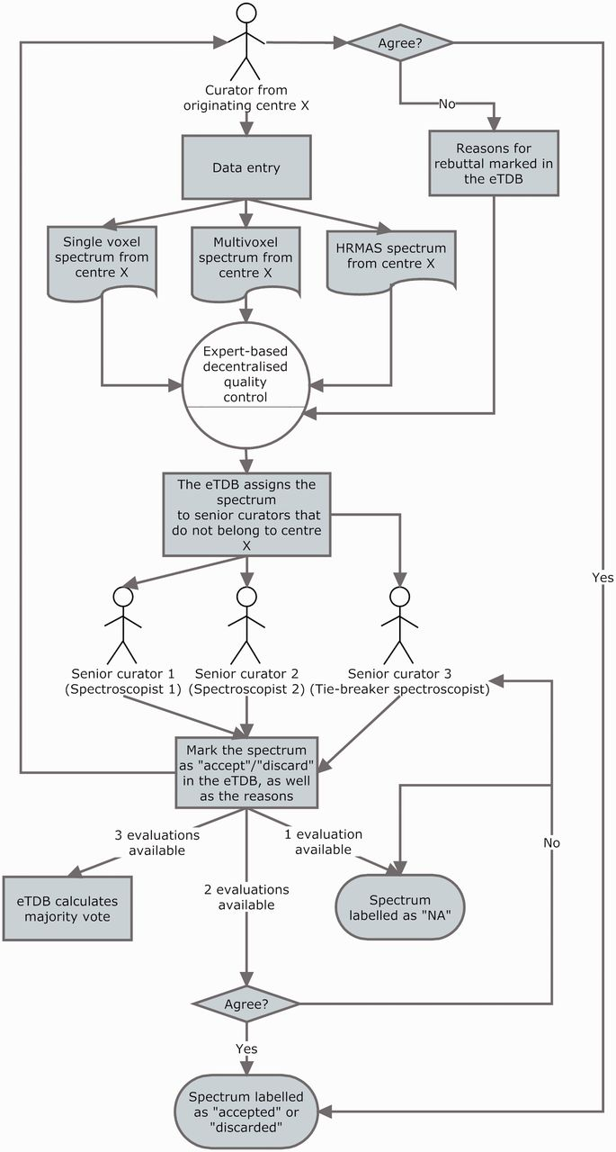
Figure 5 The three-expert system for spectroscopic QC of SV, MV and HRMAS. Two ES decided on the quality of the ...
Notes:
Figure 5 The three-expert system for spectroscopic QC of SV, MV and HRMAS. Two ES decided on the quality of the spectrum based on its empirical examination and a third one, a potential tie-breaker evaluated in case of disagreement. The spectrum could be accepted or discarded, and the instrumental reasons for it could also be stated if deemed necessary, e.g. poor signal-to-noise ratio (SNR), insufficient water suppression or signals from the scalp lipids (12). The system calculated, which was the majority vote and filled in the consensus decision that constituted another searchable meta-data field. It was as well possible that the original spectroscopist rebutted the final consensus decision and then, each of the ES could also change their verdict and state why they had changed their opinion. All these actions had specific meta-data fields. For SV spectra, the fields for ES validation were replicated, because depending on the format, it was possible to have an automatically processed spectrum or not, in which case, a manually processed one had to be entered. For MV data, because there was no automatic processing pipeline available, only expert-based meta-data fields were available. HRMAS validation was performed similarly to MV.
Unless provided in the caption above, the following copyright applies to the content of this slide: © The Author(s) 2012. Published by Oxford University Press.This is an Open Access article distributed under the terms of the Creative Commons Attribution License (http://creativecommons.org/licenses/by-nc/3.0/), which permits non-commercial reuse, distribution, and reproduction in any medium, provided the original work is properly cited. For commercial re-use, please contact journals.permissions@oup.com.

Slide 4
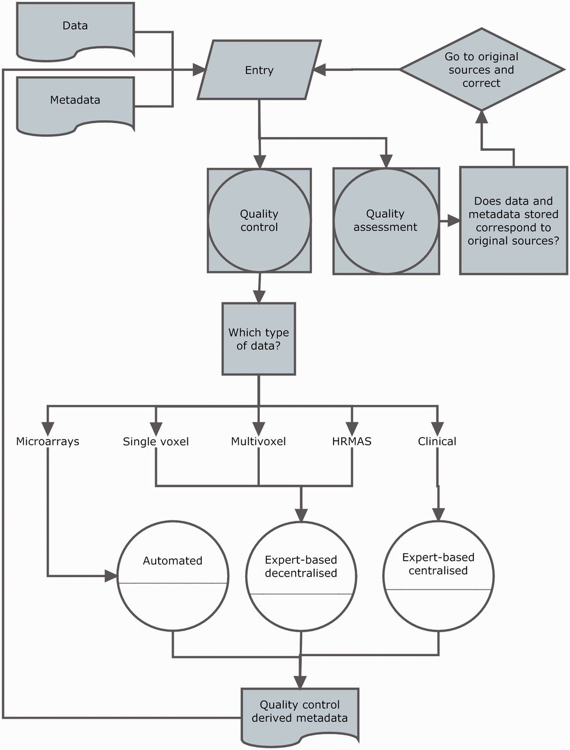
Figure 4 Curation workflow. Diagram showing the data entry, the three types of quality control (white circles), ...
Notes:
Figure 4 Curation workflow. Diagram showing the data entry, the three types of quality control (white circles), quality assurance and how they relate to different data types and meta-data and to each other.
Unless provided in the caption above, the following copyright applies to the content of this slide: © The Author(s) 2012. Published by Oxford University Press.This is an Open Access article distributed under the terms of the Creative Commons Attribution License (http://creativecommons.org/licenses/by-nc/3.0/), which permits non-commercial reuse, distribution, and reproduction in any medium, provided the original work is properly cited. For commercial re-use, please contact journals.permissions@oup.com.

Slide 5
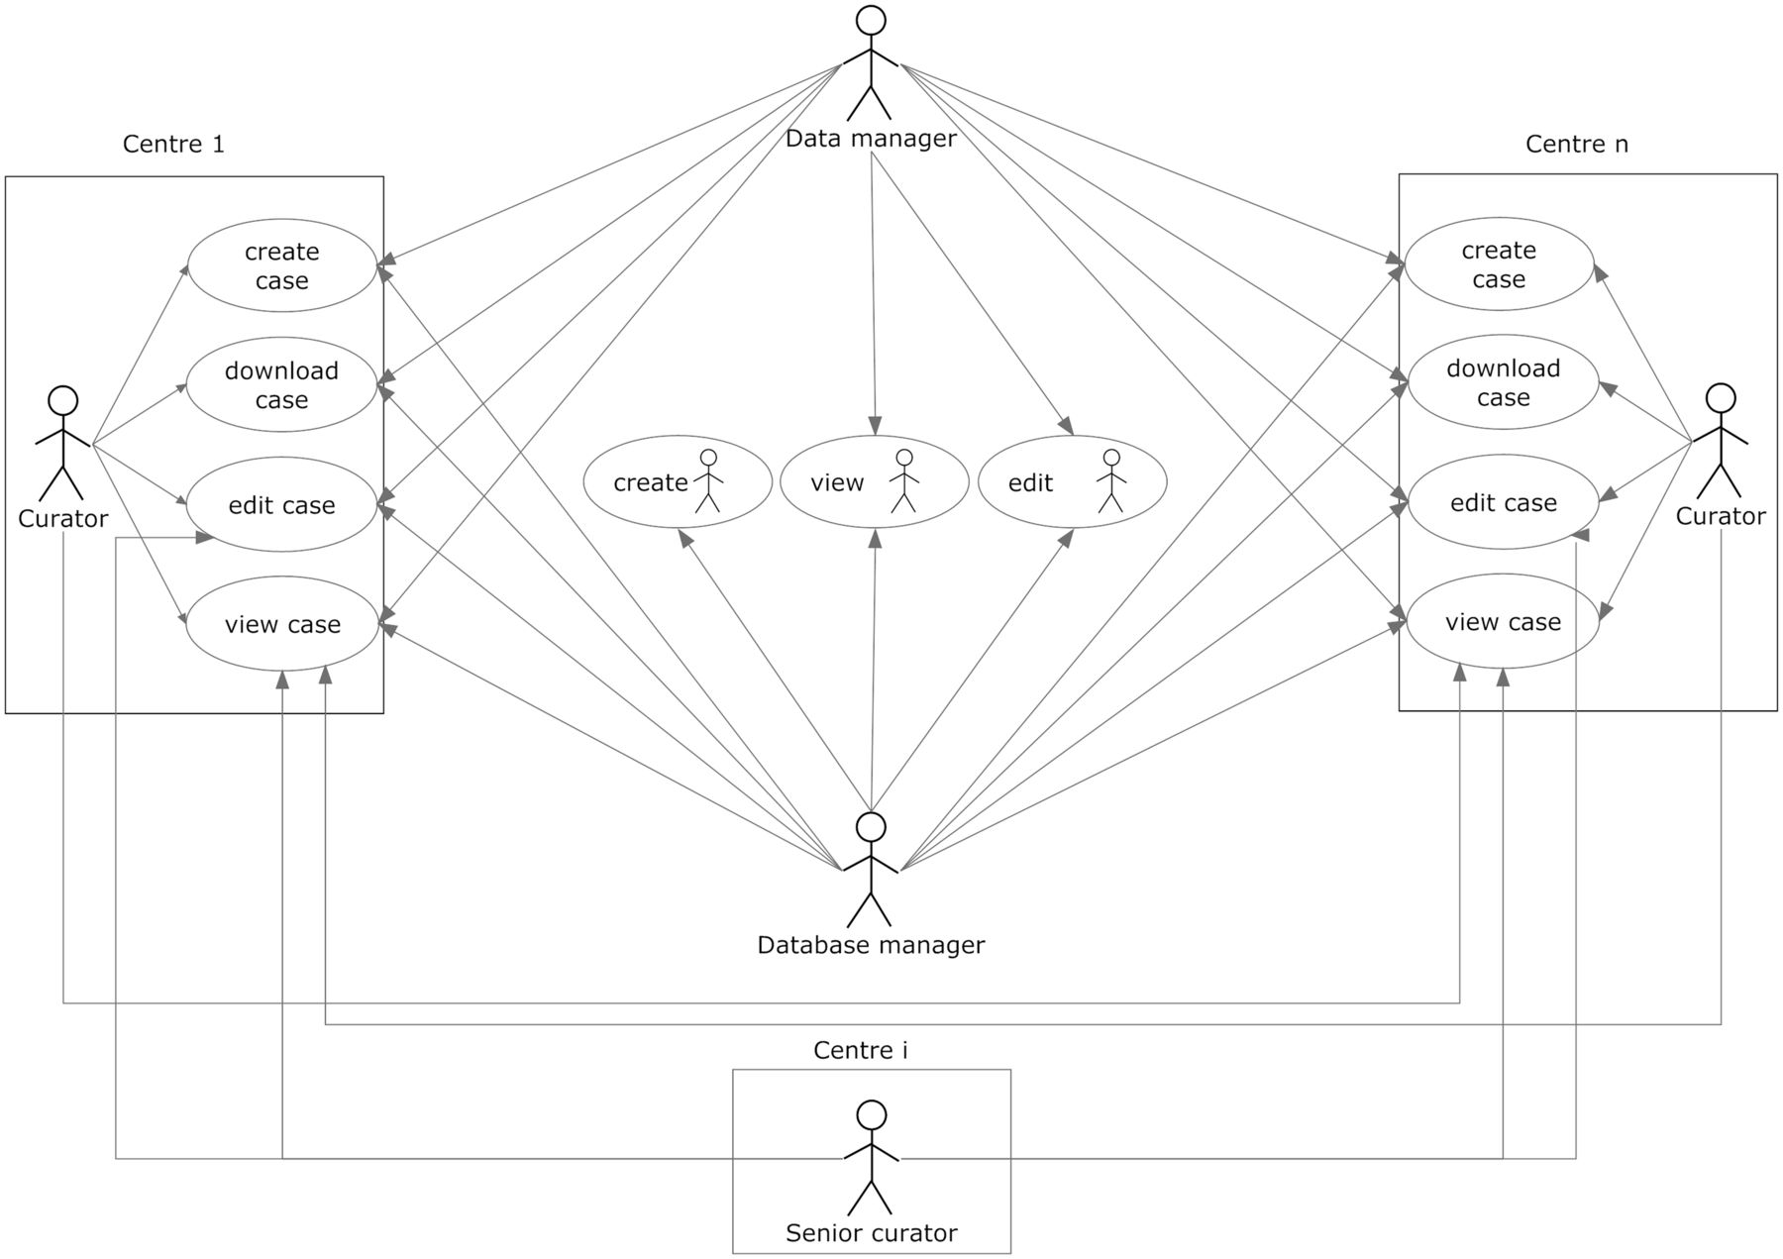
Figure 3 User roles and their permissions. Permissions to perform the different tasks are stored within the database ...
Notes:
Figure 3 User roles and their permissions. Permissions to perform the different tasks are stored within the database and are based on the centre the user belongs to.
Unless provided in the caption above, the following copyright applies to the content of this slide: © The Author(s) 2012. Published by Oxford University Press.This is an Open Access article distributed under the terms of the Creative Commons Attribution License (http://creativecommons.org/licenses/by-nc/3.0/), which permits non-commercial reuse, distribution, and reproduction in any medium, provided the original work is properly cited. For commercial re-use, please contact journals.permissions@oup.com.

Slide 6
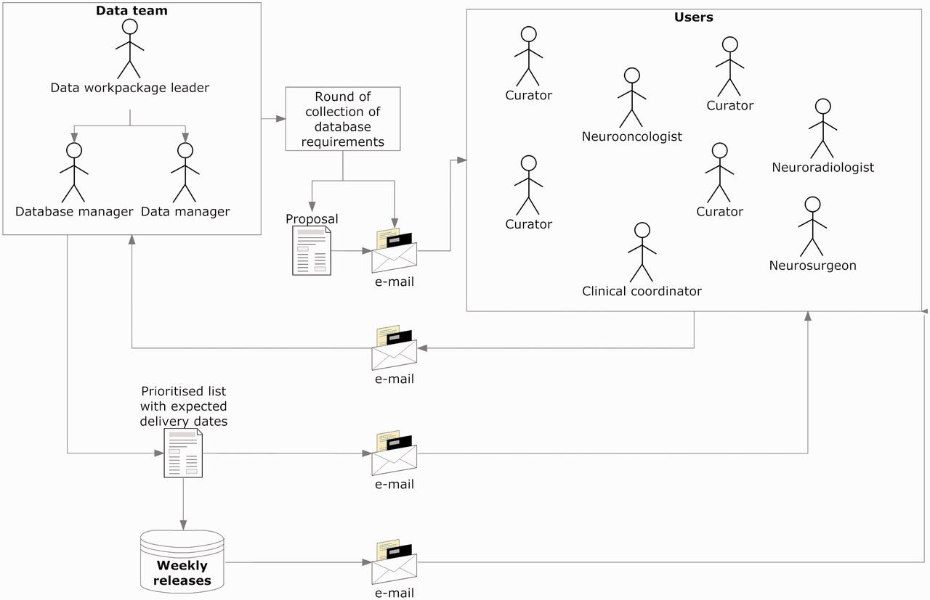
Figure 2 Collecting and implementing specifications. The data manager announced a round of collection of ...
Notes:
Figure 2 Collecting and implementing specifications. The data manager announced a round of collection of specifications, with a deadline for receiving comments and counterproposals (1–2 weeks). Generally, all requirements were incorporated, except those clearly not feasible. In case of conflicting requirements, the data team prioritized after discussion with the users making the request. Implementations were transparent to users, and when the service had to be interrupted to upload the changes, the database manager sent an announcement to the general mailing list.
Unless provided in the caption above, the following copyright applies to the content of this slide: © The Author(s) 2012. Published by Oxford University Press.This is an Open Access article distributed under the terms of the Creative Commons Attribution License (http://creativecommons.org/licenses/by-nc/3.0/), which permits non-commercial reuse, distribution, and reproduction in any medium, provided the original work is properly cited. For commercial re-use, please contact journals.permissions@oup.com.

Slide 7
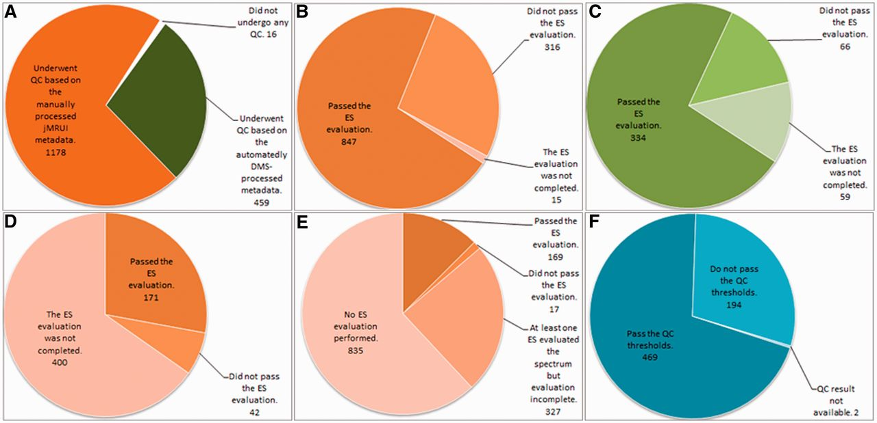
Figure 7 Summary results of the QC over the different data types. (A) Number of cases undergoing SV QC; (B) Results of ...
Notes:
Figure 7 Summary results of the QC over the different data types. (A) Number of cases undergoing SV QC; (B) Results of the SV QC over the spectra that had been manually processed with jMRUI. (C) Results of the SV QC over the spectra that had been automatically processed with the DMS. (D) Results of the MV QC, all processing being manual. (E) Results of the HRMAS QC, all processing being manual. (F) Results of the automated microarray QC.
Unless provided in the caption above, the following copyright applies to the content of this slide: © The Author(s) 2012. Published by Oxford University Press.This is an Open Access article distributed under the terms of the Creative Commons Attribution License (http://creativecommons.org/licenses/by-nc/3.0/), which permits non-commercial reuse, distribution, and reproduction in any medium, provided the original work is properly cited. For commercial re-use, please contact journals.permissions@oup.com.

Slide 8
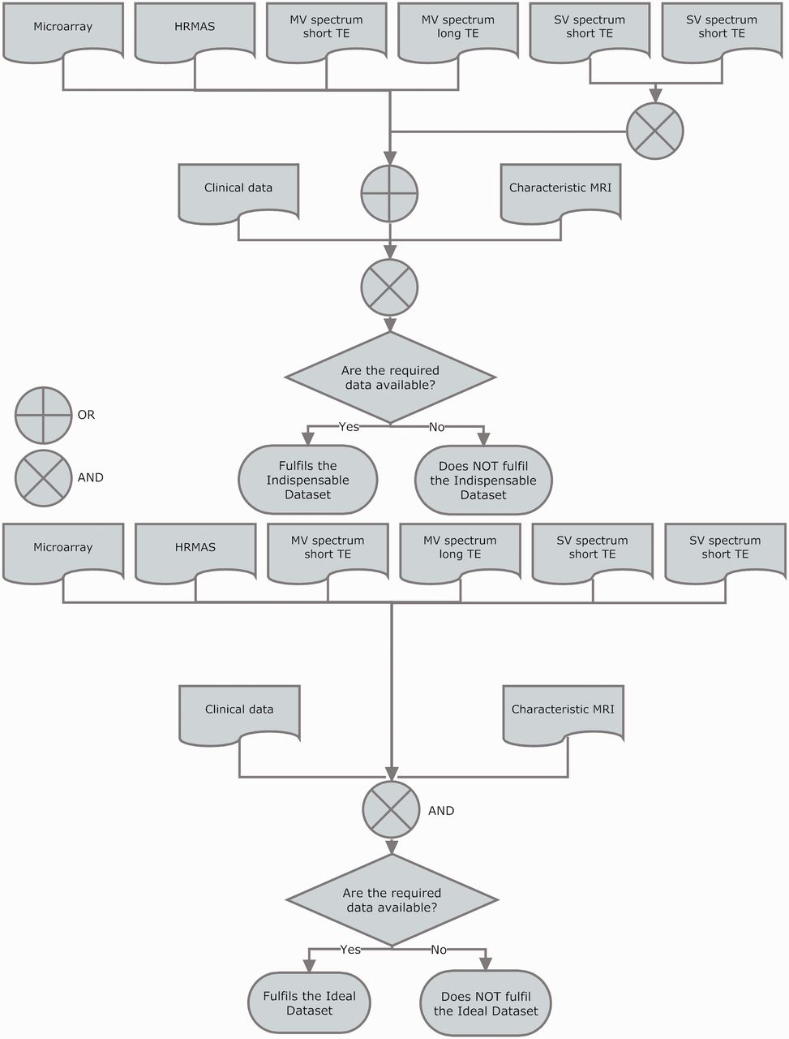
Figure 8 Indispensable (top) and ideal (bottom) datasets. For a case to fulfil the indispensable dataset, sufficient ...
Notes:
Figure 8 Indispensable (top) and ideal (bottom) datasets. For a case to fulfil the indispensable dataset, sufficient clinical information for performing the CDV had to be available. Sufficient clinical information was defined as the availability of: date of birth, sex, date of spectroscopy, at least one radiological classification (‘radiological diagnosis’ in the database), date of biopsy, paraffin section WHO (World Health Organization) classification (18, 19) (originating pathologist), relevant radiodiagnostic images [a representative T1-weighted image without contrast, a representative T2-weighted image and a representative image with voxel position(s) for the SV or the MV MRS]. In addition, the following data types were also needed to complete the indispensable dataset: one pair of MRS SV at short and long TE (except for rare cases such as childhood tumours and adults with small tumours where one echo time was acceptable), or one MRS MV at short TE, or one MRS MV at long TE, or HRMAS data, or one valid microarray.
Unless provided in the caption above, the following copyright applies to the content of this slide: © The Author(s) 2012. Published by Oxford University Press.This is an Open Access article distributed under the terms of the Creative Commons Attribution License (http://creativecommons.org/licenses/by-nc/3.0/), which permits non-commercial reuse, distribution, and reproduction in any medium, provided the original work is properly cited. For commercial re-use, please contact journals.permissions@oup.com.

Slide 9
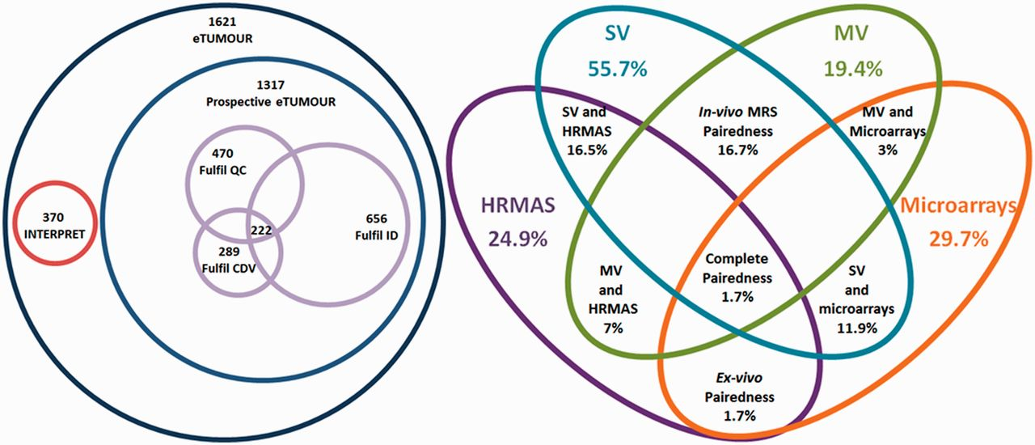
Figure 9 Venn diagrams of the main metrics defined. Left: number of cases by origin (INTERPRET or prospective eT), ...
Notes:
Figure 9 Venn diagrams of the main metrics defined. Left: number of cases by origin (INTERPRET or prospective eT), with numbers fulfilling the QC, the CDV and the ID and the intersection of all three. Size of Venn diagrams is proportional to the number of cases. Right: different pairedness values (intersections), with completeness for each data type. Values are expressed in percentage of cases from the total 1621. Size of Venn diagrams is not proportional to percentages.
Unless provided in the caption above, the following copyright applies to the content of this slide: © The Author(s) 2012. Published by Oxford University Press.This is an Open Access article distributed under the terms of the Creative Commons Attribution License (http://creativecommons.org/licenses/by-nc/3.0/), which permits non-commercial reuse, distribution, and reproduction in any medium, provided the original work is properly cited. For commercial re-use, please contact journals.permissions@oup.com.

