Slide 1
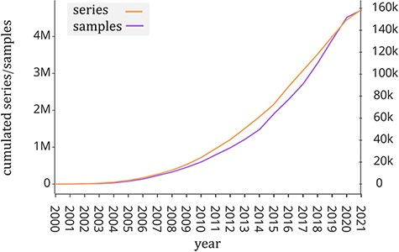
Figure 1. Number of samples (GSM, left y-axis) and experiments (GSE, right y-axis) made available by the GEO portal; ...
Notes:
Figure 1. Number of samples (GSM, left y-axis) and experiments (GSE, right y-axis) made available by the GEO portal; raw data were extracted from https://www.ncbi.nlm.nih.gov/geo/browse/?view=samples and https://www.ncbi.nlm.nih.gov/geo/browse/?view=series).
Unless provided in the caption above, the following copyright applies to the content of this slide: © The Author(s) 2022. Published by Oxford University Press.This is an Open Access article distributed under the terms of the Creative Commons Attribution License (https://creativecommons.org/licenses/by/4.0/), which permits unrestricted reuse, distribution, and reproduction in any medium, provided the original work is properly cited.

