Slide 1
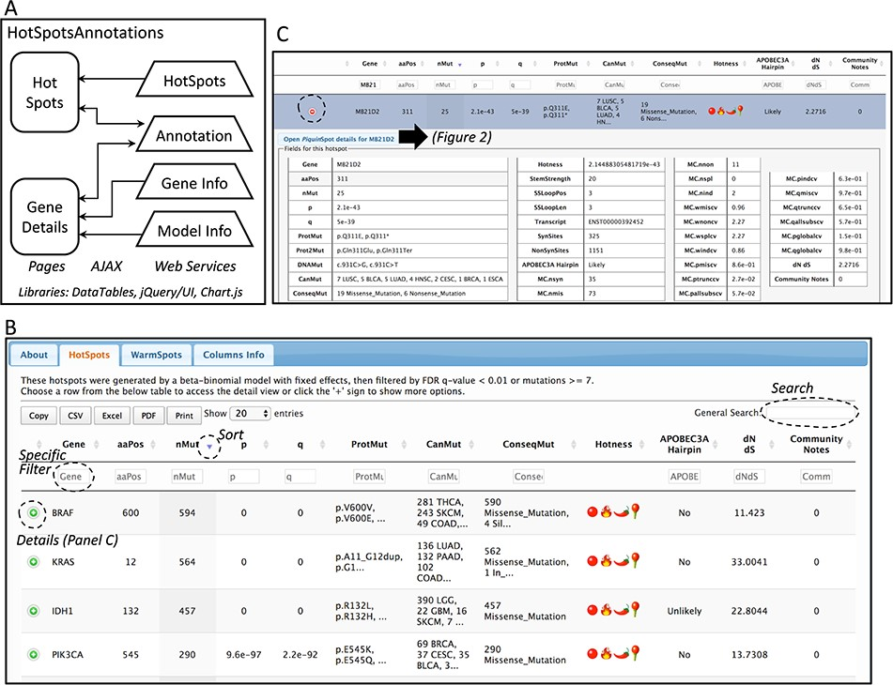
Figure 1 Database web implementation. (A) Implementation. There are two web pages, ‘Hot-Spots’ which list all ...
Notes:
Figure 1 Database web implementation. (A) Implementation. There are two web pages, ‘Hot-Spots’ which list all hotspots, and ‘Gene Details’ which shows the details for the gene including all mutations and hotspots. There are four web services that provides the data for the pages (HotSpots, Annotation, Gene Info and Model Info). Examples of the web pages are shown in B and C and in Figure 2. (B) The first web page listing all hotspots. The list can be filtered, searched, exported and selected to open details. (C) Example of the estimation details for a hotspot.
Unless provided in the caption above, the following copyright applies to the content of this slide: © The Author(s) 2020. Published by Oxford University Press.This is an Open Access article distributed under the terms of the Creative Commons Attribution License (http://creativecommons.org/licenses/by/4.0/), which permits unrestricted reuse, distribution, and reproduction in any medium, provided the original work is properly cited.

Slide 2
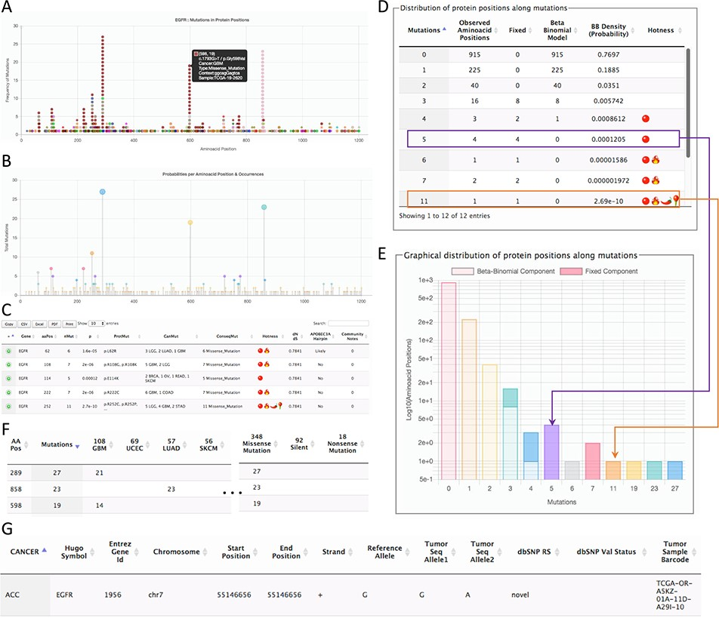
Figure 2 Page for the gene details. The example shows parts of the data shown for the gene EGFR. (A) All mutations in ...
Notes:
Figure 2 Page for the gene details. The example shows parts of the data shown for the gene EGFR. (A) All mutations in coding regions piled up per position. Pointing to a mutation, a floating tip show details of the mutation. (B) Raw count of mutations per position. (C) Detected hotspots for the current gene. (D) Distribution of mutations used to fit the beta-binomial model. (E) Graphical representation of the distribution of mutations and fitted model. (F) Mutations along cancer types per hotspot. (G) List of all mutations per gene.
Unless provided in the caption above, the following copyright applies to the content of this slide: © The Author(s) 2020. Published by Oxford University Press.This is an Open Access article distributed under the terms of the Creative Commons Attribution License (http://creativecommons.org/licenses/by/4.0/), which permits unrestricted reuse, distribution, and reproduction in any medium, provided the original work is properly cited.

Slide 3
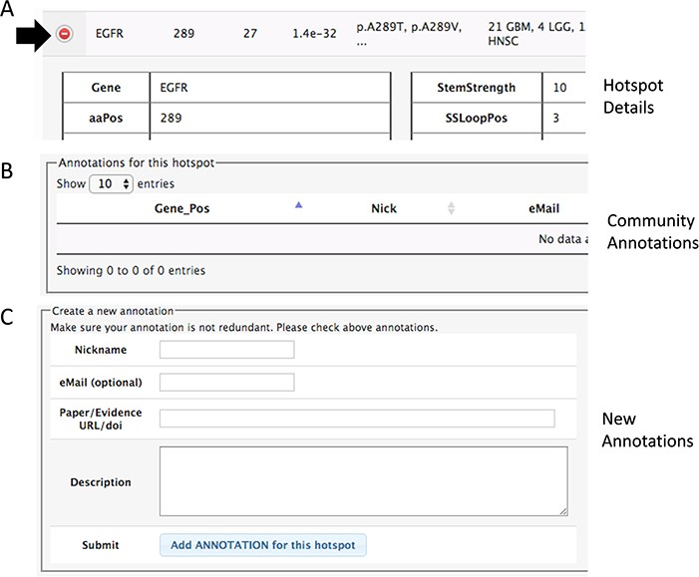
Figure 3 Section of the details to add community annotations. (A) Option to show details. (B) Current community ...
Notes:
Figure 3 Section of the details to add community annotations. (A) Option to show details. (B) Current community annotations for that hotspot. (C) Form to add new user annotations.
Unless provided in the caption above, the following copyright applies to the content of this slide: © The Author(s) 2020. Published by Oxford University Press.This is an Open Access article distributed under the terms of the Creative Commons Attribution License (http://creativecommons.org/licenses/by/4.0/), which permits unrestricted reuse, distribution, and reproduction in any medium, provided the original work is properly cited.

