Slide 1
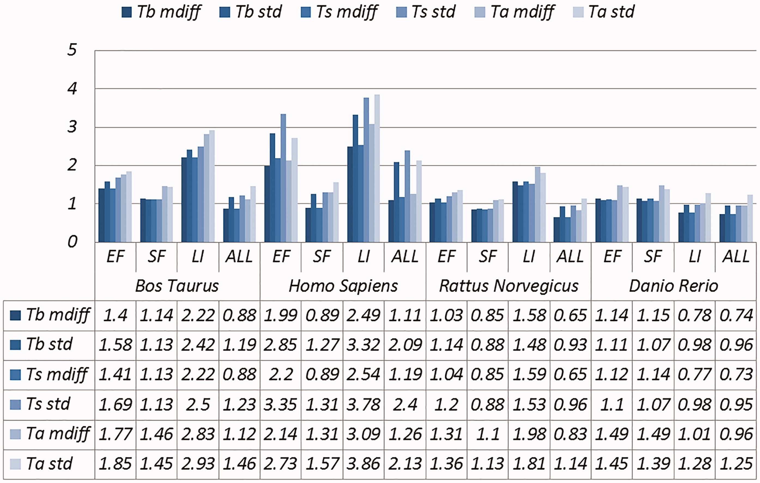
Figure 4. A selection of results for organisms in terms of melting temperatures (Exemplar vs. Duplicate pairs) mdiff ...
Notes:
Figure 4. A selection of results for organisms in terms of melting temperatures (Exemplar vs. Duplicate pairs) mdiff and std: the mean and standard deviation of absolute value of the difference between each exemplar and the mean of the original group, respectively; Tb, Ts, Ta: melting temperature calculated using basic, salted and advanced formula in supplement, respectively.
Unless provided in the caption above, the following copyright applies to the content of this slide: © The Author(s) 2017. Published by Oxford University Press.This is an Open Access article distributed under the terms of the Creative Commons Attribution License (http://creativecommons.org/licenses/by/4.0/), which permits unrestricted reuse, distribution, and reproduction in any medium, provided the original work is properly cited.

