Slide 1
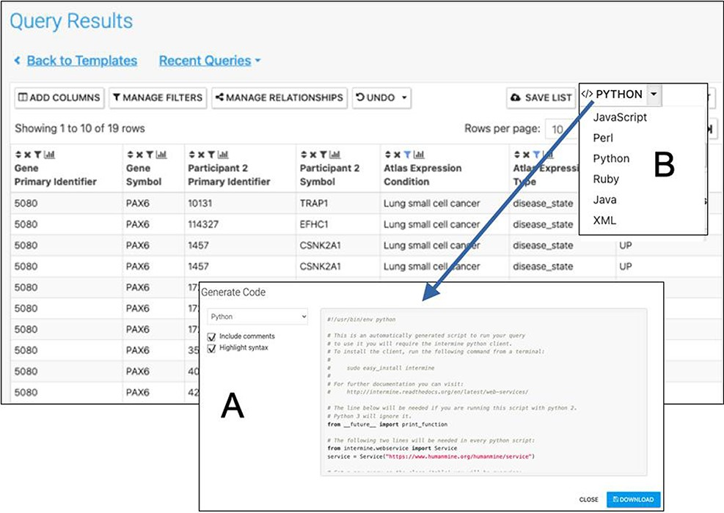
Figure 9. Automatic code generation. From any results table, it is possible to view and copy code for the underlying ...
Notes:
Figure 9. Automatic code generation. From any results table, it is possible to view and copy code for the underlying query in various programming languages. Here the python code for the Gene(s) + Disease Interactors + Disease Expression result is shown (A). Code for Python, Perl, Ruby, Javascript and Java is available (B).
Unless provided in the caption above, the following copyright applies to the content of this slide: © The Author(s) 2022. Published by Oxford University Press.This is an Open Access article distributed under the terms of the Creative Commons Attribution-NonCommercial License (https://creativecommons.org/licenses/by-nc/4.0/), which permits non-commercial re-use, distribution, and reproduction in any medium, provided the original work is properly cited. For commercial re-use, please contact journals.permissions@oup.com

