Slide 1
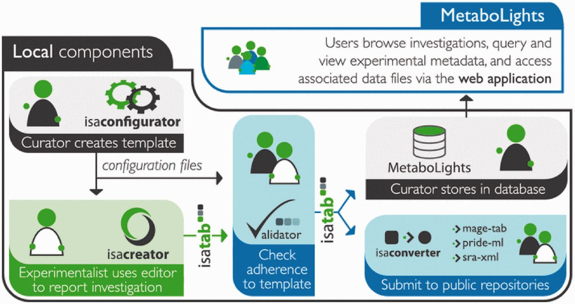
Figure 1. Showing a typical submissions pipeline using the ISA suite and submission to MetaboLights.
Notes:
Figure 1. Showing a typical submissions pipeline using the ISA suite and submission to MetaboLights.
Unless provided in the caption above, the following copyright applies to the content of this slide: © The Author(s) 2013. Published by Oxford University Press.This is an Open Access article distributed under the terms of the Creative Commons Attribution Non-Commercial License (http://creativecommons.org/licenses/by-nc/3.0/), which permits unrestricted non-commercial use, distribution, and reproduction in any medium, provided the original work is properly cited.

Slide 2
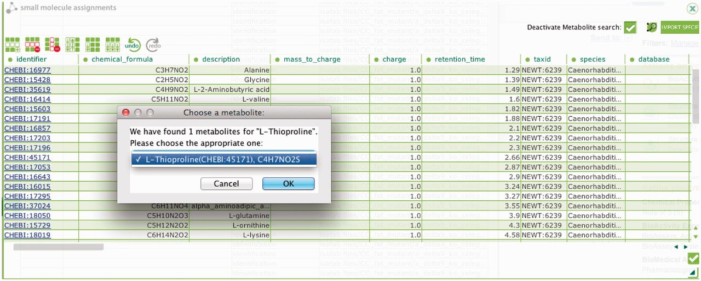
Figure 2. The ISAcreator plugin, capturing metabolites identified within the metabolomics experiments and mapped to the ...
Notes:
Figure 2. The ISAcreator plugin, capturing metabolites identified within the metabolomics experiments and mapped to the relevant chemical database.
Unless provided in the caption above, the following copyright applies to the content of this slide: © The Author(s) 2013. Published by Oxford University Press.This is an Open Access article distributed under the terms of the Creative Commons Attribution Non-Commercial License (http://creativecommons.org/licenses/by-nc/3.0/), which permits unrestricted non-commercial use, distribution, and reproduction in any medium, provided the original work is properly cited.

Slide 3
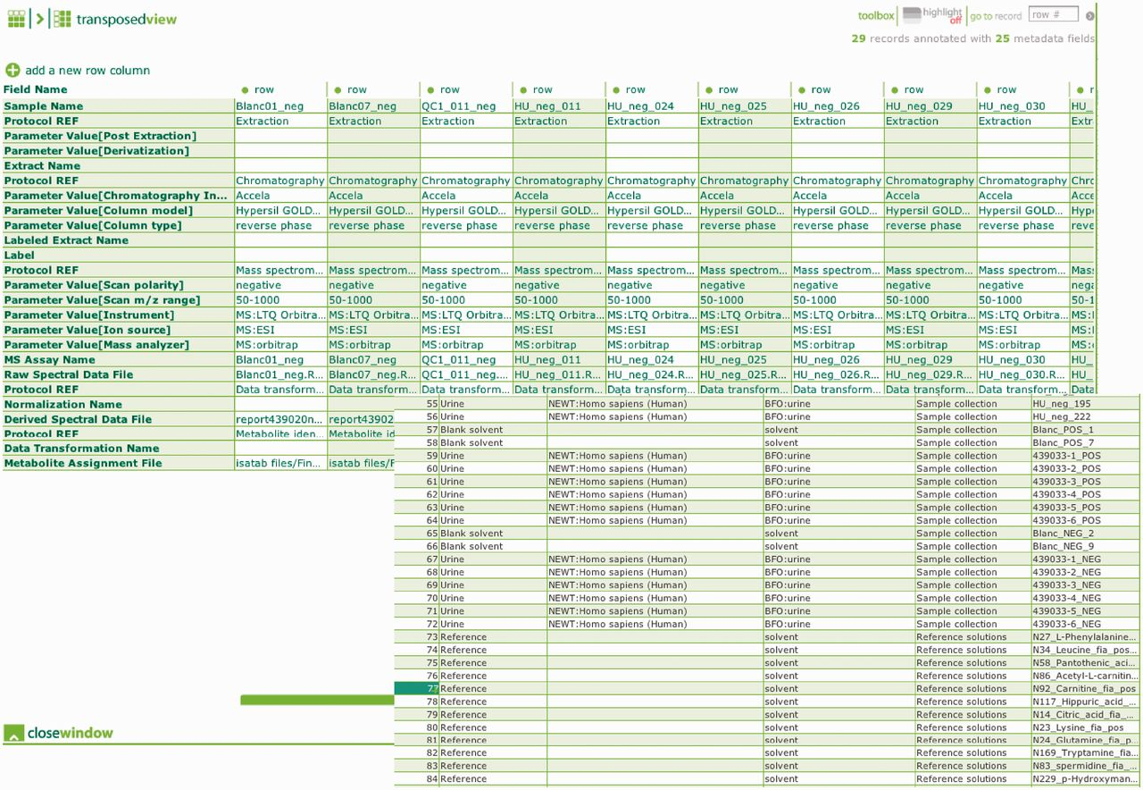
Figure 3. Overview of the ontology link instrumental and experimental metadata captured within ISAcreator, example ...
Notes:
Figure 3. Overview of the ontology link instrumental and experimental metadata captured within ISAcreator, example shows metadata for the samples, QC, blanks and reference chemical compounds.
Unless provided in the caption above, the following copyright applies to the content of this slide: © The Author(s) 2013. Published by Oxford University Press.This is an Open Access article distributed under the terms of the Creative Commons Attribution Non-Commercial License (http://creativecommons.org/licenses/by-nc/3.0/), which permits unrestricted non-commercial use, distribution, and reproduction in any medium, provided the original work is properly cited.

