Slide 1
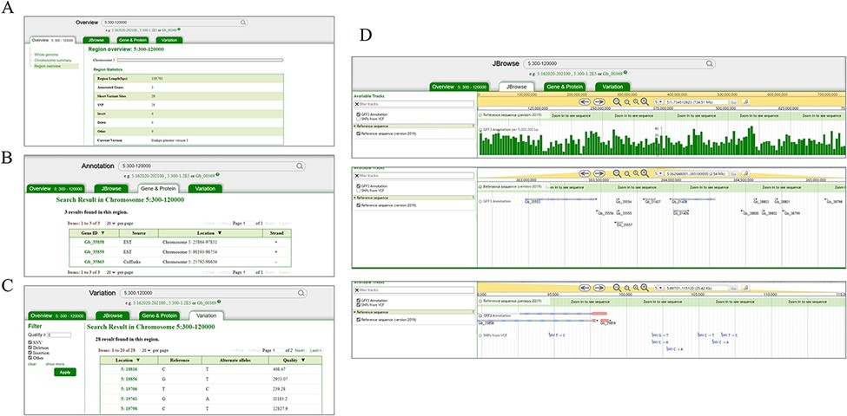
Figure 2. Search and result pages of GinkgoDB. Users can take a query for the specific genome segment or gene, which ...
Notes:
Figure 2. Search and result pages of GinkgoDB. Users can take a query for the specific genome segment or gene, which would return the summary (A), all the gene (B) and SNPs (C) of the queried region, a link to the JBrowse page (D).
Unless provided in the caption above, the following copyright applies to the content of this slide: © The Author(s) 2022. Published by Oxford University Press.This is an Open Access article distributed under the terms of the Creative Commons Attribution-NonCommercial License (https://creativecommons.org/licenses/by-nc/4.0/), which permits non-commercial re-use, distribution, and reproduction in any medium, provided the original work is properly cited. For commercial re-use, please contact journals.permissions@oup.com

