Slide 1
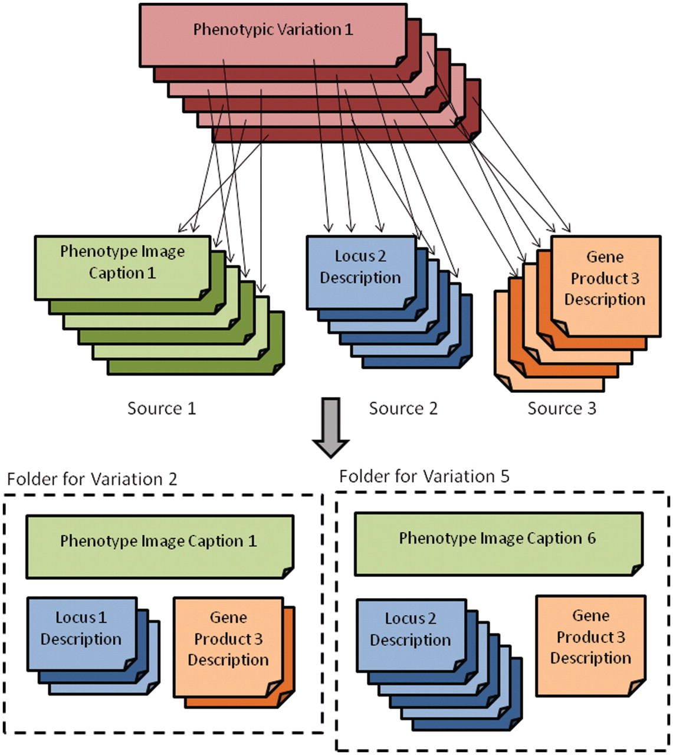
Figure 1. Depiction of the main grouping source and its relationship to the various text sources (top) as well as the ...
Notes:
Figure 1. Depiction of the main grouping source and its relationship to the various text sources (top) as well as the folder view (bottom) where related documents for phenotypic variations are grouped.
Unless provided in the caption above, the following copyright applies to the content of this slide: © The Author(s) 2011. Published by Oxford University Press.This is Open Access article distributed under the terms of the Creative Commons Attribution Non-Commercial License (http://creativecommons.org/licenses/by-nc/2.5), which permits unrestricted non-commercial use, distribution, and reproduction in any medium, provided the original work is properly cited.

Slide 2
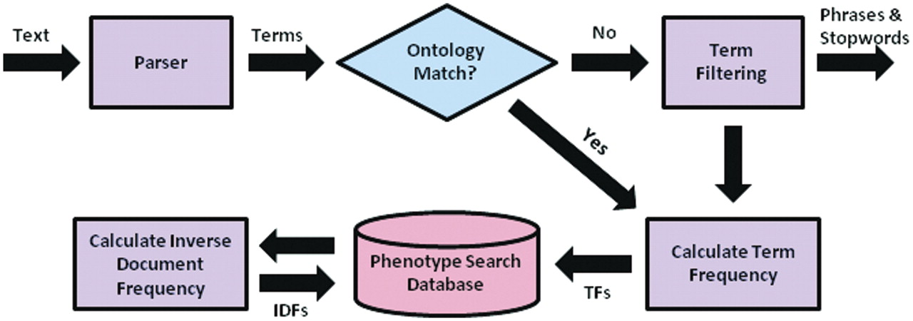
Figure 2. Preprocessing flow chart for the system, including parsing of text descriptions into individual term, ...
Notes:
Figure 2. Preprocessing flow chart for the system, including parsing of text descriptions into individual term, matching terms to ontological concepts, calculation of needed quantities for determining term weights, and insertion of terms and quantities into the MySQL database.
Unless provided in the caption above, the following copyright applies to the content of this slide: © The Author(s) 2011. Published by Oxford University Press.This is Open Access article distributed under the terms of the Creative Commons Attribution Non-Commercial License (http://creativecommons.org/licenses/by-nc/2.5), which permits unrestricted non-commercial use, distribution, and reproduction in any medium, provided the original work is properly cited.

Slide 3
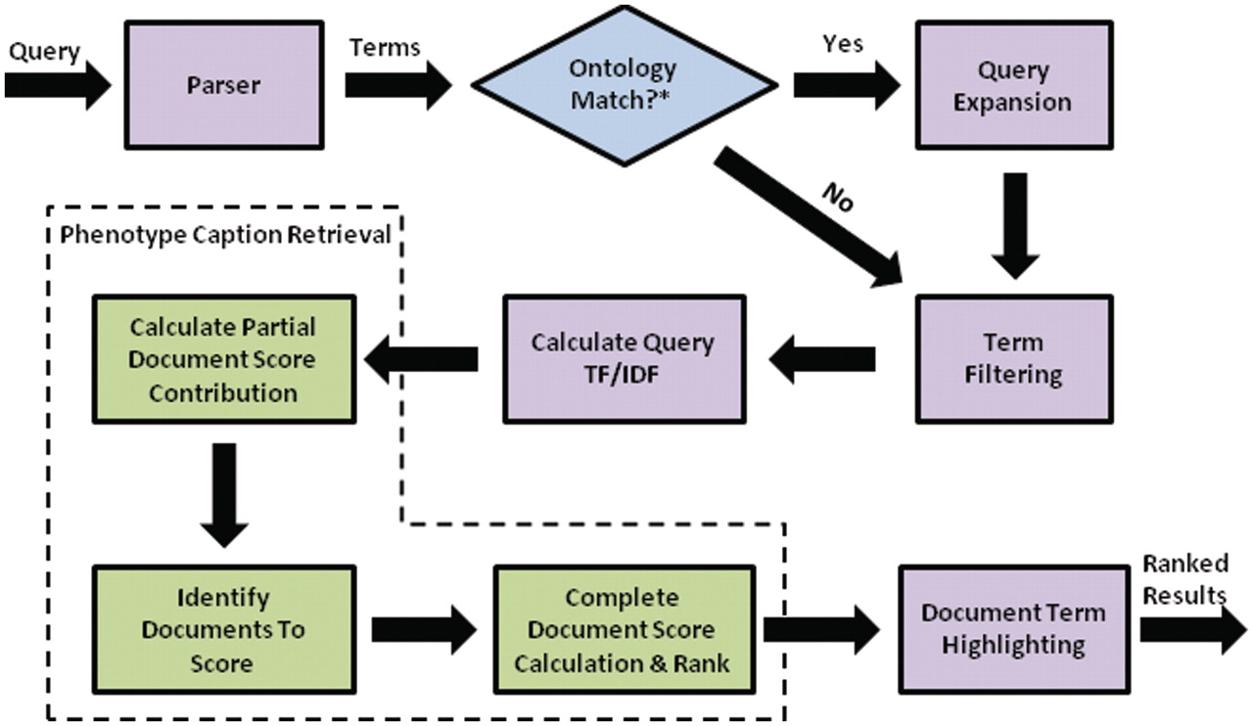
Figure 3. Flow chart for search engine retrieval, from query processing, to similarity calculations for individual text ...
Notes:
Figure 3. Flow chart for search engine retrieval, from query processing, to similarity calculations for individual text descriptions and folders, to ranking and highlighting of the search results.
Unless provided in the caption above, the following copyright applies to the content of this slide: © The Author(s) 2011. Published by Oxford University Press.This is Open Access article distributed under the terms of the Creative Commons Attribution Non-Commercial License (http://creativecommons.org/licenses/by-nc/2.5), which permits unrestricted non-commercial use, distribution, and reproduction in any medium, provided the original work is properly cited.

Slide 4
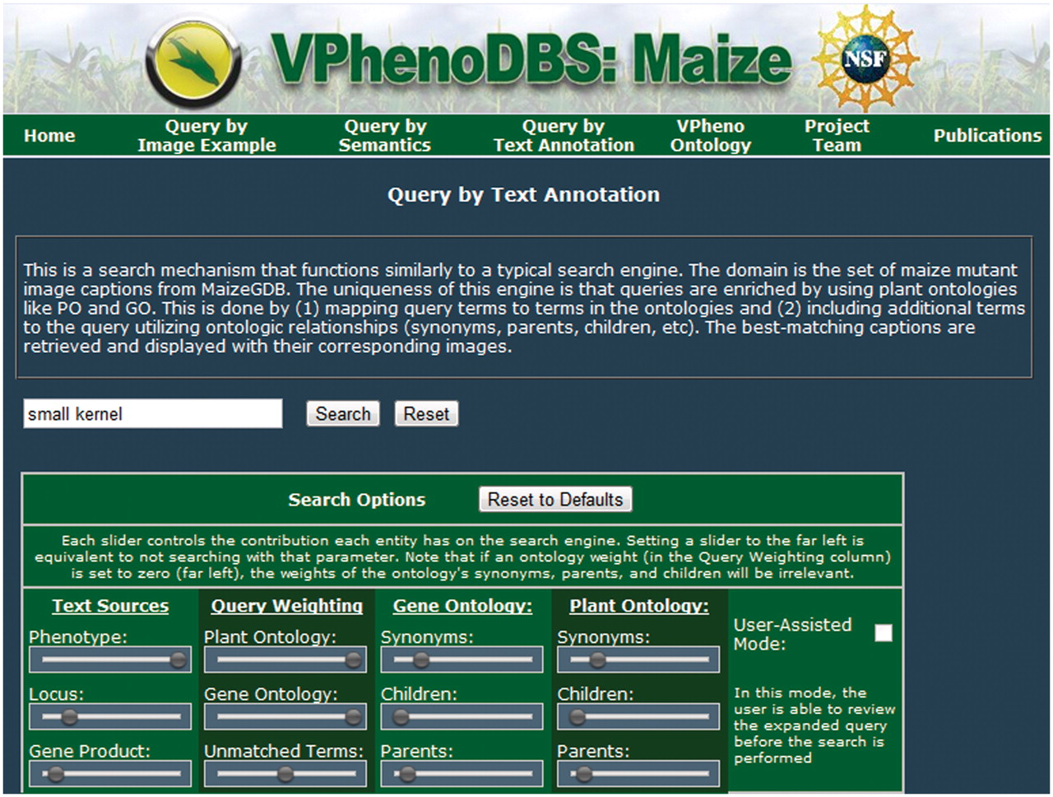
Figure 4. Query interface for the multi-source ontology-based retrieval engine for maize mutant phenotypes.
Notes:
Figure 4. Query interface for the multi-source ontology-based retrieval engine for maize mutant phenotypes.
Unless provided in the caption above, the following copyright applies to the content of this slide: © The Author(s) 2011. Published by Oxford University Press.This is Open Access article distributed under the terms of the Creative Commons Attribution Non-Commercial License (http://creativecommons.org/licenses/by-nc/2.5), which permits unrestricted non-commercial use, distribution, and reproduction in any medium, provided the original work is properly cited.

Slide 5
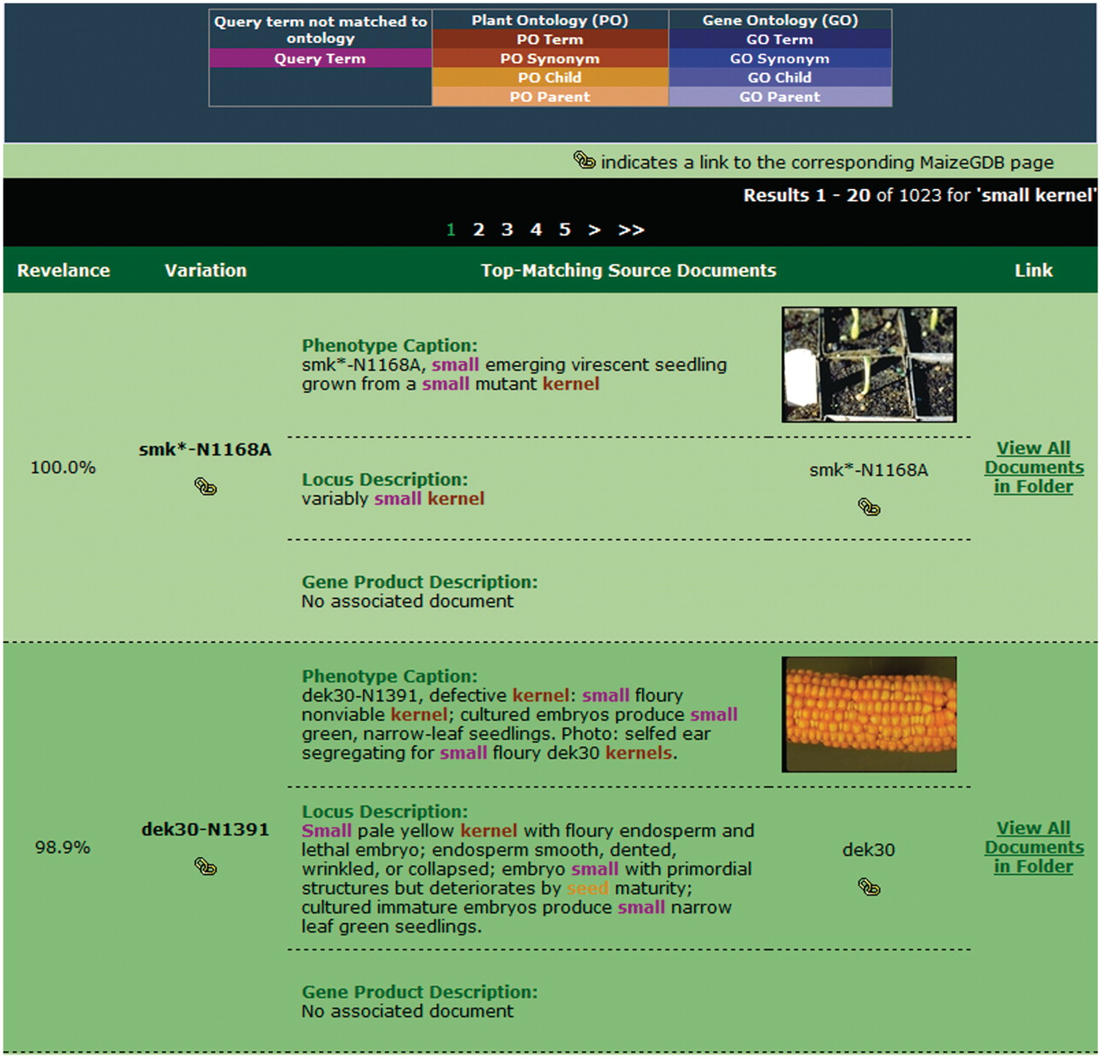
Figure 5. Sample search results for our retrieval engine using the query ‘small kernels’. Highlighted terms indicate ...
Notes:
Figure 5. Sample search results for our retrieval engine using the query ‘small kernels’. Highlighted terms indicate matches to the query (including original terms and terms included through query expansion), with the color providing information about the term.
Unless provided in the caption above, the following copyright applies to the content of this slide: © The Author(s) 2011. Published by Oxford University Press.This is Open Access article distributed under the terms of the Creative Commons Attribution Non-Commercial License (http://creativecommons.org/licenses/by-nc/2.5), which permits unrestricted non-commercial use, distribution, and reproduction in any medium, provided the original work is properly cited.

Slide 6
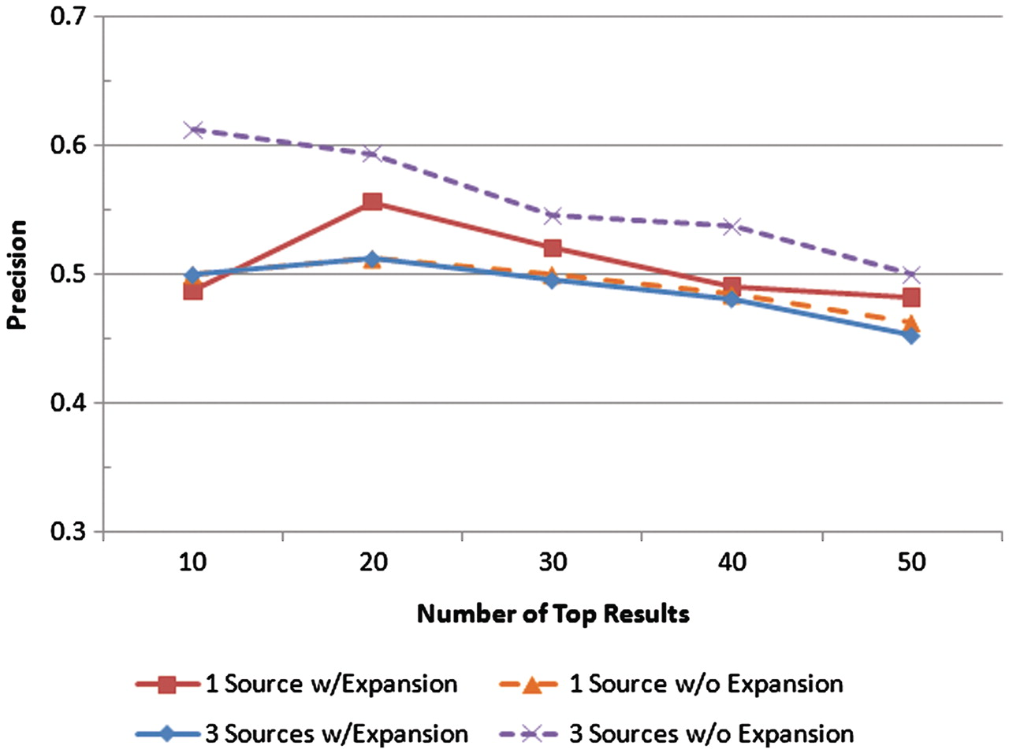
Figure 6. Precision was measured at the top 10, 20, 30, 40 and 50 results for four scenarios: one text source with ...
Notes:
Figure 6. Precision was measured at the top 10, 20, 30, 40 and 50 results for four scenarios: one text source with query expansion, one text source without query expansion, all three text sources with query expansion, and all three text sources without query expansion. The precision values at each of those levels for each scenario are shown.
Unless provided in the caption above, the following copyright applies to the content of this slide: © The Author(s) 2011. Published by Oxford University Press.This is Open Access article distributed under the terms of the Creative Commons Attribution Non-Commercial License (http://creativecommons.org/licenses/by-nc/2.5), which permits unrestricted non-commercial use, distribution, and reproduction in any medium, provided the original work is properly cited.

Slide 7
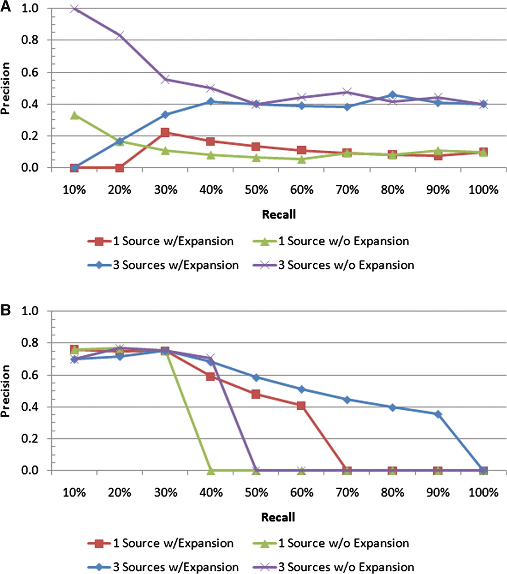
Figure 7. Precision–recall plots for two individual queries: (A) ‘ear’ and (B) ‘endosperm’. For the ‘endosperm query, ...
Notes:
Figure 7. Precision–recall plots for two individual queries: (A) ‘ear’ and (B) ‘endosperm’. For the ‘endosperm query, all four scenarios have similar precision values at low recall levels; however, the scenario with all the text sources and query expansion includes many more of the relevant documents in the result sets than the others, as indicated by the higher precision at the higher recall levels. For the ‘ear’ query, the best performance is achieved by all the text sources with no query expansion.
Unless provided in the caption above, the following copyright applies to the content of this slide: © The Author(s) 2011. Published by Oxford University Press.This is Open Access article distributed under the terms of the Creative Commons Attribution Non-Commercial License (http://creativecommons.org/licenses/by-nc/2.5), which permits unrestricted non-commercial use, distribution, and reproduction in any medium, provided the original work is properly cited.

Slide 8
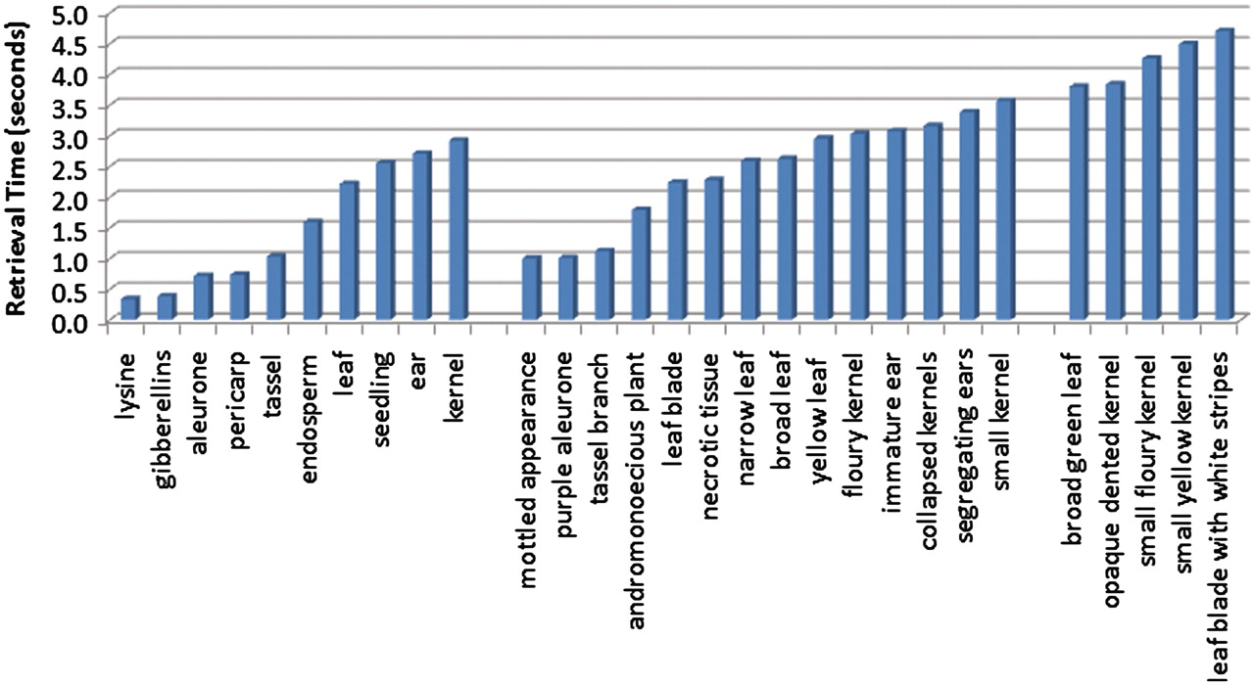
Figure 8. Average retrieval speeds for queries, ordered by query length. The leftmost group corresponds to the ...
Notes:
Figure 8. Average retrieval speeds for queries, ordered by query length. The leftmost group corresponds to the single-term queries, and these have the quickest execution times. The middle group contains queries consisting of two terms, and the query speeds for these are on average slightly slower than the single-term queries. The rightmost group of queries all contain three terms, and these are the most time consuming of the queries tested.
Unless provided in the caption above, the following copyright applies to the content of this slide: © The Author(s) 2011. Published by Oxford University Press.This is Open Access article distributed under the terms of the Creative Commons Attribution Non-Commercial License (http://creativecommons.org/licenses/by-nc/2.5), which permits unrestricted non-commercial use, distribution, and reproduction in any medium, provided the original work is properly cited.

Slide 9
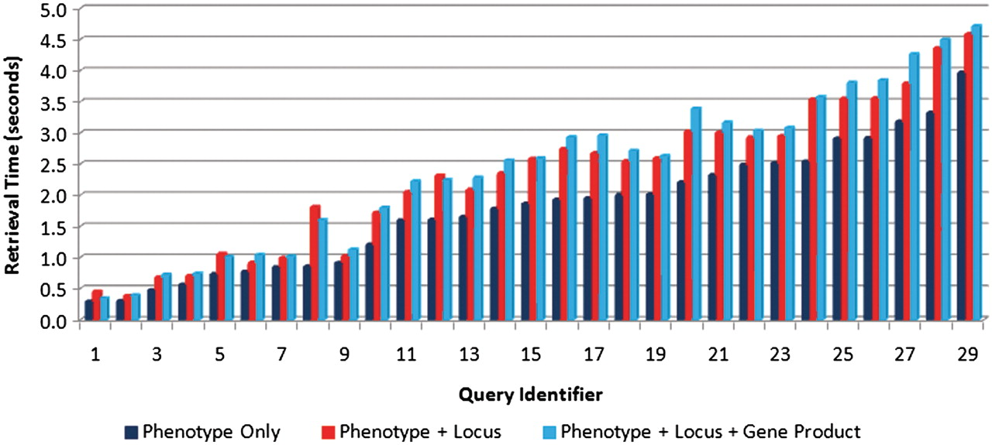
Figure 9. Comparison of retrieval speeds for each of the test queries (see Table 4 for the link between query ...
Notes:
Figure 9. Comparison of retrieval speeds for each of the test queries (see Table 4 for the link between query identifier and query text) executed on one text source (phenotype captions only) (right bars), two sources (phenotype caption + locus descriptions) (middle bars) and three sources (left bars). There is a slight increase in execution as the number of sources increases.
Unless provided in the caption above, the following copyright applies to the content of this slide: © The Author(s) 2011. Published by Oxford University Press.This is Open Access article distributed under the terms of the Creative Commons Attribution Non-Commercial License (http://creativecommons.org/licenses/by-nc/2.5), which permits unrestricted non-commercial use, distribution, and reproduction in any medium, provided the original work is properly cited.

Slide 10
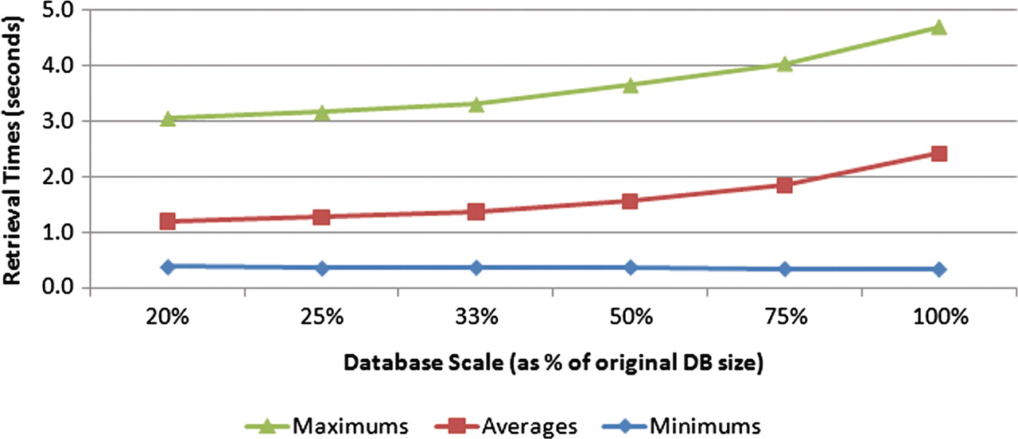
Figure 10. Effect of database size on retrieval speeds. Six different-sized test databases were constructed from subsets ...
Notes:
Figure 10. Effect of database size on retrieval speeds. Six different-sized test databases were constructed from subsets of the original data set. All the test queries were executed against each of these test databases, with the minimum, average and maximum query times measured. The trend suggests a nonlinear complexity for the search task.
Unless provided in the caption above, the following copyright applies to the content of this slide: © The Author(s) 2011. Published by Oxford University Press.This is Open Access article distributed under the terms of the Creative Commons Attribution Non-Commercial License (http://creativecommons.org/licenses/by-nc/2.5), which permits unrestricted non-commercial use, distribution, and reproduction in any medium, provided the original work is properly cited.

