Slide 1
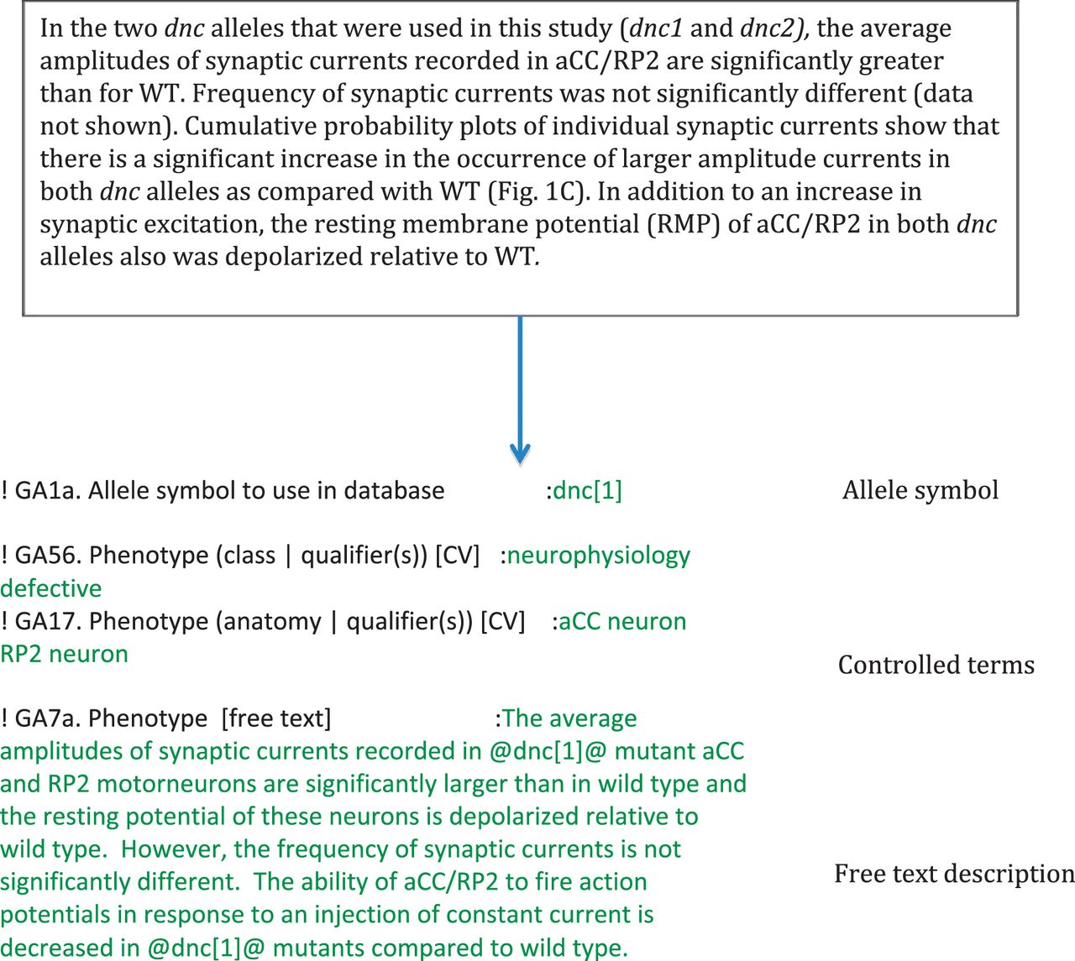
Figure 3 Phenotype curation. Example data entries for a section of text [taken from an article by Baines (2003), see ...
Notes:
Figure 3 Phenotype curation. Example data entries for a section of text [taken from an article by Baines (2003), see Ref. 5]. First, we identify the object we are ascribing the phenotype to, then we concisely curate the phenotype as free text, relating it to the object (which is placed between ‘at sign’ symbols as these symbols are hyperlinked). We then annotate the phenotype to CV terms, in this case, to terms from our ‘phenotypic class’ and ‘fly_anatomy’ ontologies.
Unless provided in the caption above, the following copyright applies to the content of this slide: © The Author(s) 2012. Published by Oxford University Press.This is an Open Access article distributed under the terms of the Creative Commons Attribution License (http://creativecommons.org/licenses/by-nc/3.0/), which permits non-commercial reuse, distribution, and reproduction in any medium, provided the original work is properly cited. For commercial re-use, please contact journals.permissions@oup.com.

