Slide 1
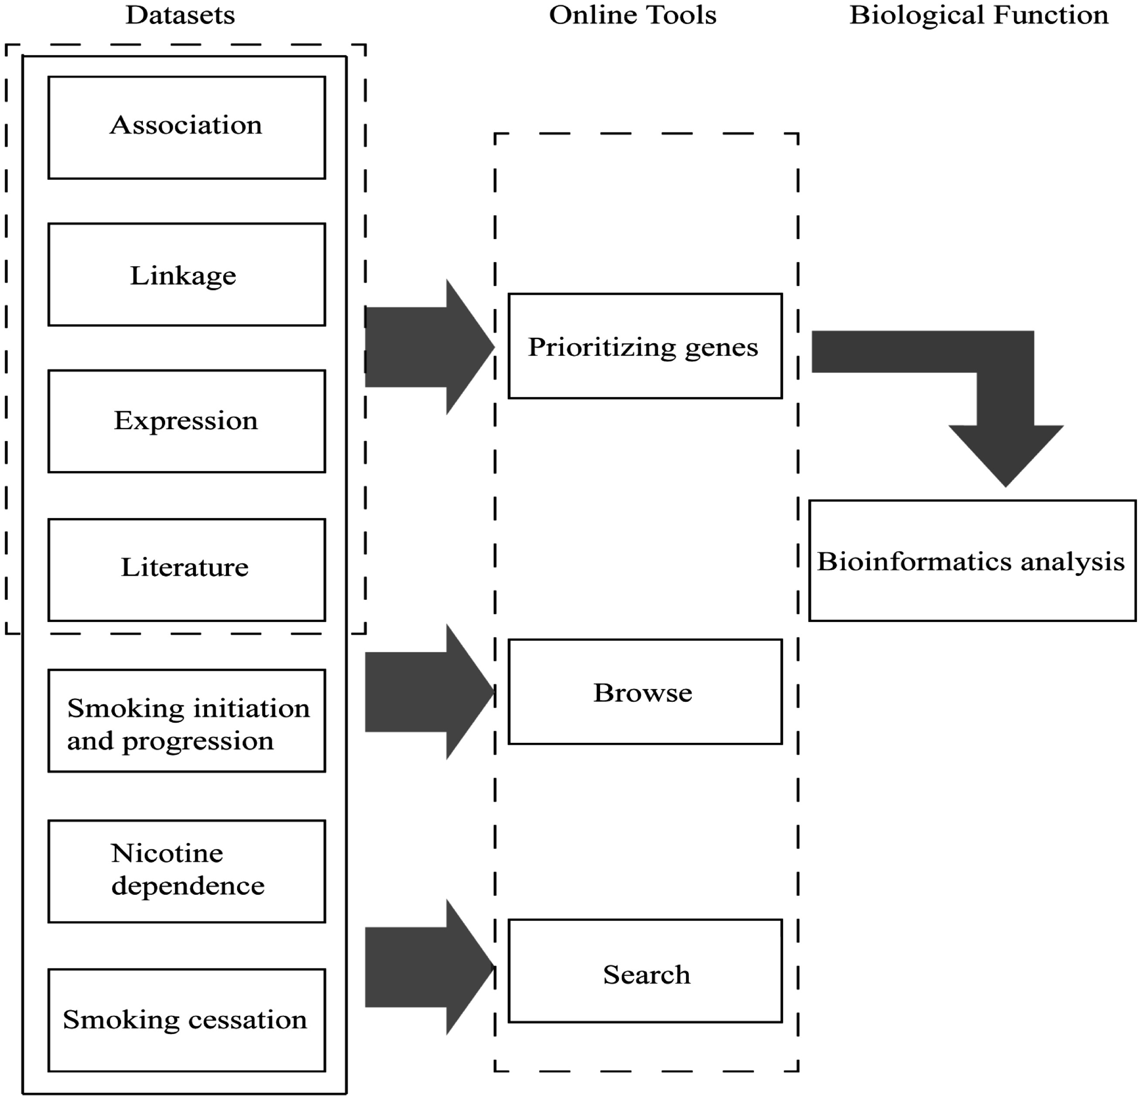
Figure 1. Main components of GRONS. The genes related to the biological responses to nicotine exposure and smoking ...
Notes:
Figure 1. Main components of GRONS. The genes related to the biological responses to nicotine exposure and smoking behaviors are mainly collected from four sources, i.e. genetic association studies, genetic linkage analysis, gene expression studies via microarray or proteomic tools and literature search of single gene/protein-based studies. For the genetic association studies, the genes are further grouped according to the phenotypes, i.e. smoking initiation and progression to smoking dependence, nicotine dependence and smoking cessation. The genes collected from the four sources were prioritized and a list of 220 genes were obtained, which were further analysed via bioinformatics tools.
Unless provided in the caption above, the following copyright applies to the content of this slide: © The Author(s) 2017. Published by Oxford University Press.This is an Open Access article distributed under the terms of the Creative Commons Attribution License (http://creativecommons.org/licenses/by/4.0/), which permits unrestricted reuse, distribution, and reproduction in any medium, provided the original work is properly cited.

