Slide 1
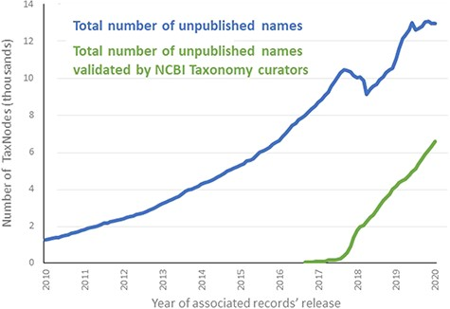
Figure 4 Total number of names labeled as unpublished in NCBI Taxonomy, over time.
Notes:
Figure 4 Total number of names labeled as unpublished in NCBI Taxonomy, over time.
Unless provided in the caption above, the following copyright applies to the content of this slide: Published by Oxford University Press 2020.This work is written by US Government employees and is in the public domain in the US.

