Slide 1
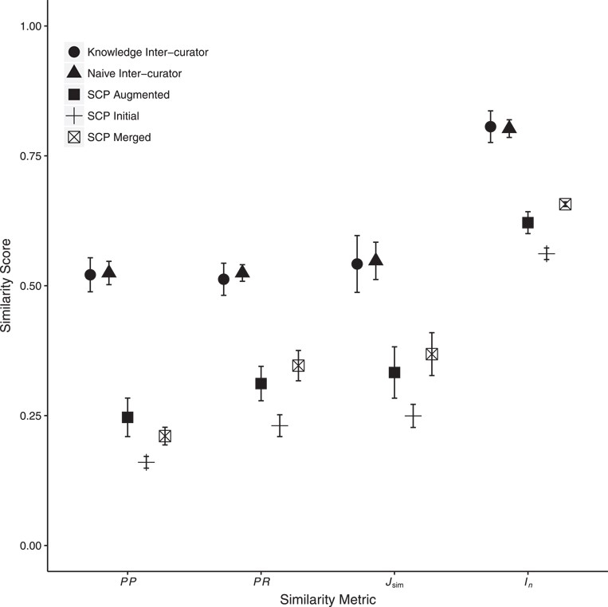
Figure 5 Mean inter-curator consistency and mean similarity between human- and machine (SCP)-generated annotations. ...
Notes:
Figure 5 Mean inter-curator consistency and mean similarity between human- and machine (SCP)-generated annotations. Error bars show two standard errors of the mean. Inter-curator consistency results are shown for both the Naïve and Knowledge annotation rounds. SCP runs used either the Initial, C1, C2 or C3 Augmented or the Merged ontologies. Only SCP similarity to human-generated annotations from the Knowledge round are shown. Consistency between SCP annotations to human annotations was significantly lower than human inter-curator consistency. Across all metrics, SCP annotation similarity to human annotations increased significantly between the use of Initial to Augmented ontologies and again from Augmented to Merged ontologies except for PP (decreased from Augmented to Merged). Detailed results are in Supplementary Materials, Tables 4 and 5.
Unless provided in the caption above, the following copyright applies to the content of this slide: © The Author(s) 2018. Published by Oxford University Press.This is an Open Access article distributed under the terms of the Creative Commons Attribution License (http://creativecommons.org/licenses/by/4.0/), which permits unrestricted reuse, distribution, and reproduction in any medium, provided the original work is properly cited.

