Slide 1
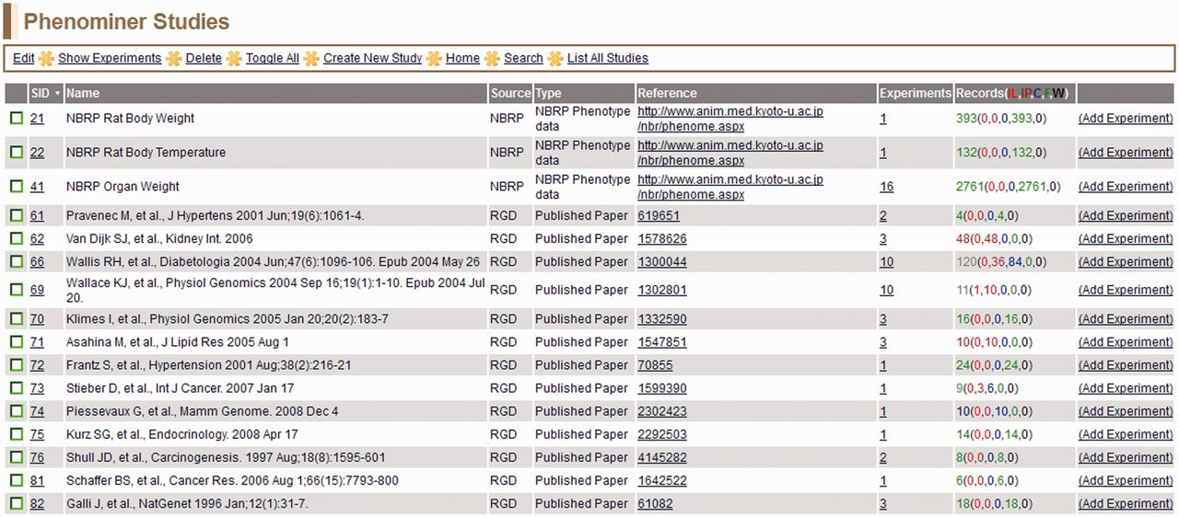
Figure 6 PhenoMiner Studies page—this is a one-page view of all studies in the PhenoMiner curation tool. The columns ...
Notes:
Figure 6 PhenoMiner Studies page—this is a one-page view of all studies in the PhenoMiner curation tool. The columns are all sortable by clicking on the headings. Important to note is the ‘Records’ column, which shows the number of records and status of those records. The status is color-coded—IL (red): initial load; IP (dark red): in progress; C (blue): curated; F (green): final; W (black): withdrawn.
Unless provided in the caption above, the following copyright applies to the content of this slide: © The Author(s) 2013. Published by Oxford University Press.This is an Open Access article distributed under the terms of the Creative Commons Attribution Non-Commercial License (http://creativecommons.org/licenses/by-nc/3.0/), which permits unrestricted non-commercial use, distribution, and reproduction in any medium, provided the original work is properly cited.

