Slide 1
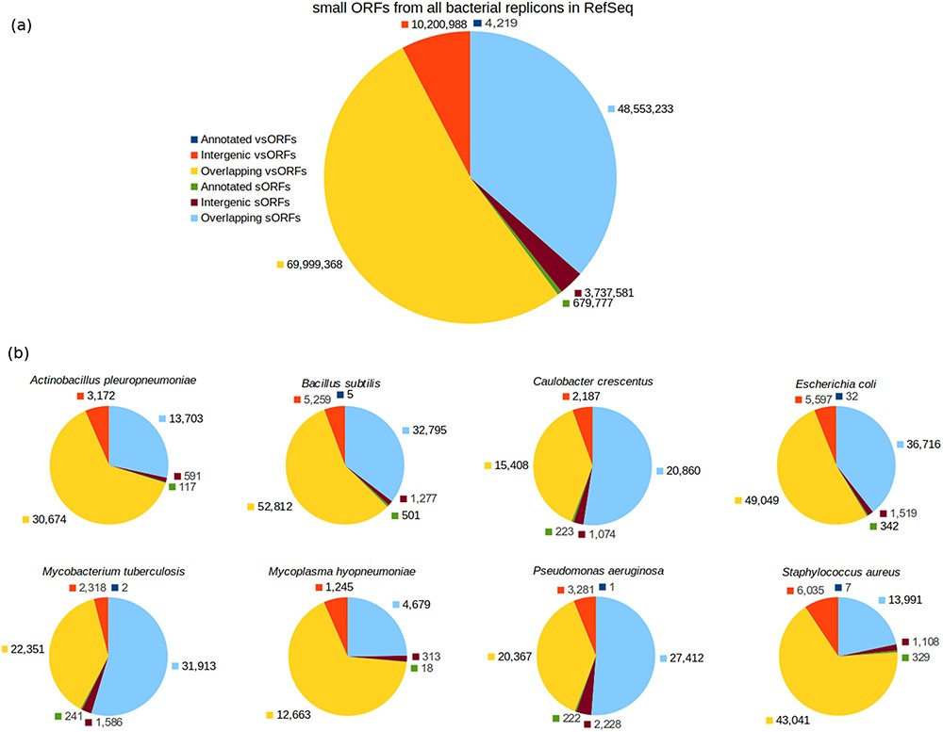
Figure 2. Category breakdown of small ORFs. (a) The whole set of small ORFs obtained for all bacteria in RefSeq. (b) ...
Notes:
Figure 2. Category breakdown of small ORFs. (a) The whole set of small ORFs obtained for all bacteria in RefSeq. (b) Small ORFs of the eight bacteria that we used in our experiments.
Unless provided in the caption above, the following copyright applies to the content of this slide: © The Author(s) 2020. Published by Oxford University Press.This is an Open Access article distributed under the terms of the Creative Commons Attribution License (http://creativecommons.org/licenses/by/4.0/), which permits unrestricted reuse, distribution, and reproduction in any medium, provided the original work is properly cited.

