Slide 1
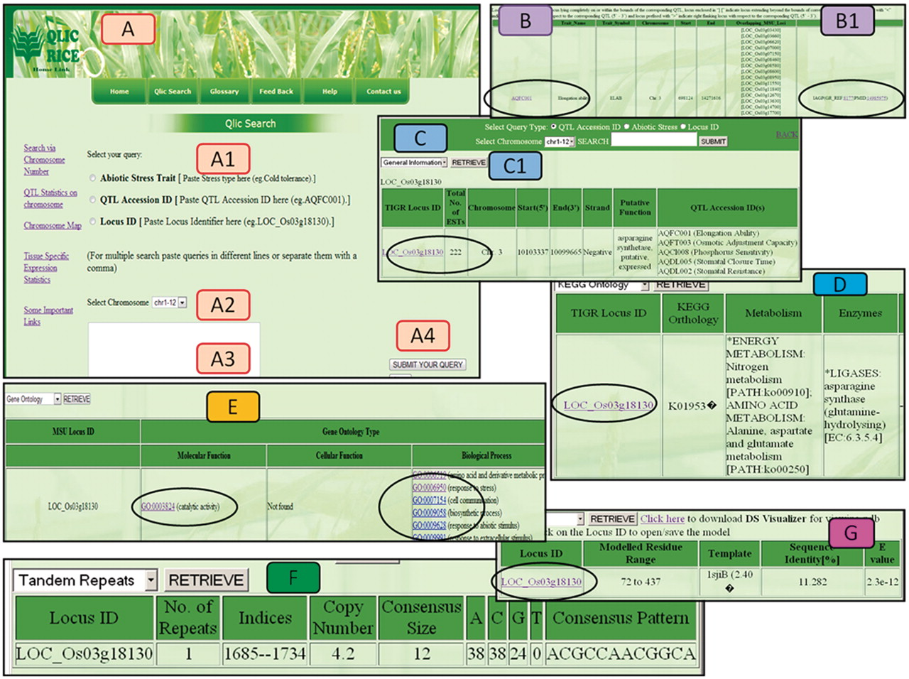
Figure 4. Different views of the QlicRice search user interface. (A) Query interface: (A1) select the query type, (A2) ...
Notes:
Figure 4. Different views of the QlicRice search user interface. (A) Query interface: (A1) select the query type, (A2) select chromosome, (A3) type your query in the given search box and (A4) submit your query. (B/B1) QTL search results for a given QTL ID. (C) Gene search result for a given Gene ID. (C1) View details of the given gene, which include: (D) the KEGG ontology and pathway mappings, (E) GO assignments, (F) scored tandem repeat(s) and (G) the protein structure module with a gene ID link to the downloadable PDB-formatted protein structure data file. This PDB file can be uploaded in any of the protein 3D-viewers listed on the page or described in the article.
Unless provided in the caption above, the following copyright applies to the content of this slide: © The Author(s) 2011. Published by Oxford University Press.This is Open Access article distributed under the terms of the Creative Commons Attribution Non-Commercial License (http://creativecommons.org/licenses/by-nc/2.5), which permits unrestricted non-commercial use, distribution, and reproduction in any medium, provided the original work is properly cited.

